Slide 2
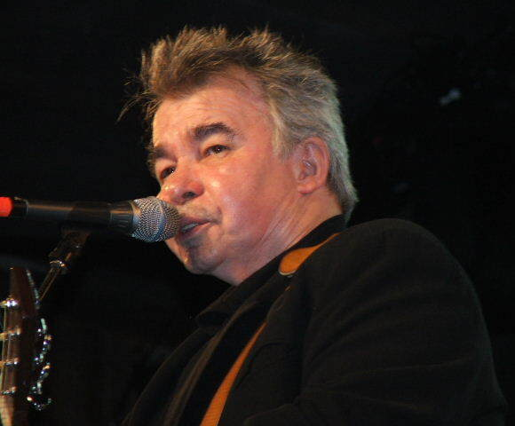
Transitions in John Prine’s “Souvenirs”

Slide 3
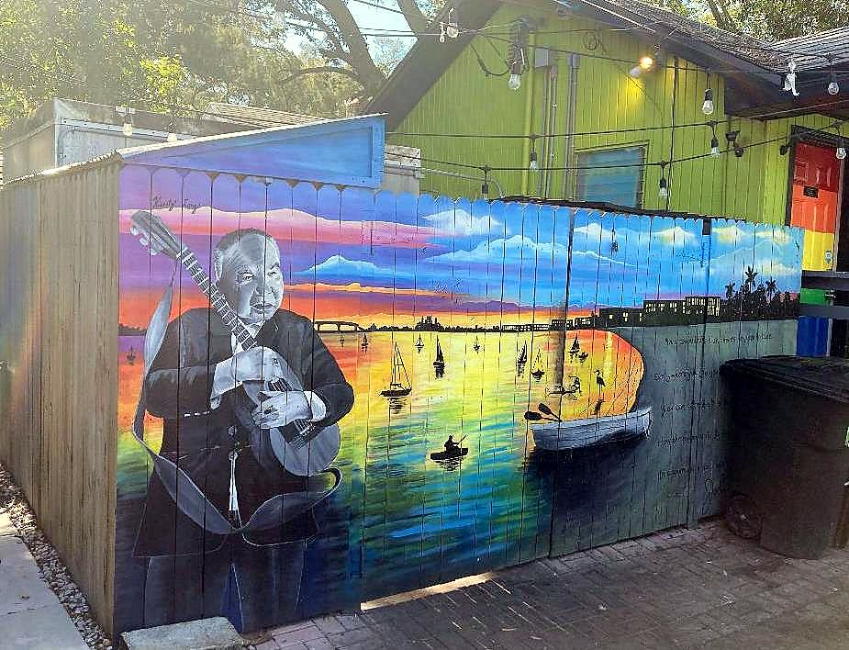
Who Was John Prine?

Slide 4
John Prine’s Career
Born 1946 in Maywood, IL.
Two sides of Prine
Recorded debut album in 1970.
Recorded 18 albums.
Died of COVID-19 in 2020.
Goofy, humorous songs.
Pathos-laden songs that often illustrate transition from innocence to experience.

Slide 5

“Souvenirs”
Recorded in 1972 for Diamonds in the Rough album.
As you listen, look for examples of transitions in the lyrics.

Slide 6

Line by Line Analysis of the Song

Slide 7
Analysis of Lyrics
Numerous examples of transitions
Broken Hearts and Dirty Windows
Melting snow.
Time marches on.
Broken toys (loss of innocence).
Faded colors.
A vision obscured.
Narrator’s sense of being “robbed.”
Lack of forgiveness.
Innocence scorned.
An honest sulk.

Slide 8
References
"John Prine by Ron Baker" by Ron Baker (https://www.flickr.com/photos/kingsnake) is licensed under CC BY 3.0.
"John Prine does Gulfport" by sirqitous is licensed under CC BY 2.0.
"TIME" by becosky... is licensed under CC BY-SA 2.0.

