Slide 1
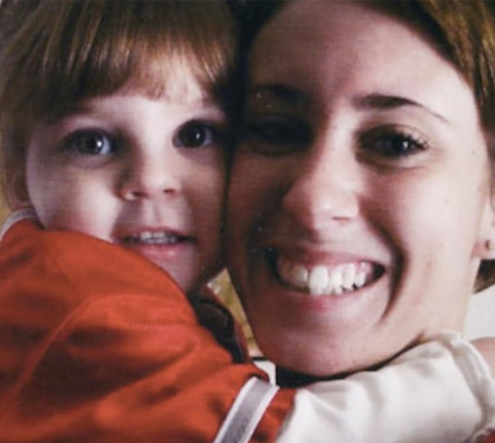
Victims of Family, Filicide in the United States: The Caylee Anthony Case
By: Madelyn Frye

Slide 2
What is Filicide?
“About 2.5% of all homicide arrests in the United States are for parents who have killed their children (Mariano et al., 2014). This amounts to an average of about 500 filicide arrests each year” (204)
Types:
Altruistic
Acutely Psychotic
Unwanted Child
Child Maltreatment
Spouse Revenge
Risk Factors:
“maternal age of 19 years or younger, education of 12 years or less, single marital status, and late or absent prenatal care” he also includes that ninety percent of filicides are committed by biological parents opposed to stepparents or others (Resnick 2016:204)

Slide 3
Media and Filicide
When it comes to cases of filicide the media plays a major role in how it is viewed by the public
When there is a trial by media as happened with the Casey Anthony case the public becomes an “armchair jury”
When mothers kill their children, they are viewed as evil, mad, or just bad. Fathers may be shown in a less harsh light by the media because “…they are not expected to have the same unconditional love that mothers have for their children” (Resnick 2016).
Effects:
Can affect people involved emotionally, physically, and financially, it can even effect employment.
Jurors can also experience negative effects in the aftermath of a trial by media and one juror from the Anthony case described their life after the trial as a nightmare and they feared others learning they were a part of the jury.

Slide 4
The Victims and Harm
Direct Victim: Caylee Antony
Died at age 2, possible victim of filicide by mother but she wasn’t convicted
Caylee had characteristics of an ”ideal victim” for the media: young, innocent, white, female, and vulnerable
Secondary Victims:
Grandparents
Lost granddaughter and damaged relationship to daughter
Harassed and called ”baby killers” by public
Reputation damaged
George Anthony tried to kill himself
Zenaida Gonzalez
Accused of kidnapping Caylee Anthony by Casey Anthony
Casey Anthony
Lost daughter and went to jail for years before being found not guilty

Slide 5
Resolution and Cost
Casey Anthony was not convicted for killing Caylee but was found guilty of four misdemeanor charges of lying to the police and was released 10 days after the trial ended due to good behavior and time served
Case cost close to $700,000
Zenaida Gonzalez sued Casey Anthony
Damage to reputations, mental health, and people’s ability to live life post case

Slide 6
Prevention
In Florida, a new law was put into place in the aftermath of the Casey Anthony case. This new law was made so that anyone found guilty of neglect, and that don’t report their missing child as missing, will face felony charges and up to twenty years in jail.
Better mental health programs and increase availability for everyone but especially new parents

Slide 7
References
Liston, Barbara. 2011. “Price tag for Casey Anthony case near $700,000.” Reuters. Retrieved December 13, 2023 (https://www.reuters.com/article/us-crime-anthony-idUSTRE76S72320110729/#:~:text=ORLANDO%2C%20Fla%20(Reuters)%20%2D,agencies%20involved%20in%20the%20case.)
Ott, Tim. 2020. “Casey Anthony: A Complete Timeline of Her Murder Case and Trial” Hearst Digital Media. Retrieved October 19, 2023 (https://www.biography.com/crime/casey-anthony-muder-trial-timeline-facts).
Resnick, Phillip. 2016. "Filicide in the United States." Indian Journal of Psychiatry, Suppl.Suppl 58.

