Slide 1
Health Insurance correlation to juvenile crime
Brooke Blackburn
Katholiki Koukia
Juvenile Justice Honors Project

Slide 2
Background and significance
Many factors contribute to the connection of crime and healthcare access.
-When there is limited access to healthcare, patients are left untreated with a result of behavioral disorders, substance abuse, or untreated illness contributing to delinquent behavior.
-Health care access is linked to social determinants of health such as socioeconomic status and education. Limited access to healthcare can make things worse by increasing the chance of delinquency as a result of poverty, financial constraints or lack of education.
-Access to healthcare has an impact to the family as a whole. If someone in the family needs access to medication but there is no access to healthcare, there a possibility members of the family act delinquent either to find the medicine without having to pay or by making a lot of money easy so they can treat the family member in need.
This is an exploratory analysis of the significance of having health insurance is the prevention of juvenile delinquency in the United States.

Slide 3
Research Question
How do juvenile crime rates correlate to the provision of health insurance in the United States?

Slide 4
Analysis
Variables:
2019 arrest rates: data collected from the FBI's Uniform Crime report include the rate of arrest for aggravated assault, larceny theft, drug abuse, weapons offenses for every 100,000 people in a state's population.
2019 health Insurance: The proportion of juveniles in each state that was on Medicaid or uninsured in that year.
A correlation matrix was made to examine the data for any significant correlation between the variables; scatterplots show the relationships between the rates of crime and the level of health insurance among the states.
Notes:
Describe the variables- where did the data come from
Correlation matrix and scatterplot

Slide 5
Correlation Matrix
 | Aggravated assault | Robbery | Larceny theft | Drug abuse | Weapons | Medicaid | Uninsured
Aggravated assault | 1
Robbery | 0.396681 | 1
Larceny theft | 0.114902 | 0.086911 | 1
Drug abuse | 0.294358 | 0.164595 | 0.470687 | 1
Weapons | 0.435454 | 0.610383 | 0.223706 | 0.444112 | 1
Medicaid | 0.155296 | -0.01316 | -0.33093 | -0.50527 | -0.01354 | 1
Uninsured | 0.131773 | -0.19843 | 0.117178 | 0.4342 | -0.09543 | -0.18126 | 1
Notes:
Describe the variables- where did the data come from
Correlation matrix and scatterplot

Slide 9
Results
The data created scatterplot graphs that indicated significantly trendlines in all 50 states. The first two graphs indicated a negative relationship between different juvenile arrests (Larceny Theft and Drug Abuse Crimes) and states with higher amounts of insured children under Medicaid. States that provide more poor children to access to healthcare thru medicaid have lower juvenile drug and theft crime rates.
The third graph indicated a positive relationship between Drug Abuse Crimes and uninsured children, with states that had the most uninsured juvenile population having more arrests for drug abuse in 2019.

Slide 10
Conclusions
Through our research we can see the importance of the access to healthcare in the United States. The data showed a significant relationship between drug crimes and health insurance across US states, as states that had a higher percentage of insured children 0-18 had significantly fewer arrests than states that had mandatory family health insurance.
States such as Massachusetts, Vermont, California and Rhode Island all require health insurance and most of the data reflects the positive correlation as they had reported a lower number of arrests. States such as Alabama and Texas who do not require health insurance, had much higher crime rates for drug abuse and larceny theft.
It could be that states that don't provide access to healthcare also have stricter drug laws, or enforce the drug laws to a greater extent, but this doesn't seem to be the case. For example, Wyoming a state with one of the highest rates of juvenile drug crime has fully legalized the recreational use of marijuana.

Slide 11
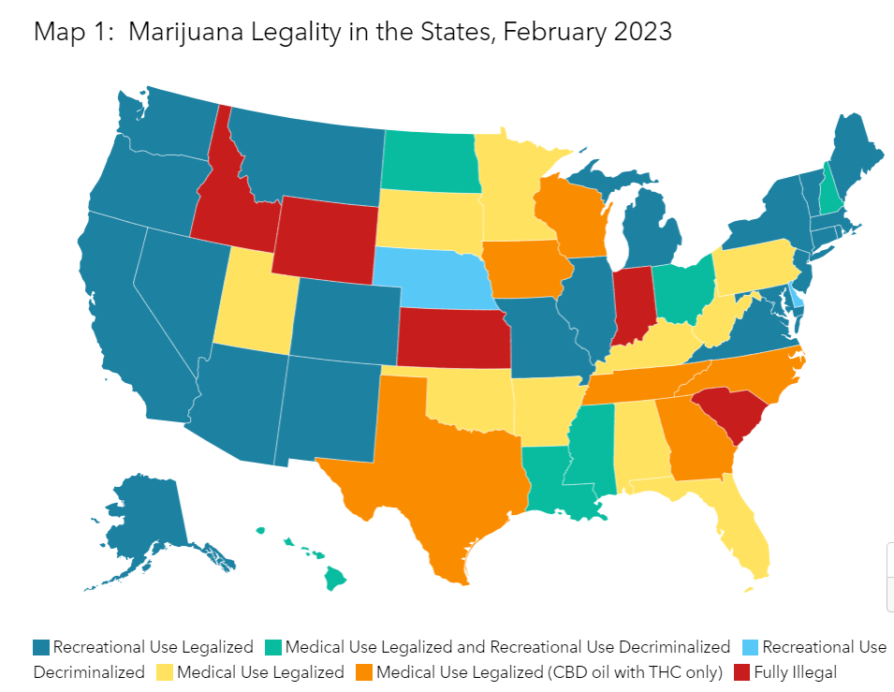

Slide 12
Implications
With the results in mind, health insurance should be considered as a necessity for children and important to public safety and crime control.
Many juveniles are not properly treated because their families do not have healthcare such as Medicaid which leaves many undiagnosed and unmedicated kids in need.
A system such as Medicaid should become universal throughout the states to prevent further unmet health needs or the kind that leads to problems for that result in arrest juvenile arrests.

Slide 13
Future Research
In the future, research should investigate more fully these relationships when data are available from after the COVID years. There may be less effect on mental health and crime rates.
Research should also consider other factors related to juvenile healthcare needs and various types of crimes, such as population size and density and size of the state juvenile population.

Slide 14
References
References
Farrell, C. M., & Gottlieb, A. (2020). The effect of health insurance on health care utilization in the justice-involved population: United States, 2014–2016. American Journal of Public Health, 110(S1), S78-S84. https://doi.org/10.2105/ajph.2019.305399
Health insurance coverage of children 0-18. (2023, October 27). KFF. https://www.kff.org/other/state-indicator/children-0-18/?currentTimeframe=0&sortModel=%7B%22colId%22:%22Location%22,%22sort%22:%22asc%22%7D
Juvenile arrest rates by state. (n.d.). Office of Juvenile Justice and Delinquency Prevention. https://ojjdp.ojp.gov/statistical-briefing-book/crime/faqs/qa05103
Pro, G., Montgomery, B. E., & Zaller, N. (2021). Tailoring services in opioid treatment programs for patients involved in America’s criminal justice system: National associations and variation by state and Medicaid expansion status. Substance Abuse Treatment, Prevention, and Policy, 16(1). https://doi.org/10.1186/s13011-021-00388-5
Saloner, B., Li, W., Bandara, S. N., McGinty, E. E., & Barry, C. L. (2022). Trends in the use of treatment for substance use disorders, 2010–19. Health Affairs, 41(5), 696-702. https://doi.org/10.1377/hlthaff.2021.01767

