Slide 1
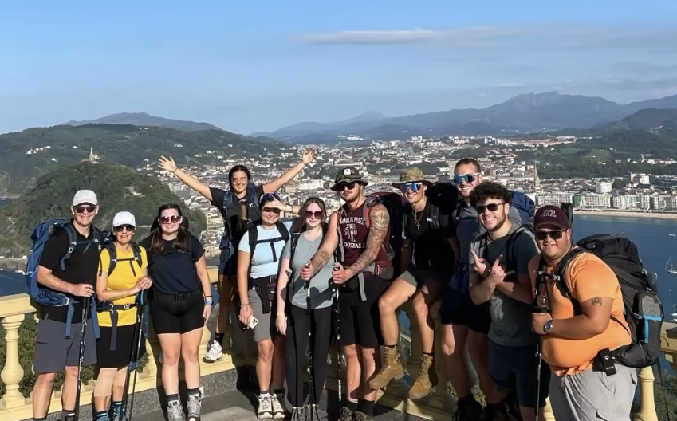
THE CAMINO DE SANTIAGO STUDY ABROAD 2023
9 students
1 professor
1 nurse

Slide 2
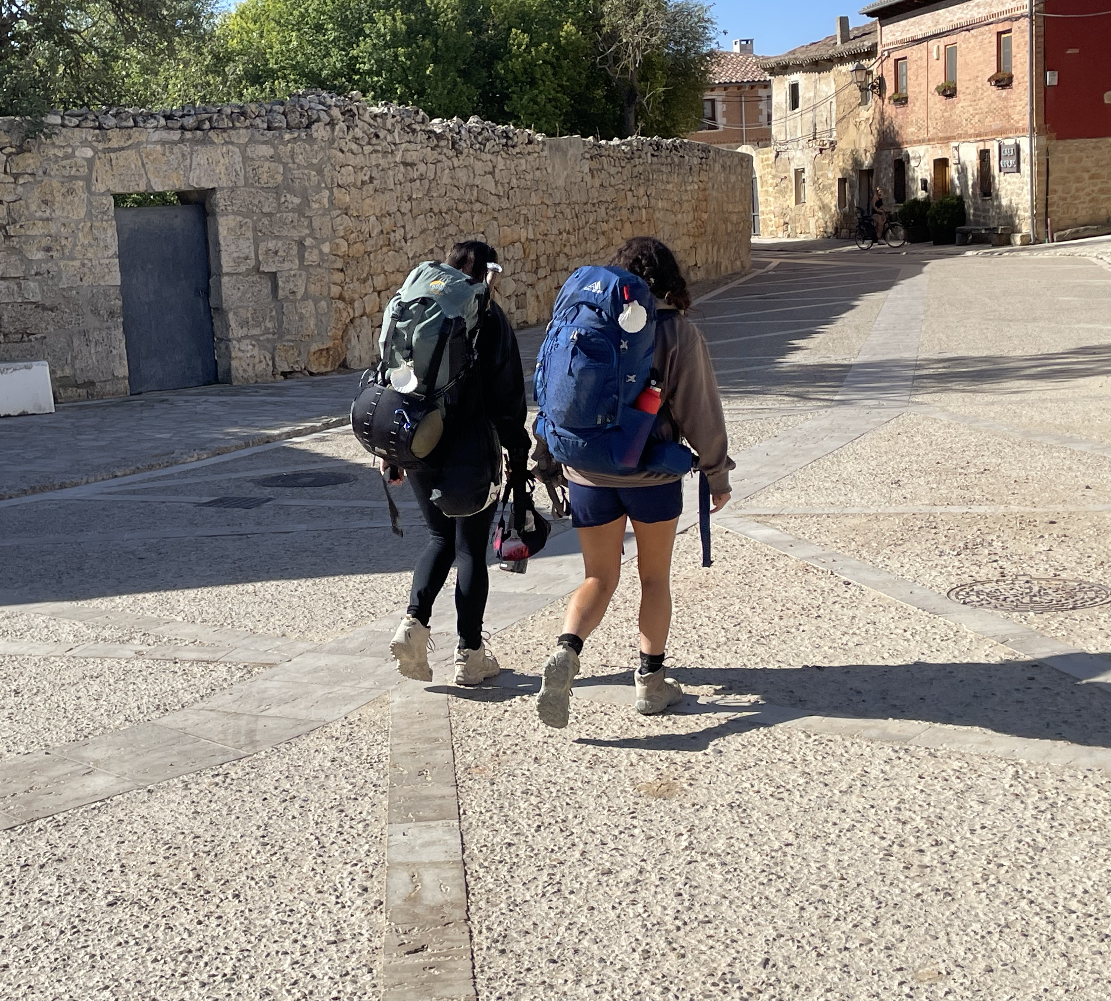
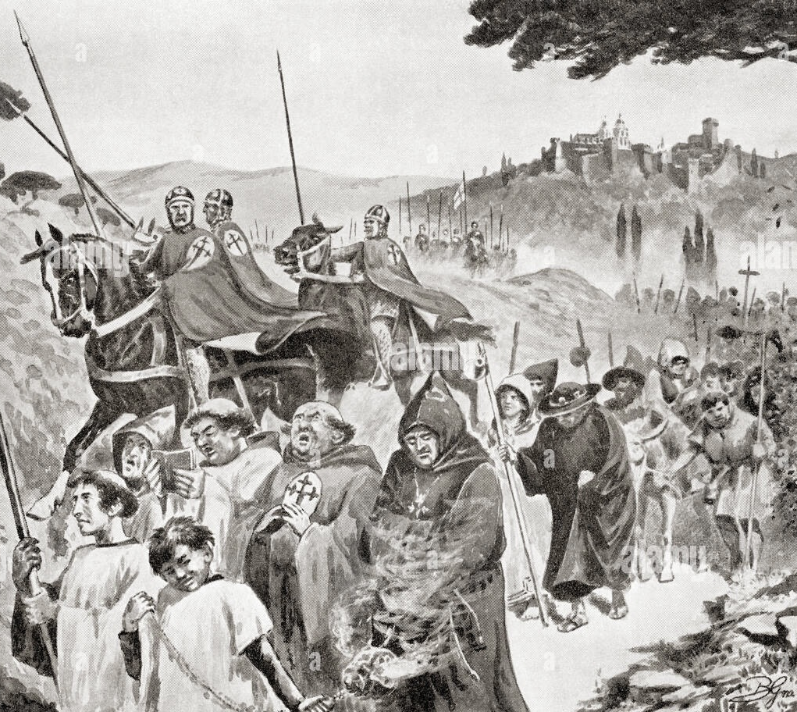
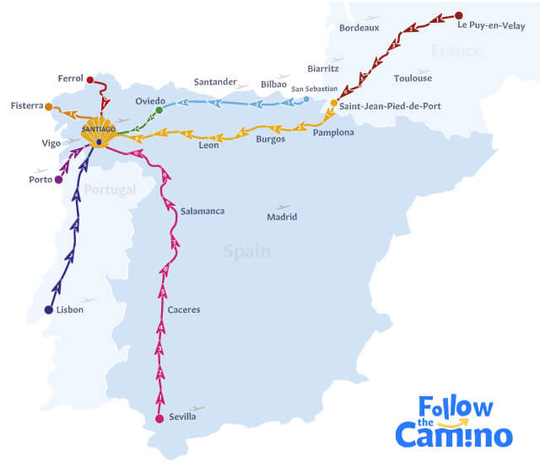
WHAT IS THE CAMINO?
How it started
  Religious pilgrimage
  Spread of Christianity
  Search for redemption
What is it like being a modern pilgrim
  Albergue, Donativo, Hostal prices
  HAMISH-the differences we felt in places

Slide 3
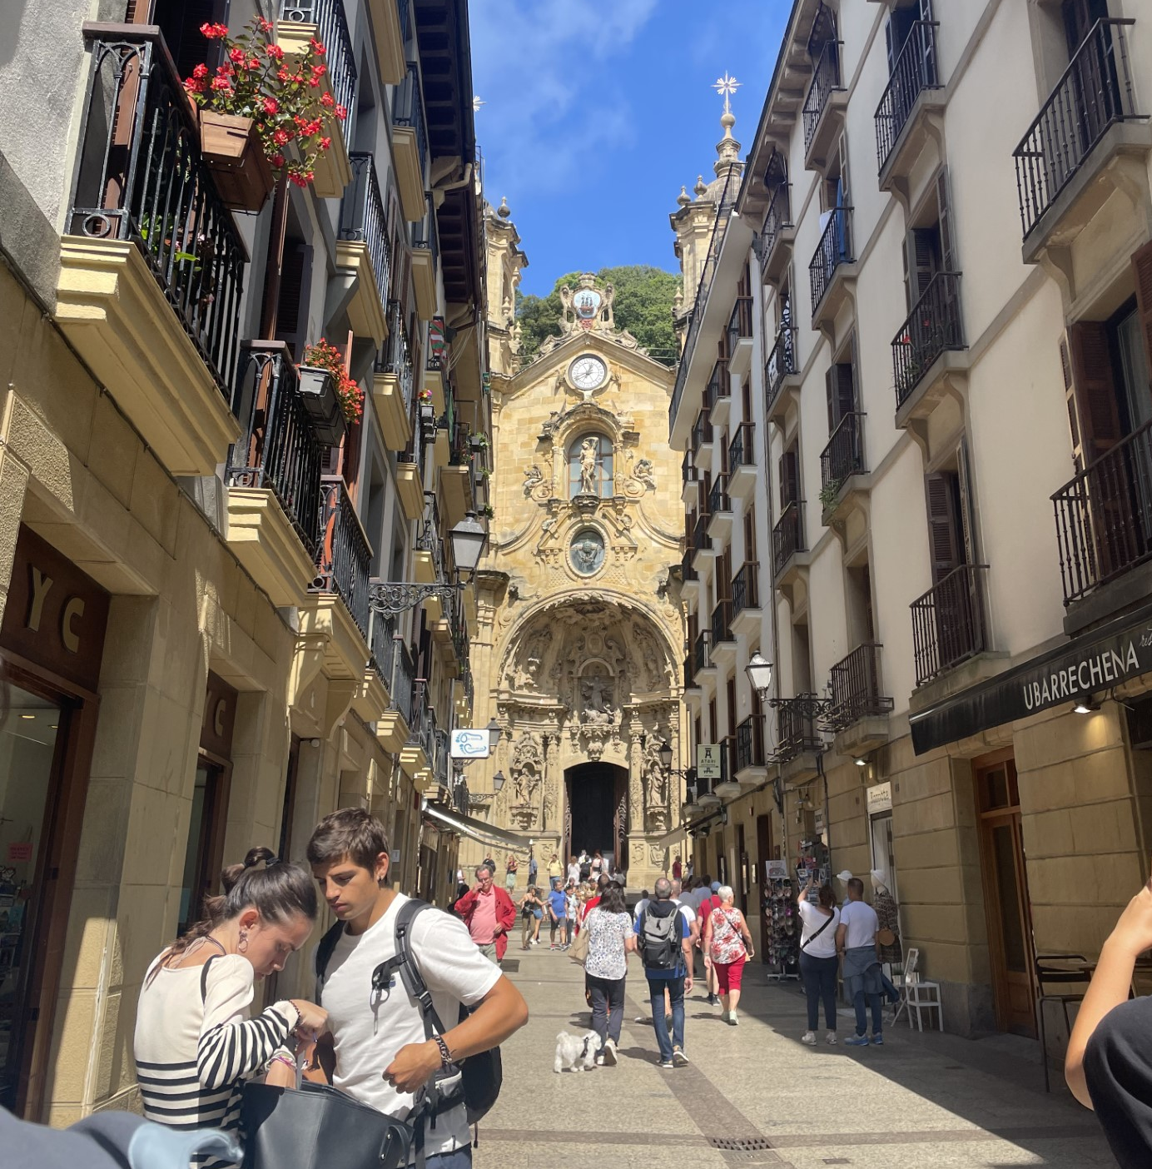
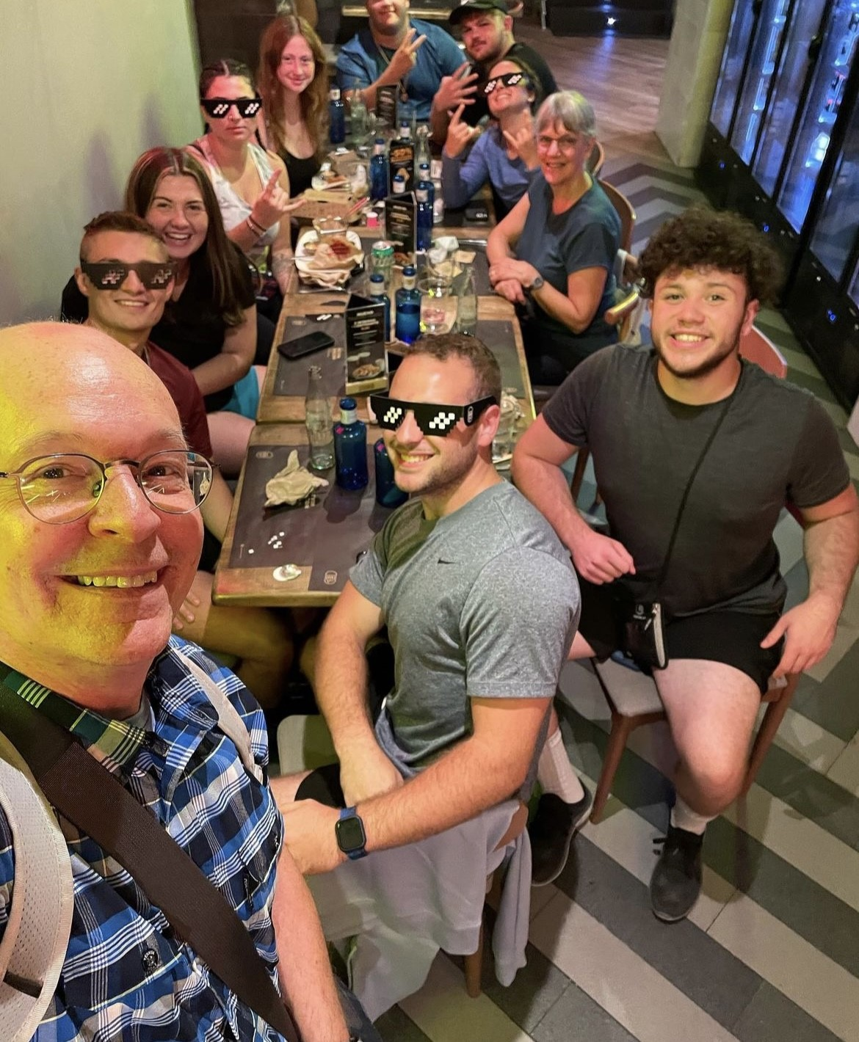
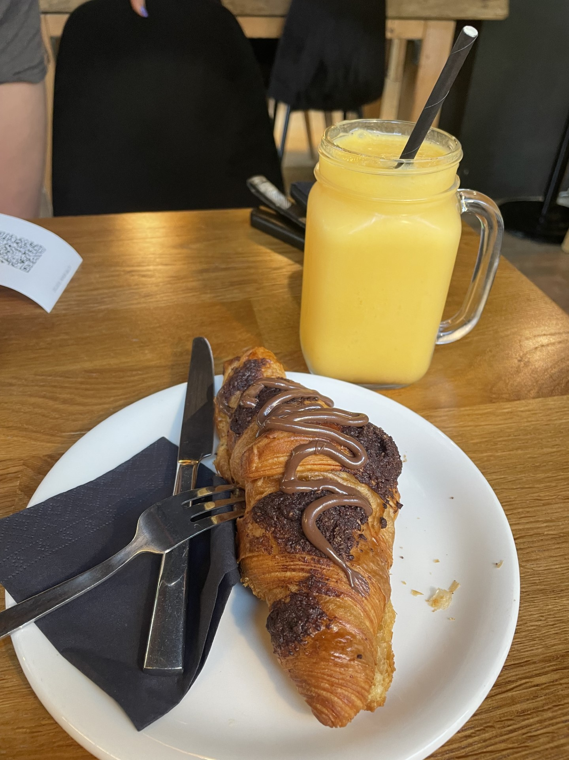
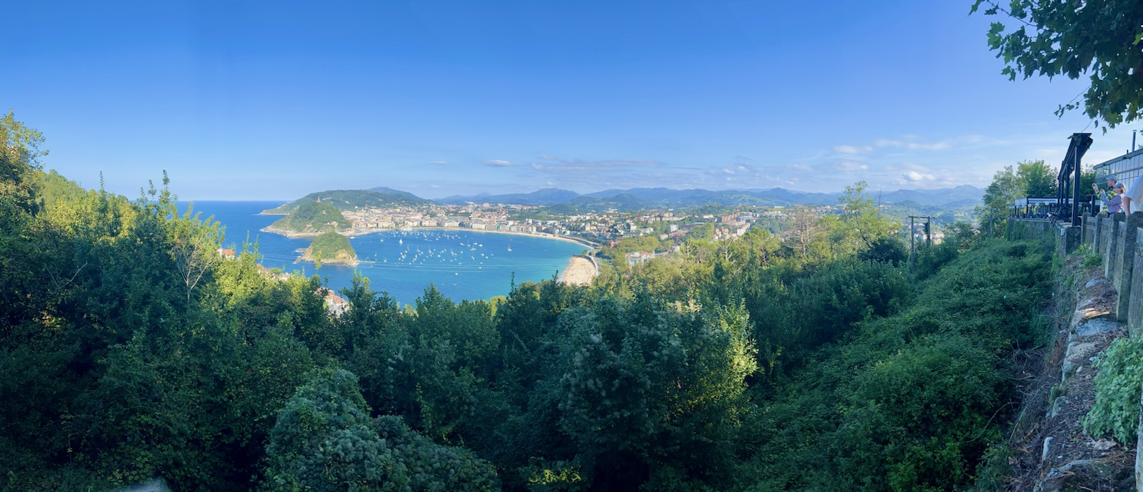
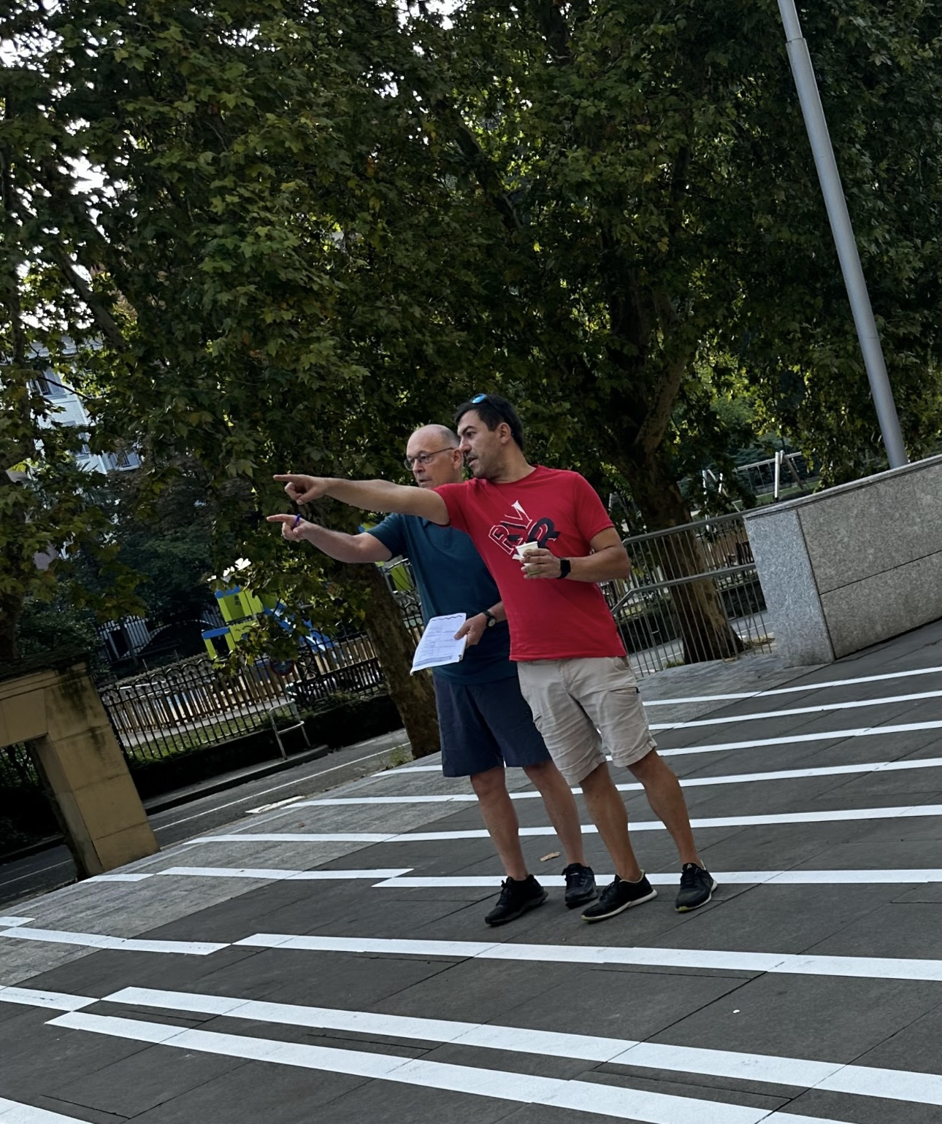
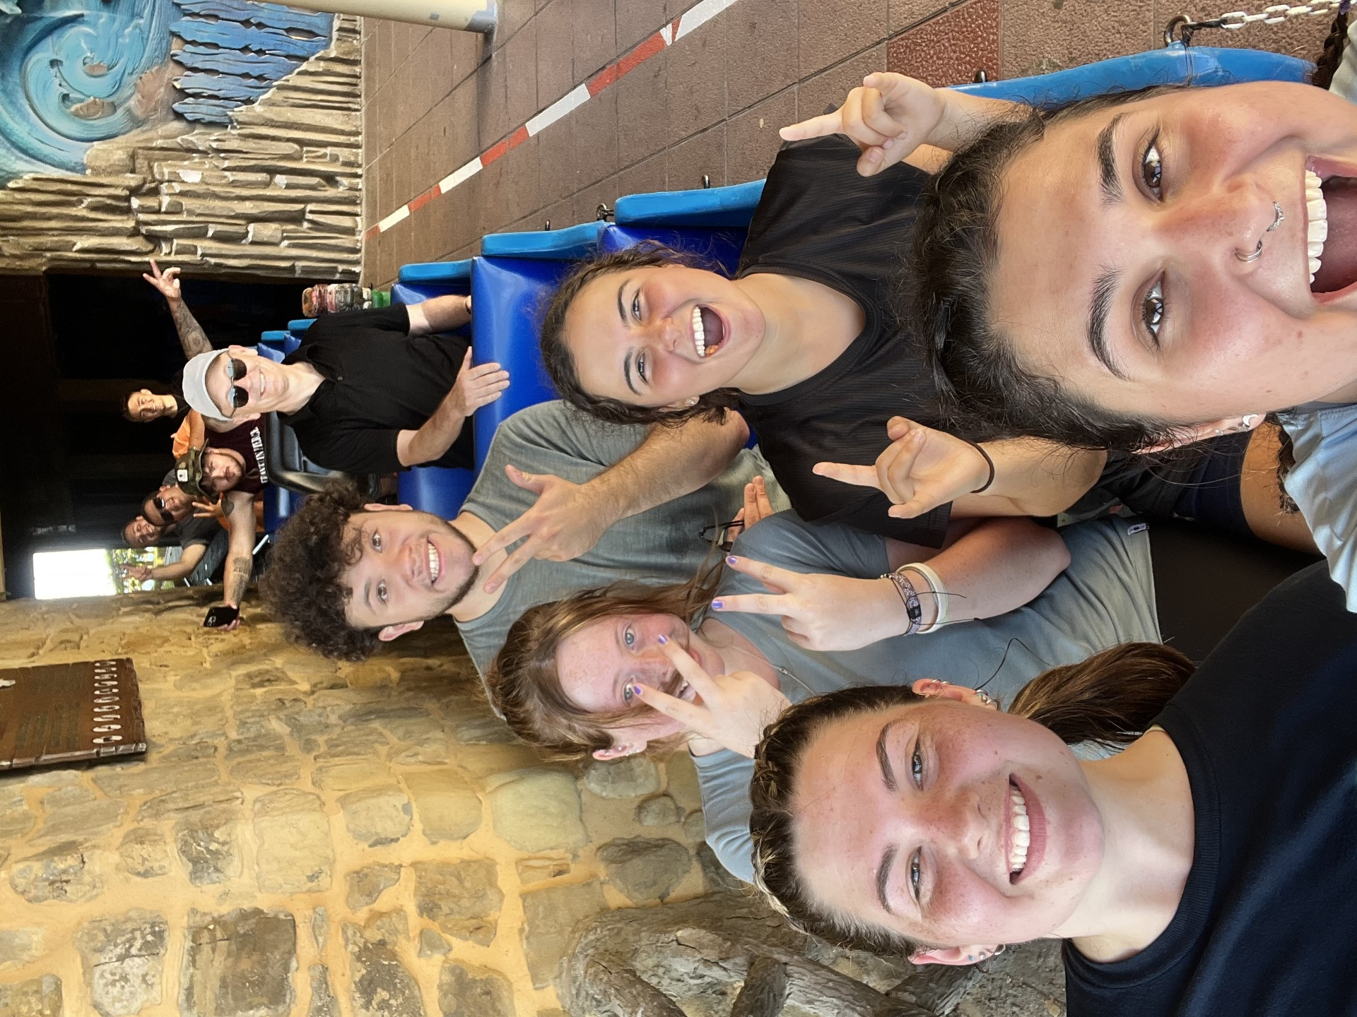
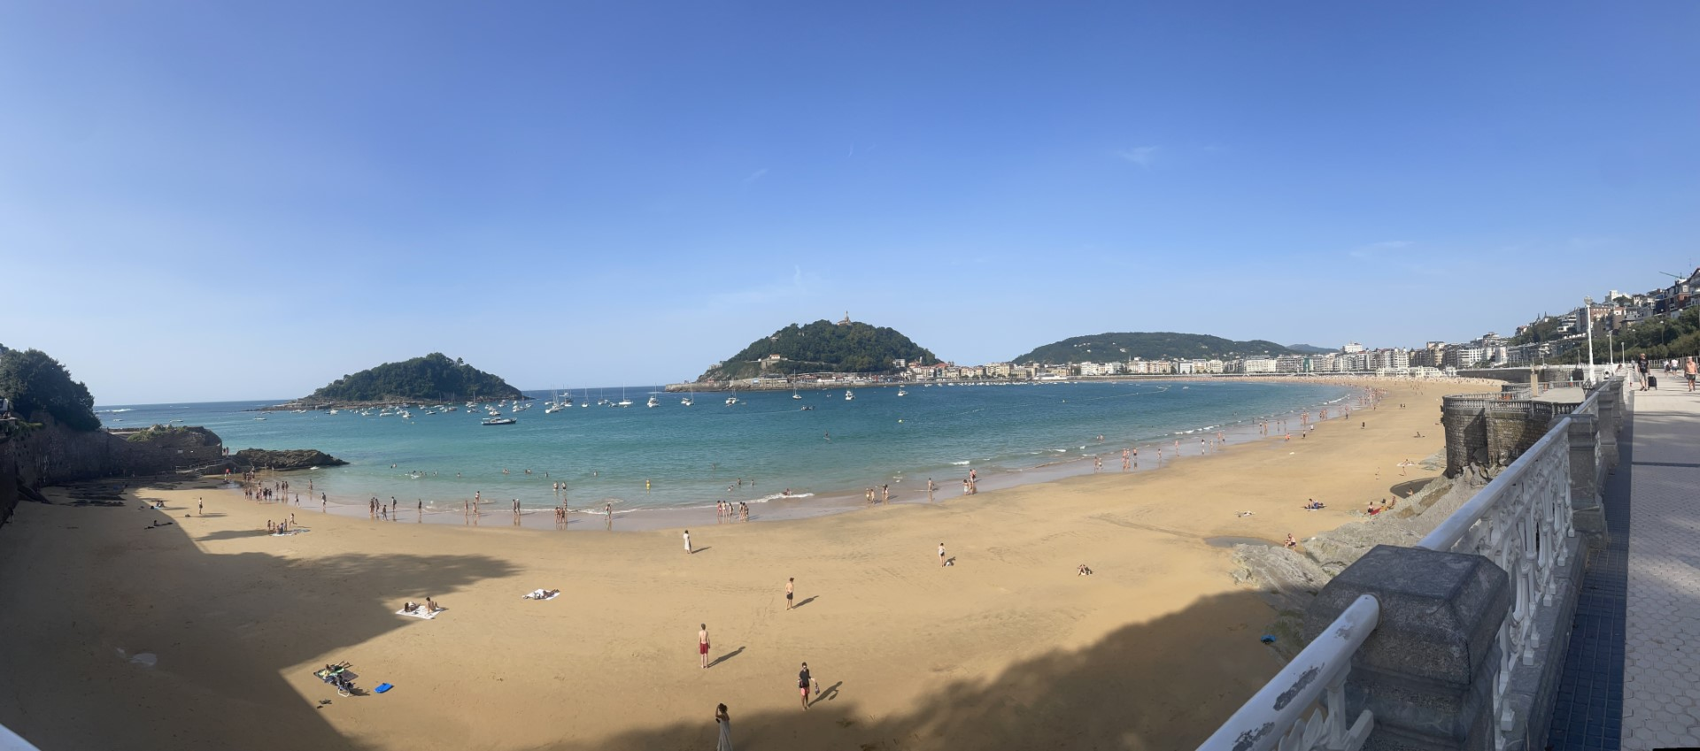
SAN SEBASTIAN
2 Weeks of Intensive Spanish with Yulia
Learning to live with host families
Taught us to be independent from the start & money-cautious
  Talk about the money distribution with Doug & Laurie
  Vulnerability, friendship, Helado trips

Slide 4
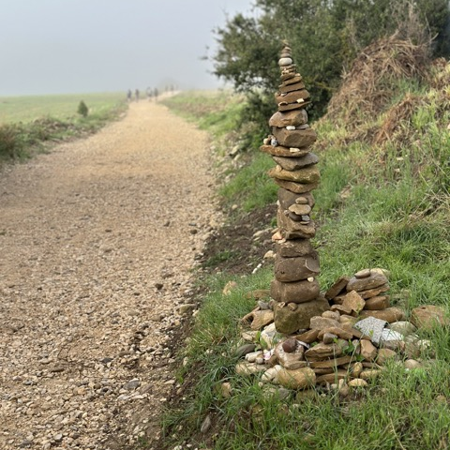
DAILY LIFE OF A PILGRIM
Around 10 to 25 kilometers a day
Albergues & Hostels
Pilgrim Menu & Group Dinners
Packing Our Bags (Example?)
Camino de Santiago Week 1!! (youtube.com)

Slide 5
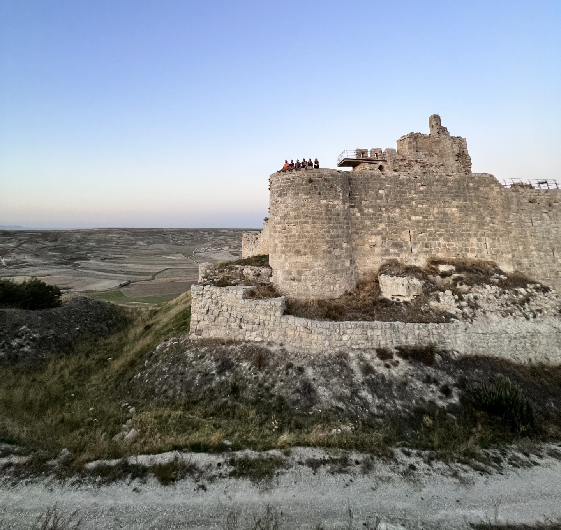
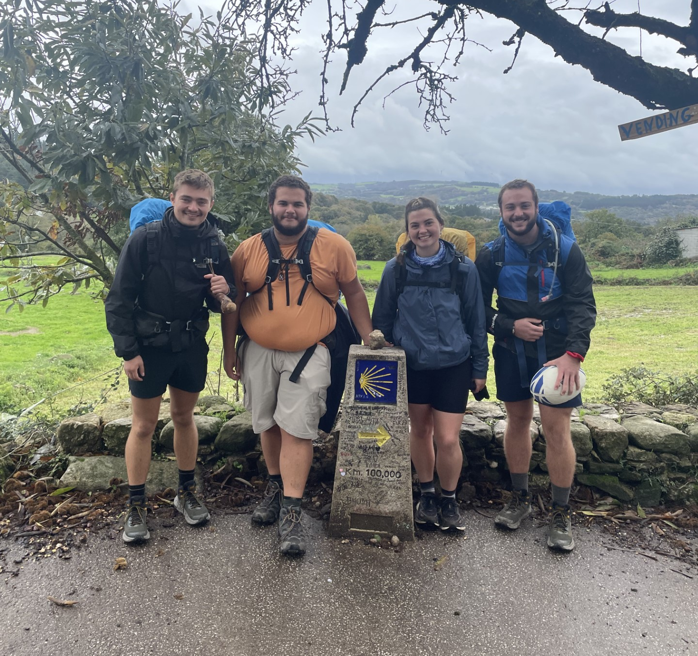
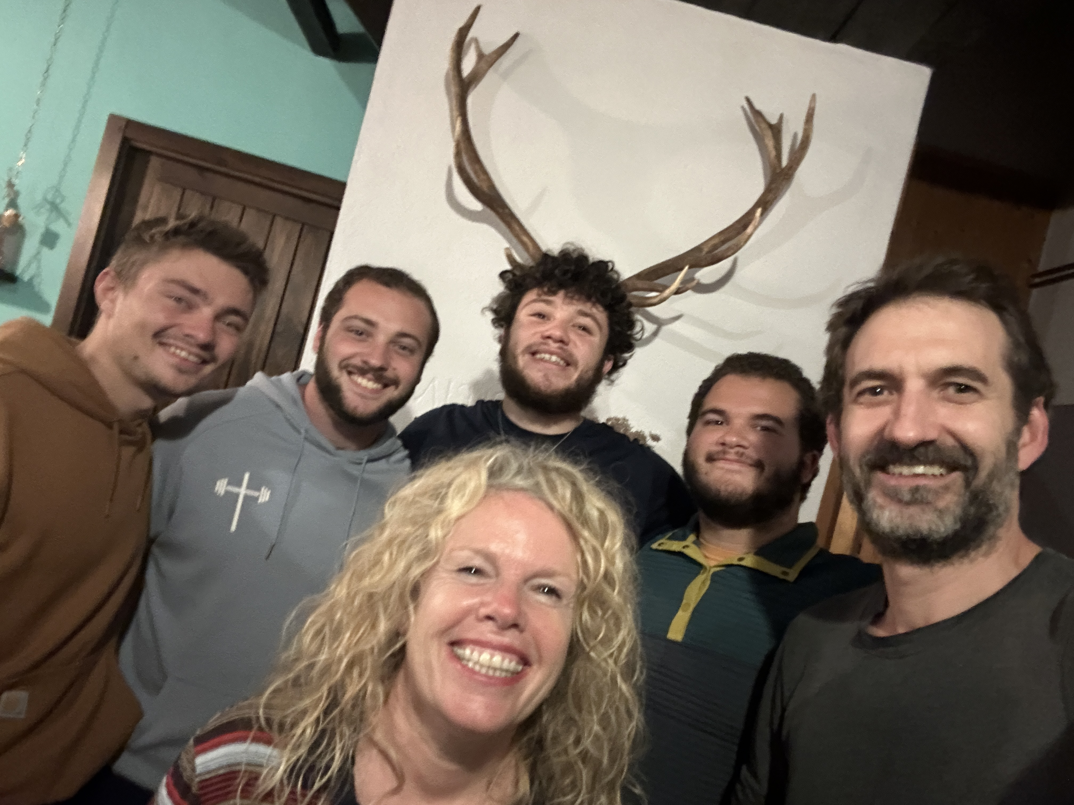
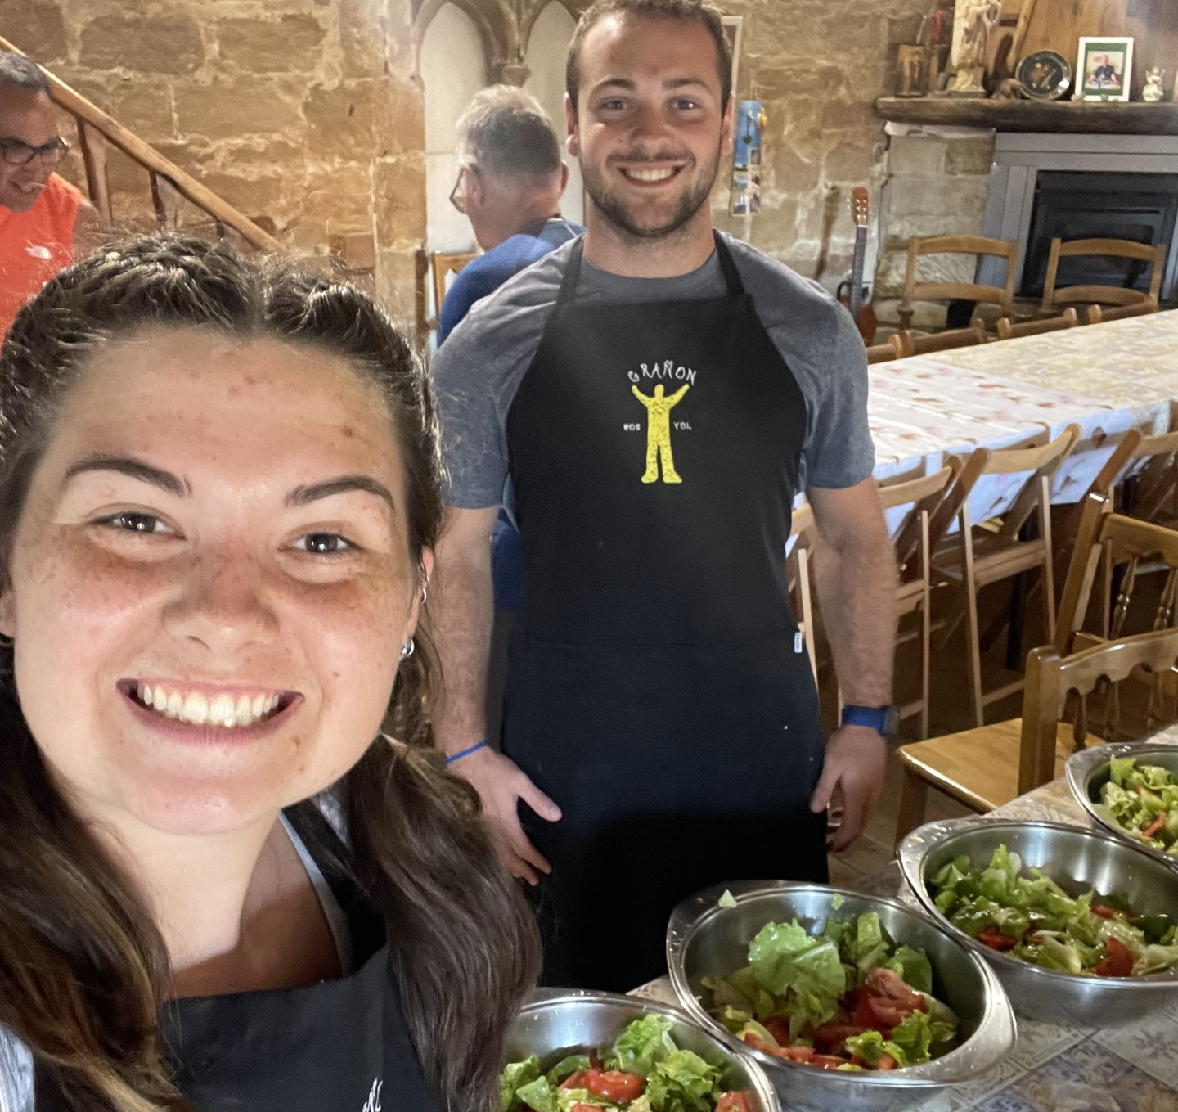
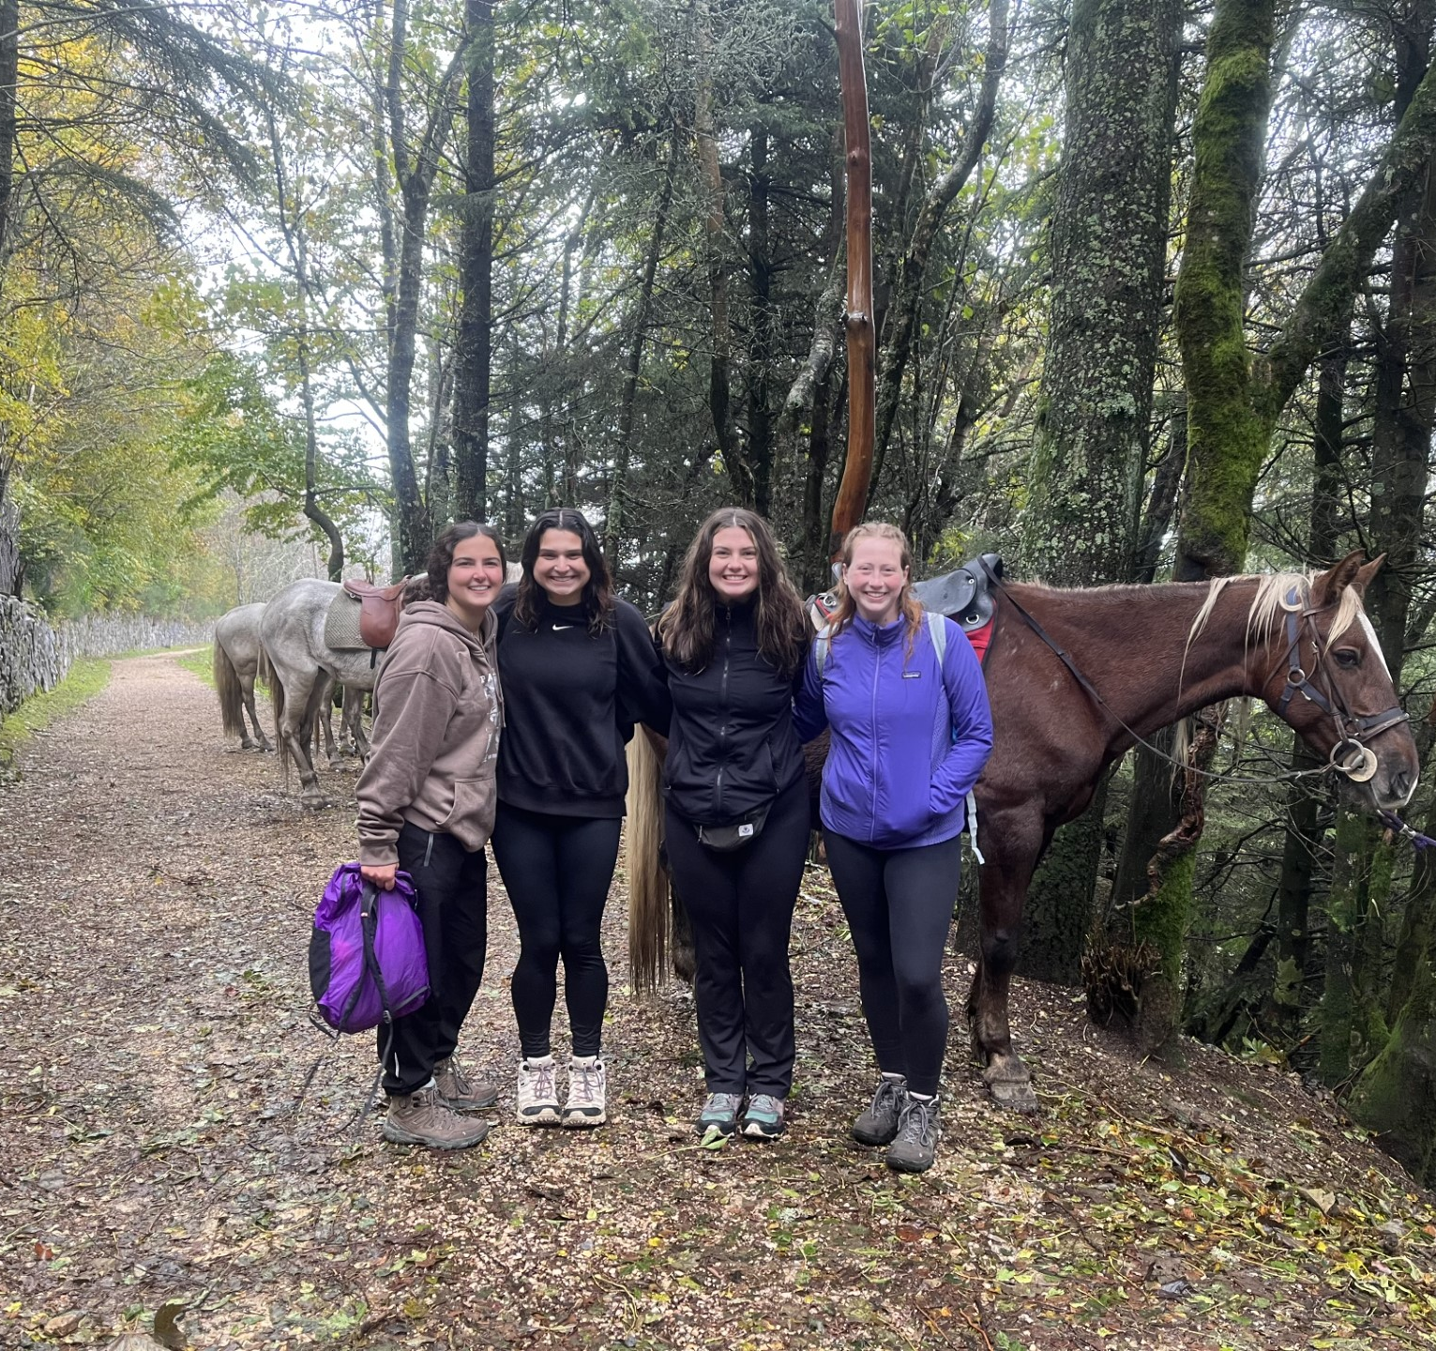
INFLUENTIAL PLACES ALONG THE WAY
Castilla De Castrojeriz
100KM marker
Donativo Dinners
O Cebreiro Horseback riding
Casa Susi

Slide 6
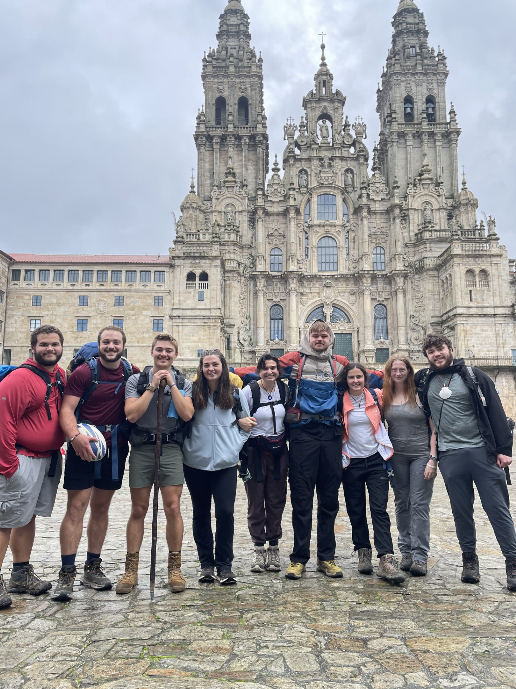
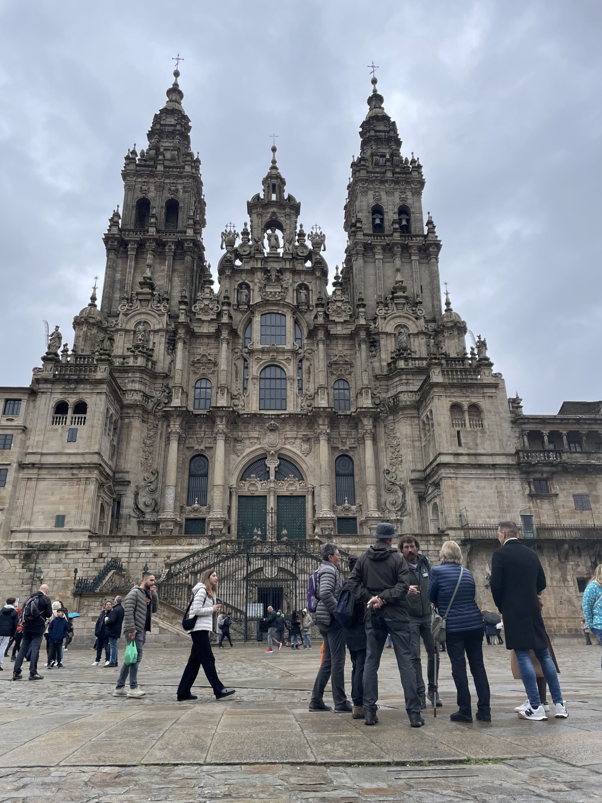
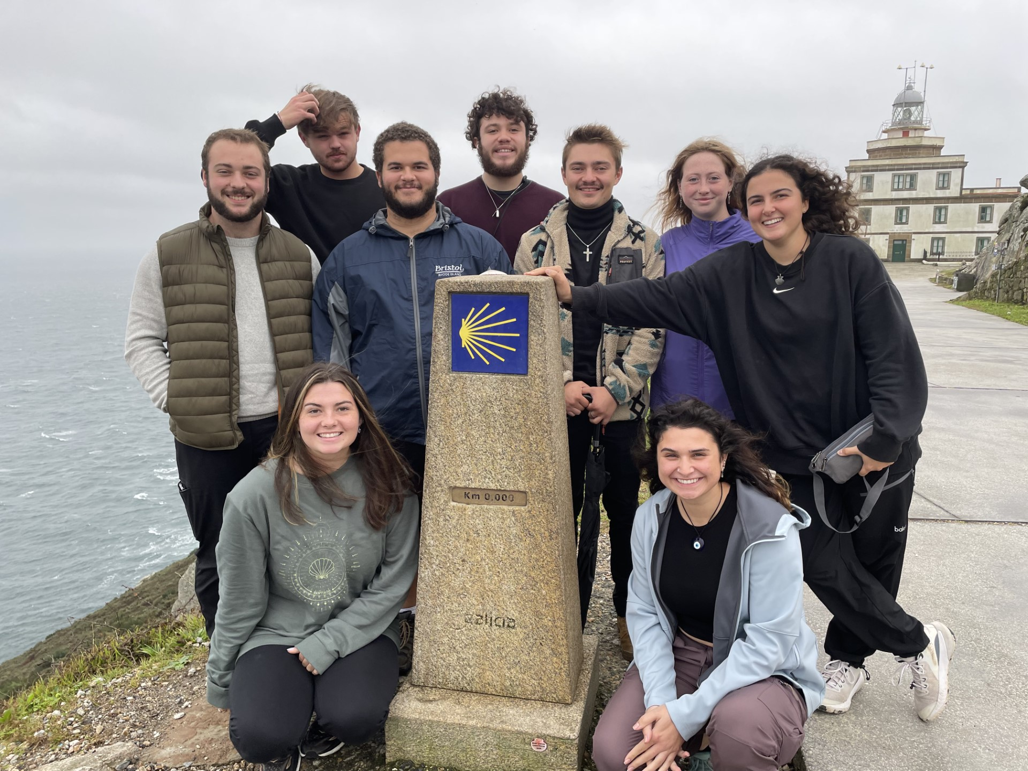
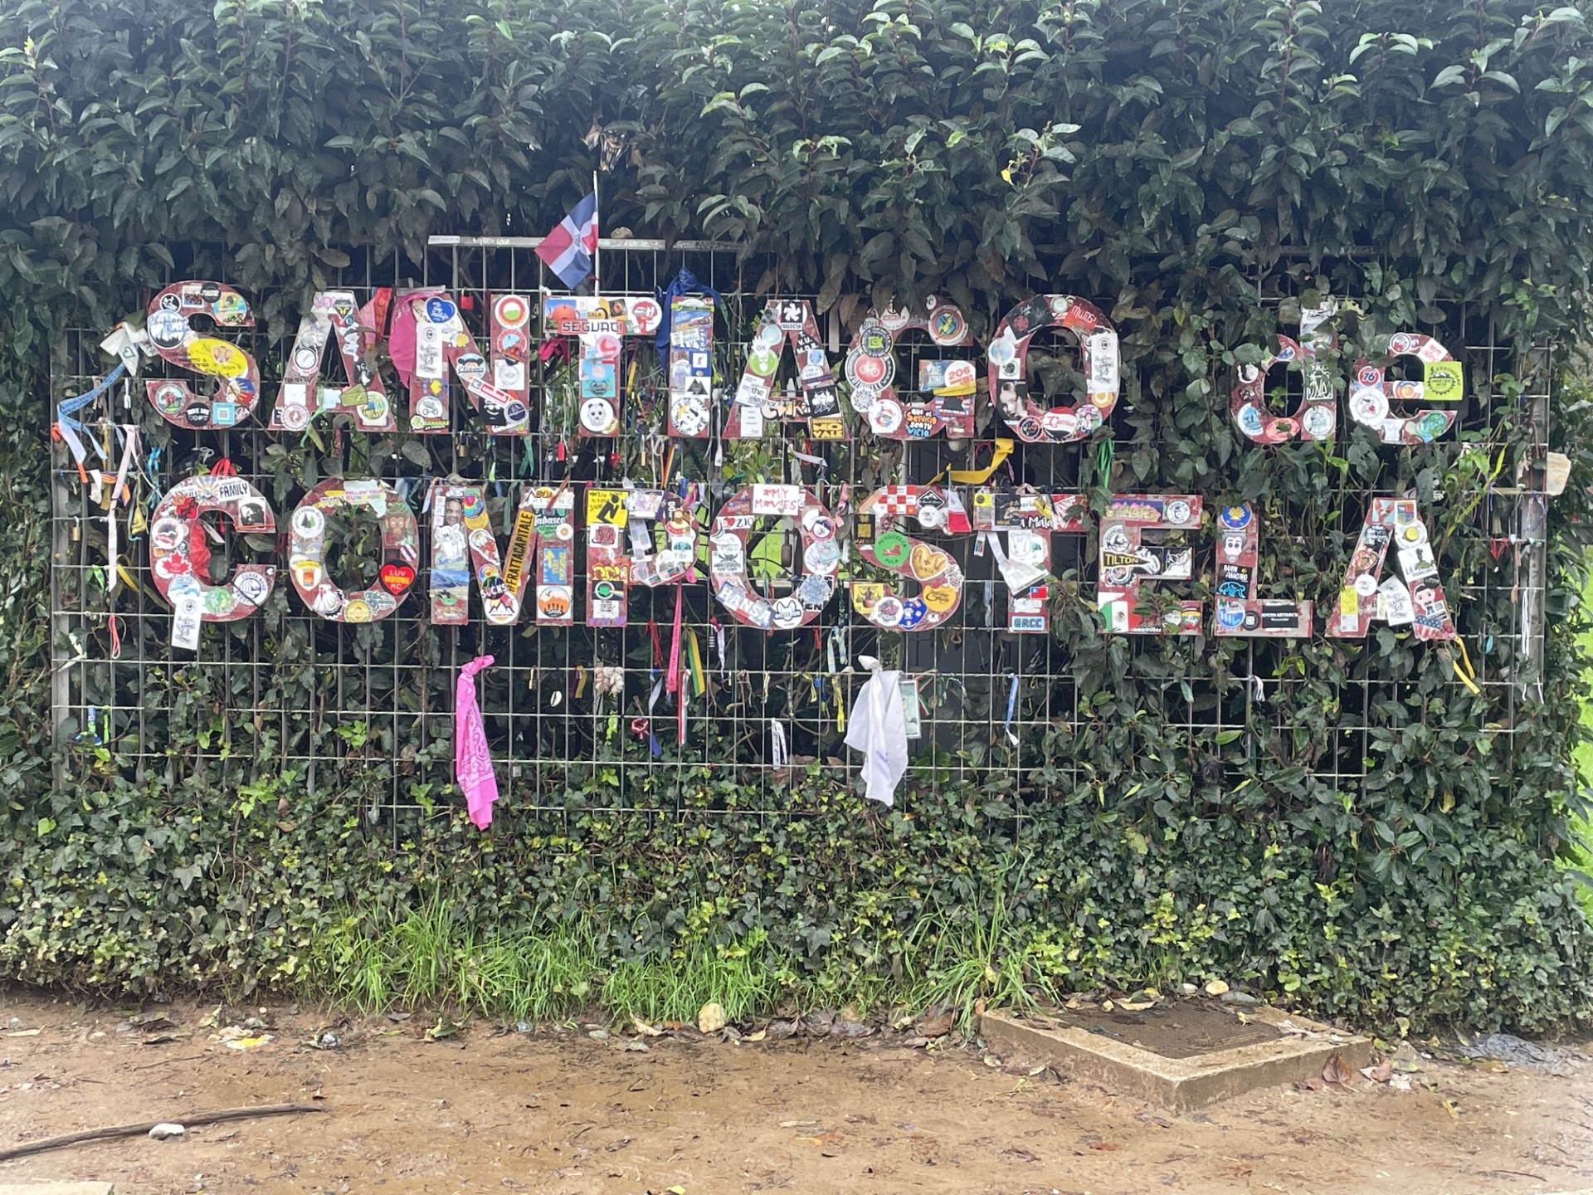
SANTIAGO DE COMPOSTELLA
Initial thoughts/ fears vs. differences at Cathedral
Culturally- another language, country, connection with strangers
What we felt getting our Compostellas
Found out our year was the most Americans

Slide 7
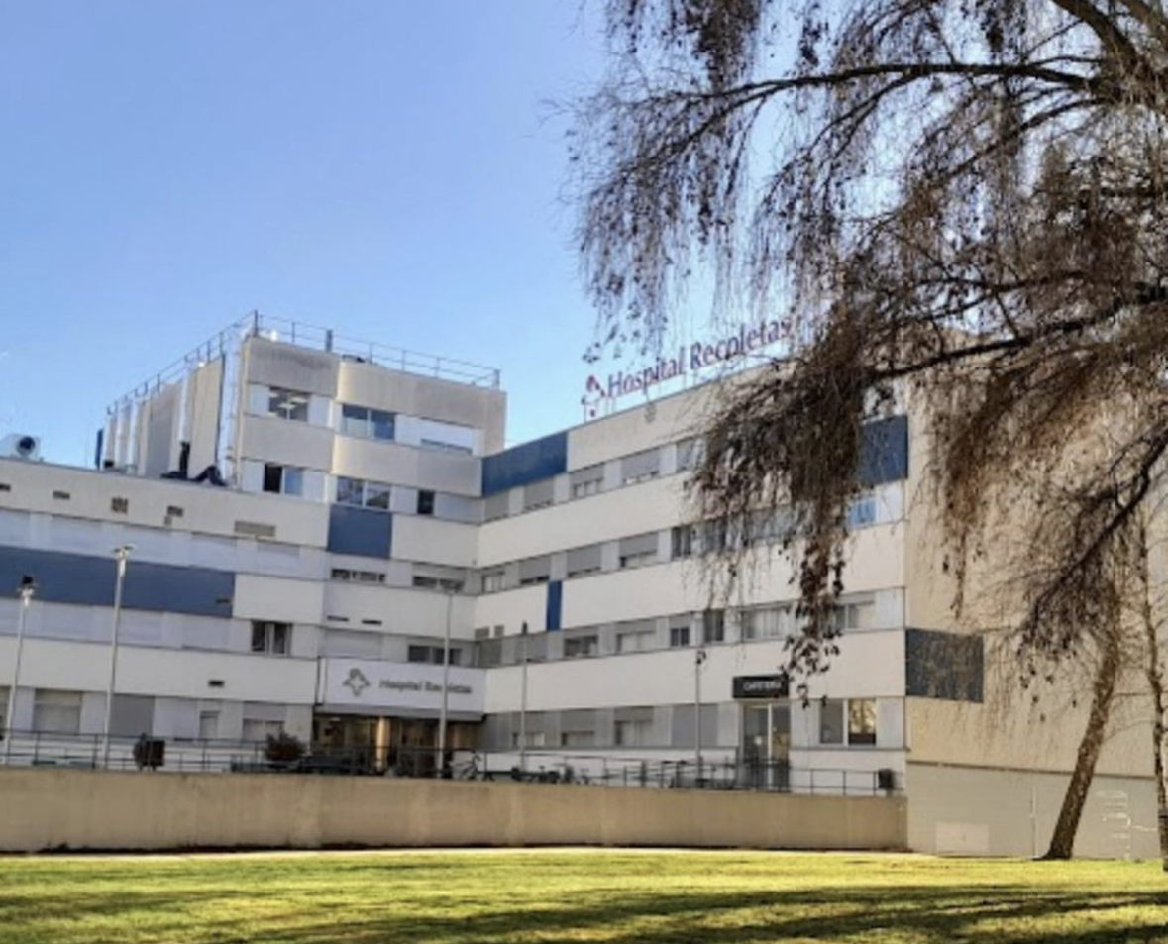
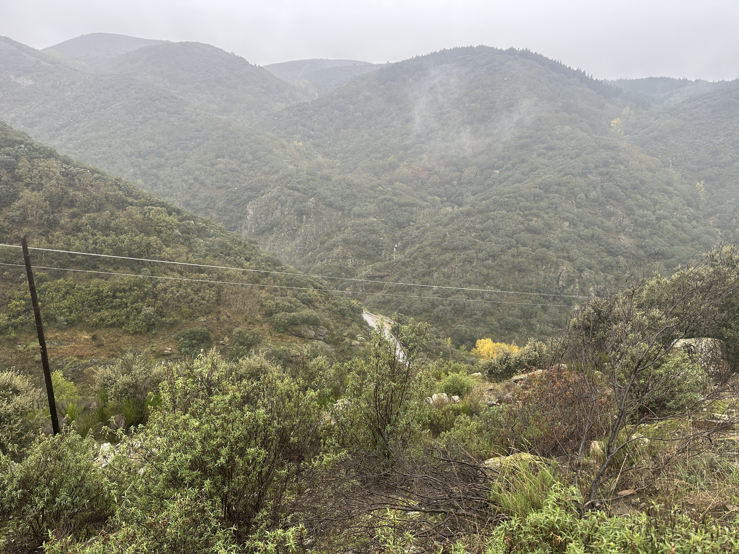
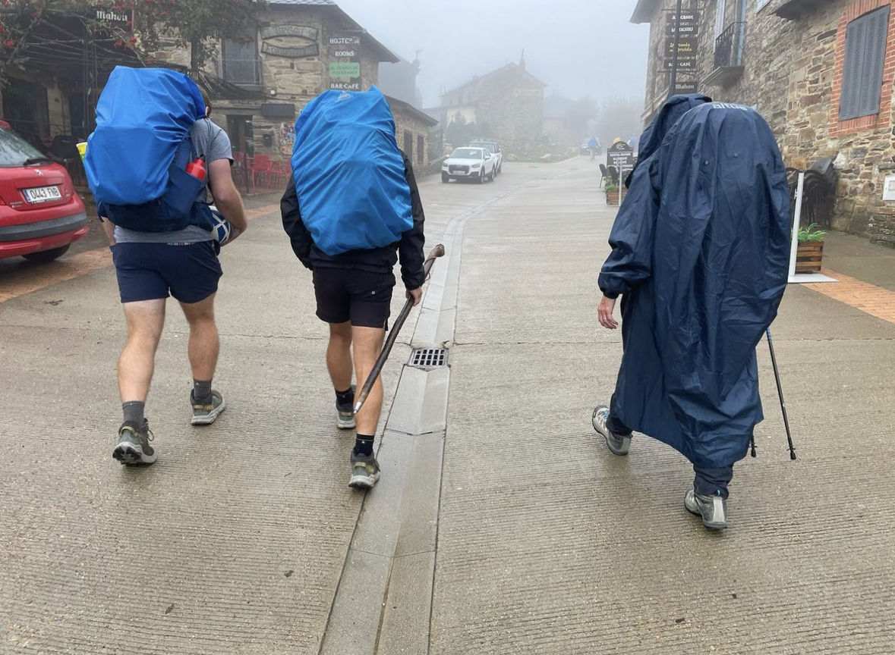
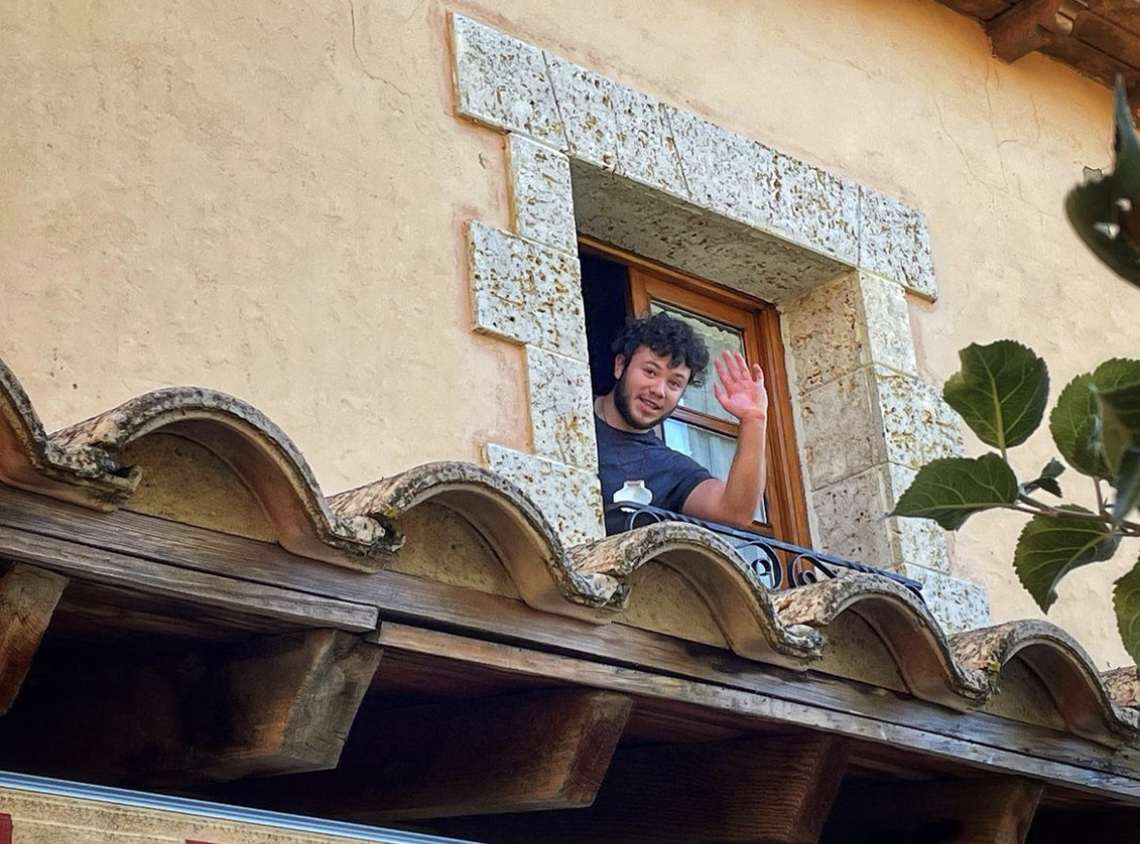
STRUGGLES & RESLILIENCE
Long fought rainy days
Injuries – Needing to taxi
COVID & Blisters

Slide 8
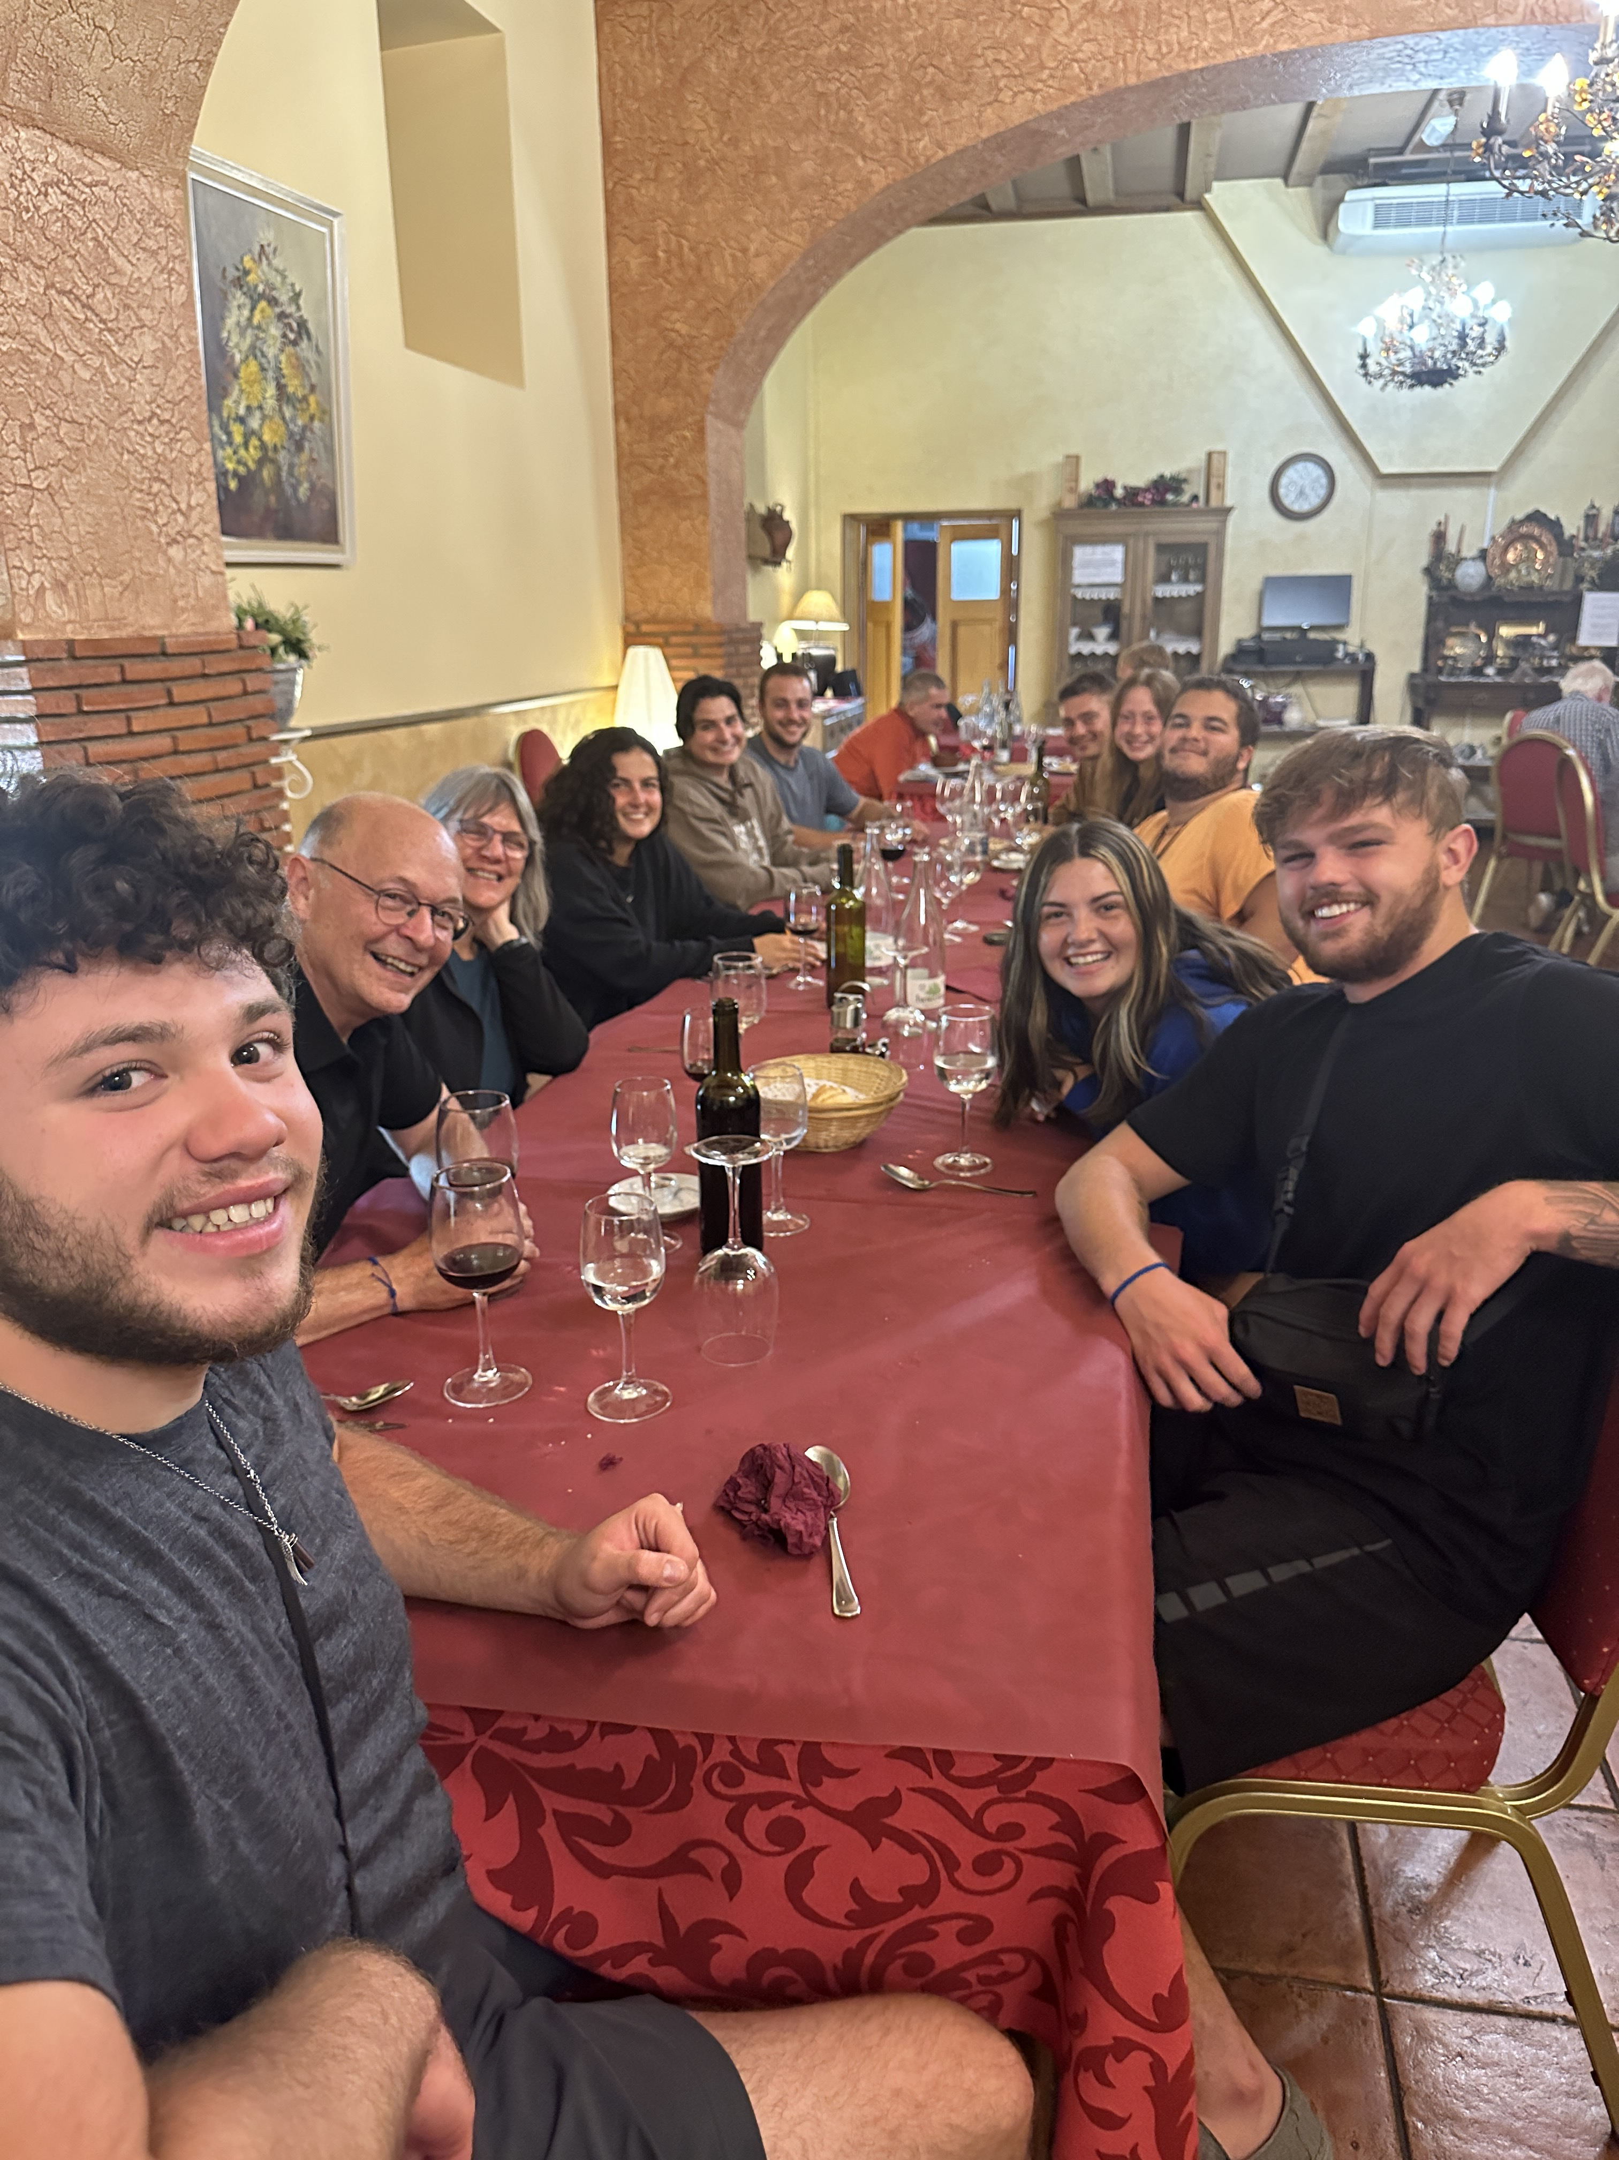
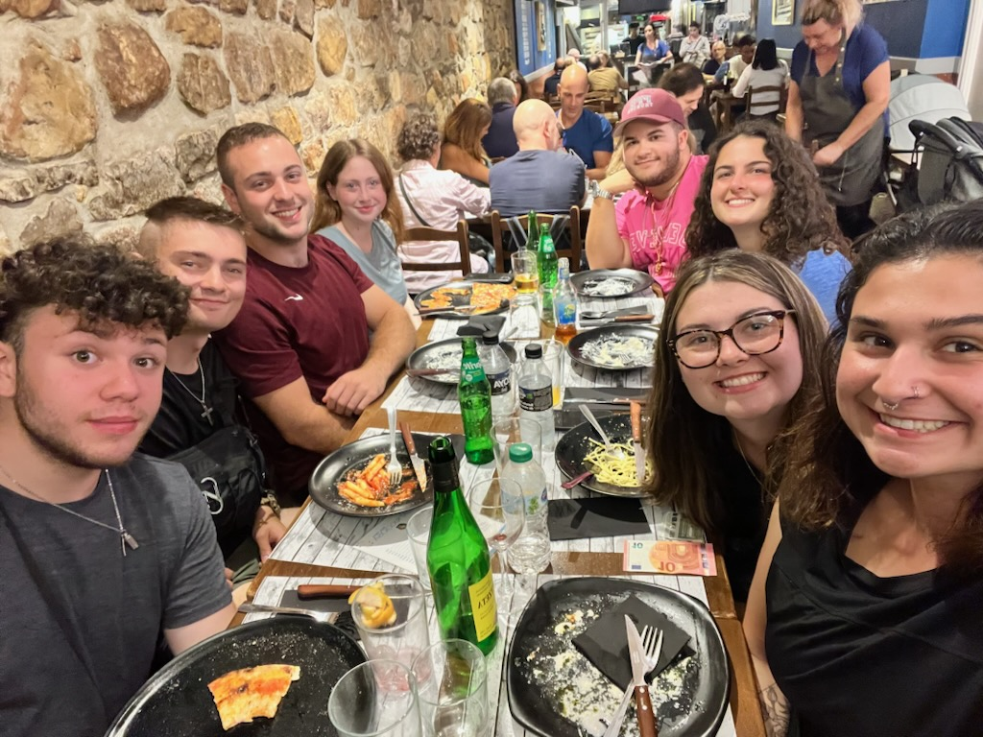
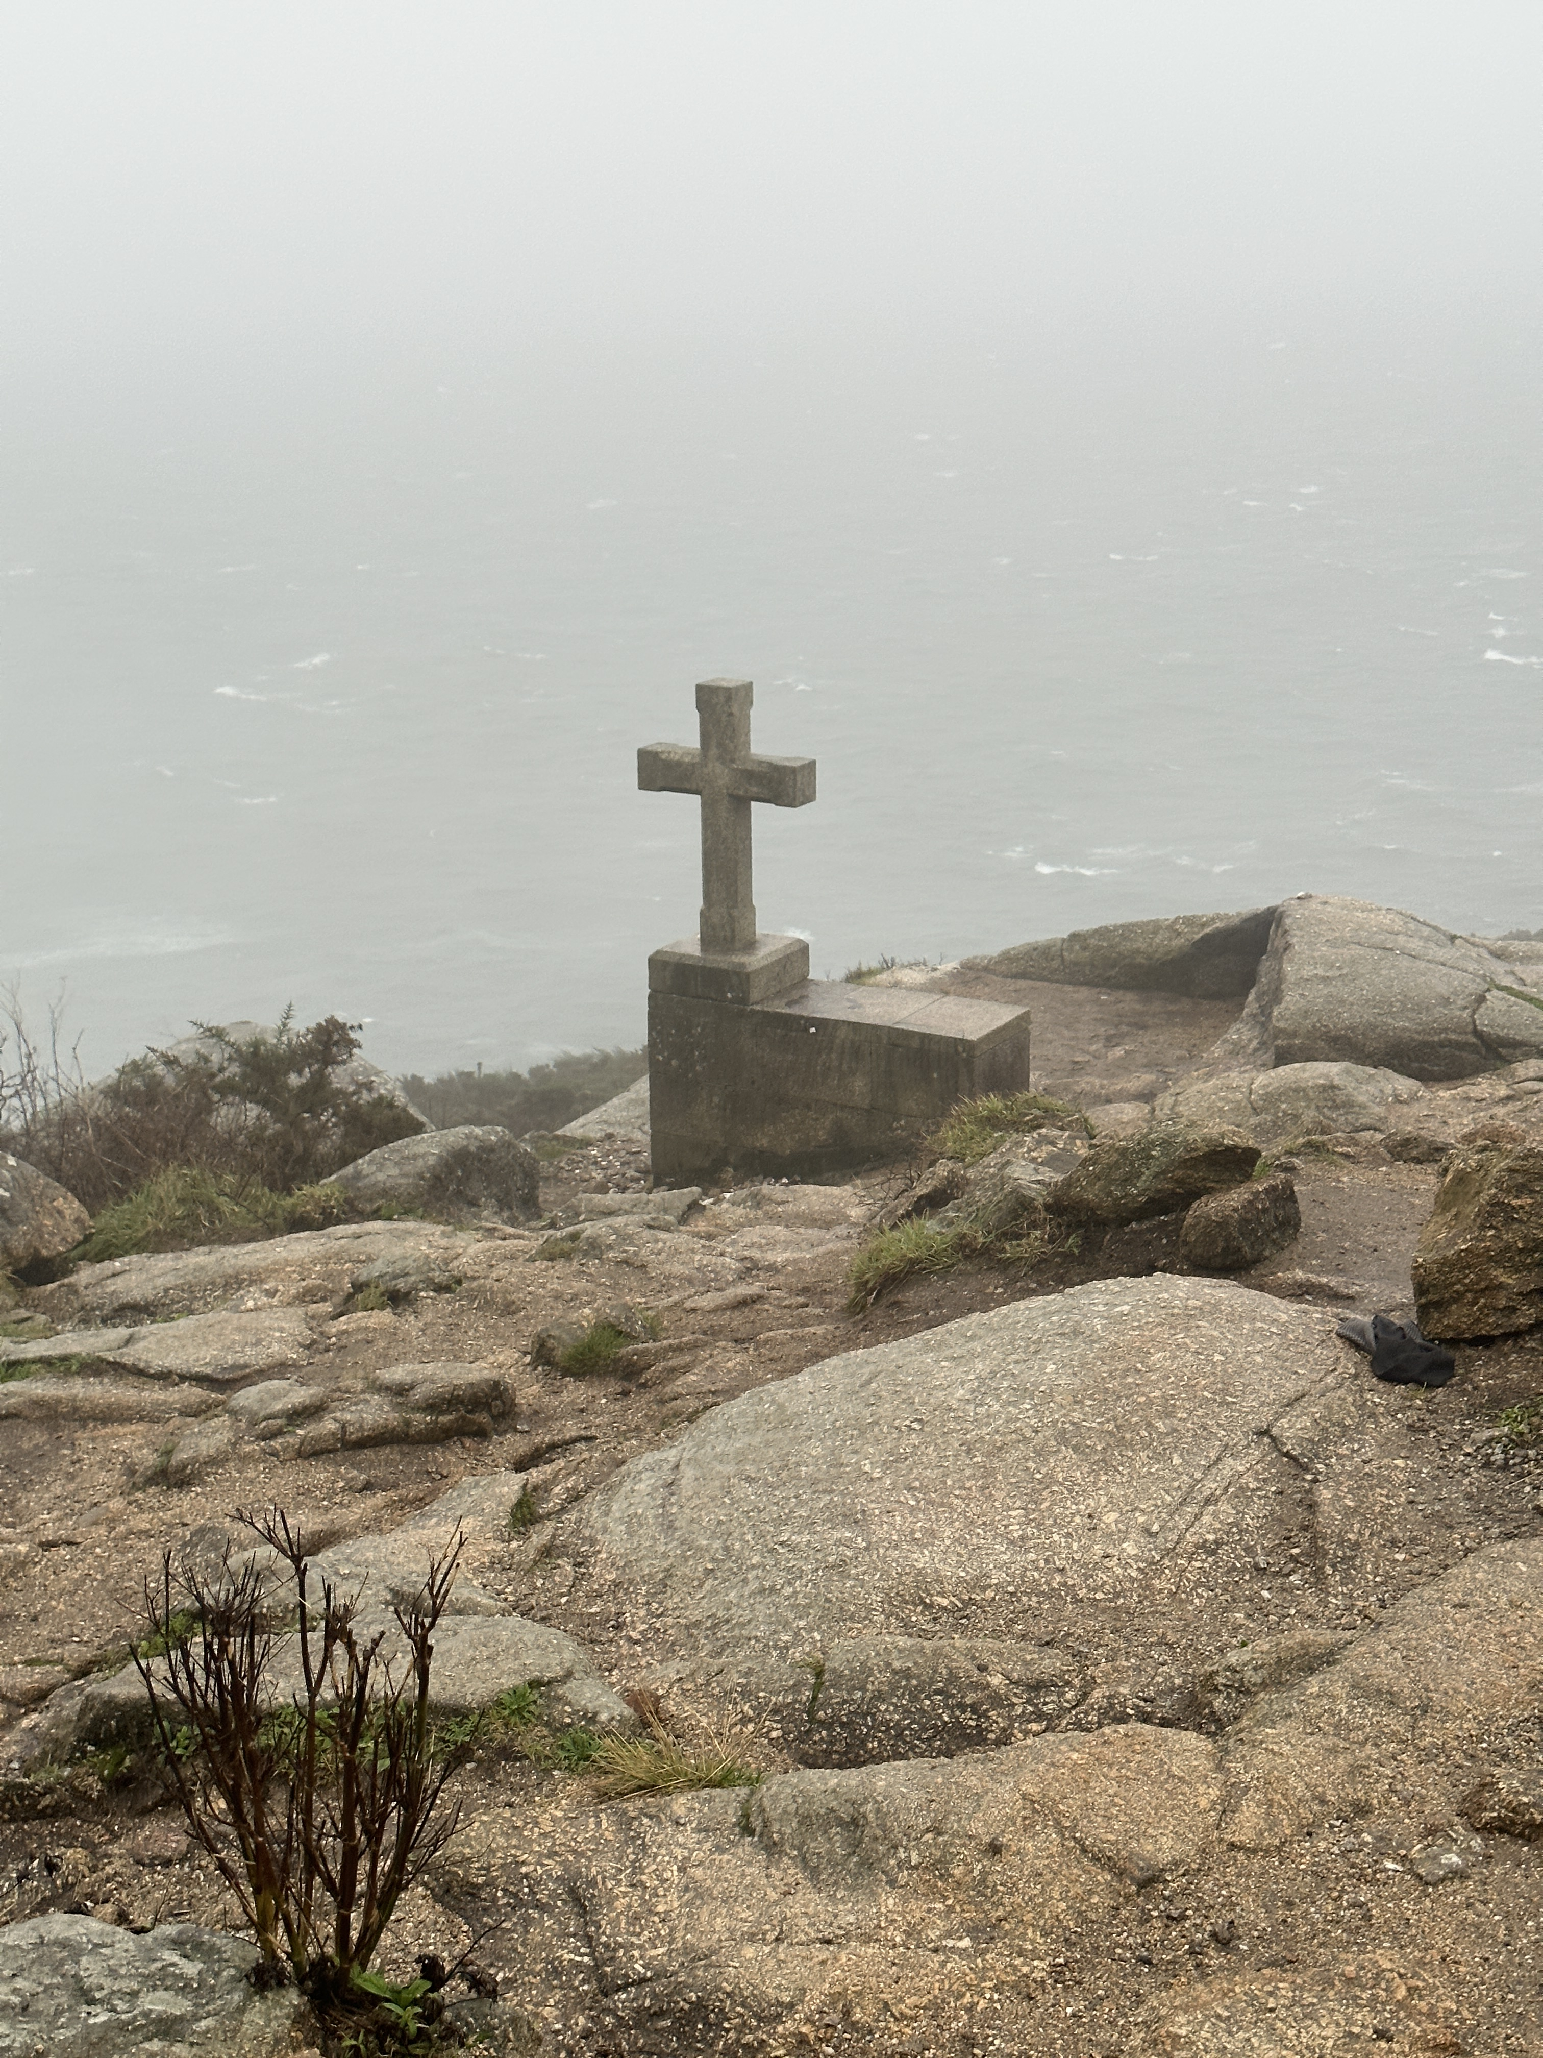
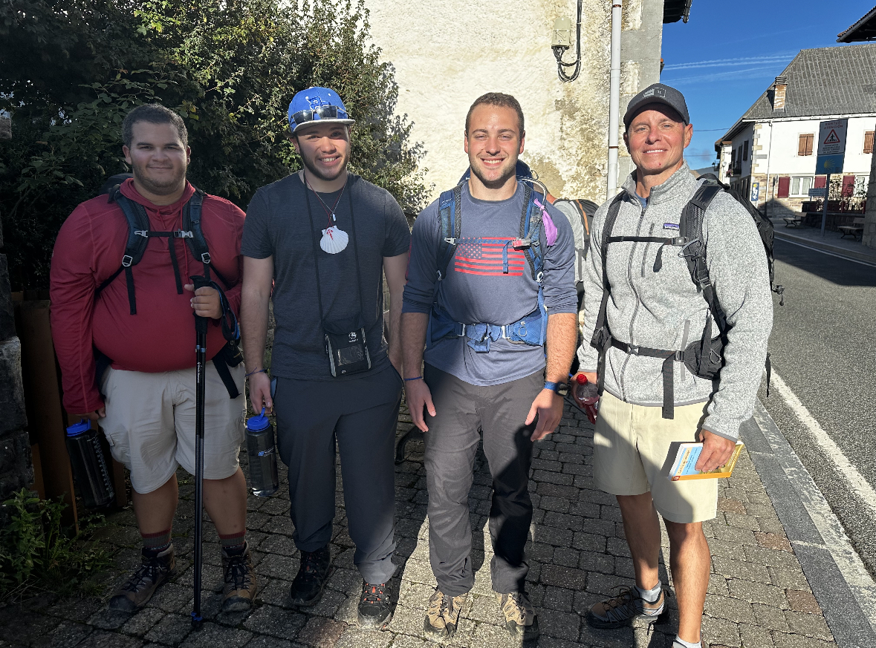
WHAT WE TOOK AWAY
Connecting with new people
Better understanding of oneself
Cultural Differences
Personal goals

