Slide 1
“It’s the Economy Stupid!” Public Economic Perceptions and Presidential Approval Rating
Abigail Farley

Slide 2
Hypothesis and reason for study
Hypothesis: How does public economic perception effect presidential approval?
Why focus on presidential approval instead of Congress?
Why public economic perception?
Why this question?

Slide 3
What this is and isn’t
What this is:
  Inquiry into a possible connection.
What this isn’t:
  Not trying to predict an election.
  Economic reality doesn’t matter.
  Not a judge of a president.

Slide 4
Literature
Literature on a similar topic discussed:
  Presidential approval
  Public perception of the economy
  How people gain information
  Partisanship

Slide 5
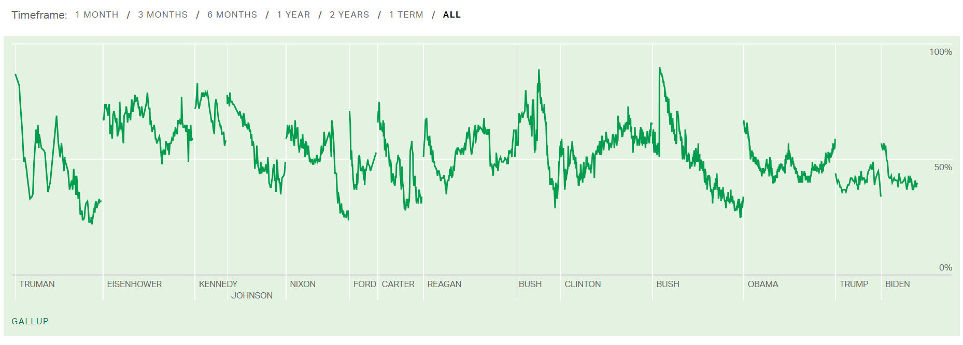
Presidential approval
Presidential approval from Truman to Biden
Gallup. (n.d.). Presidential Job Approval Center. Retrieved March 6, 2024, from Gallup: https://news.gallup.com/interactives/507569/presidential-job-approval-center.aspx

Slide 6
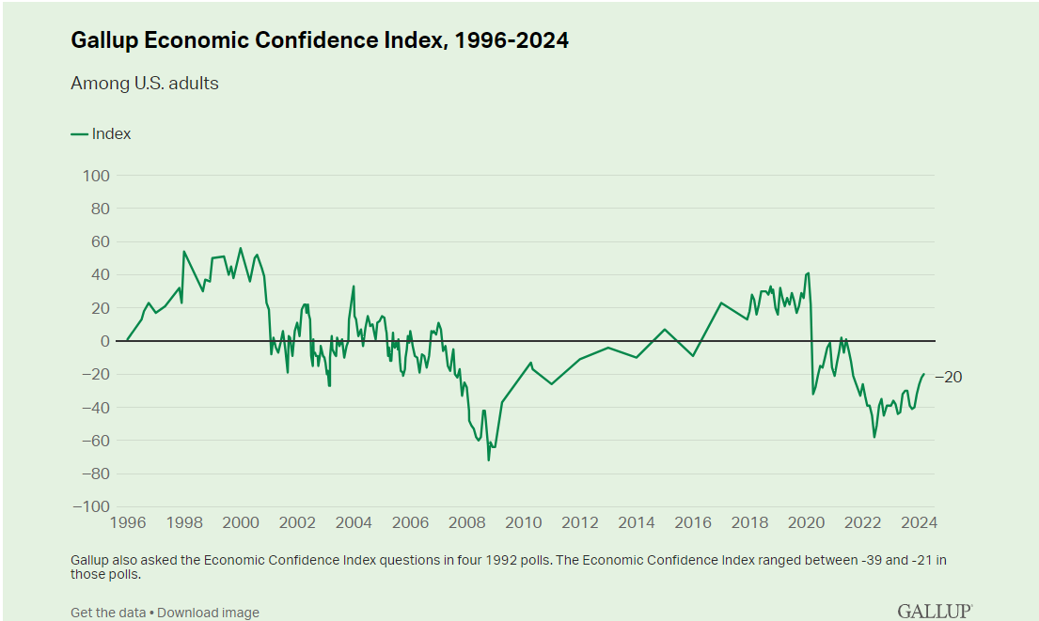
Economic perception
Gallup Consumer price index from 1996 to 2024
Gallup. (n.d.). Economy. Retrieved April 1, 2024, from Gallup: https://news.gallup.com/poll/1609/consumer-views-economy.aspx

Slide 7
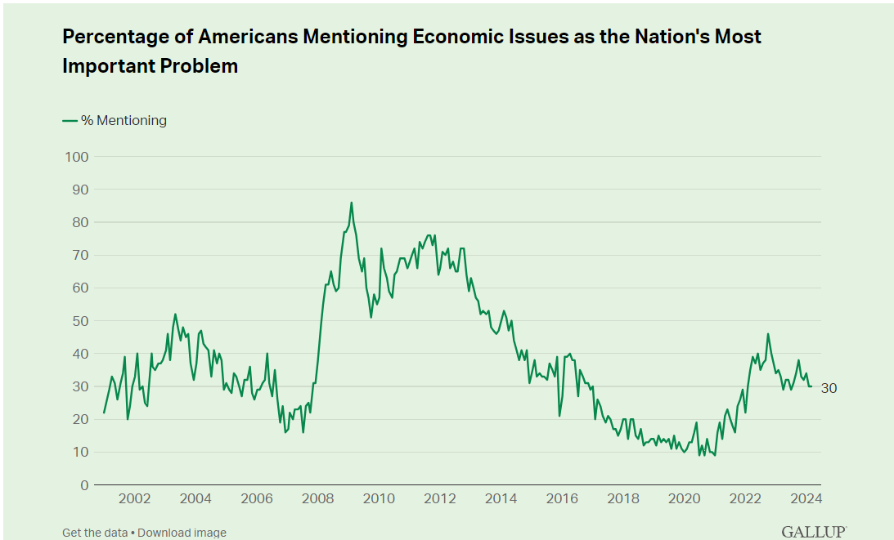
Importance of the economy
The economy as a top issue from 2001-2024
Gallup. (n.d.). Most Important Problem. Retrieved April 3, 2024, from Gallup: https://news.gallup.com/poll/1675/most-important-problem.aspx

Slide 8
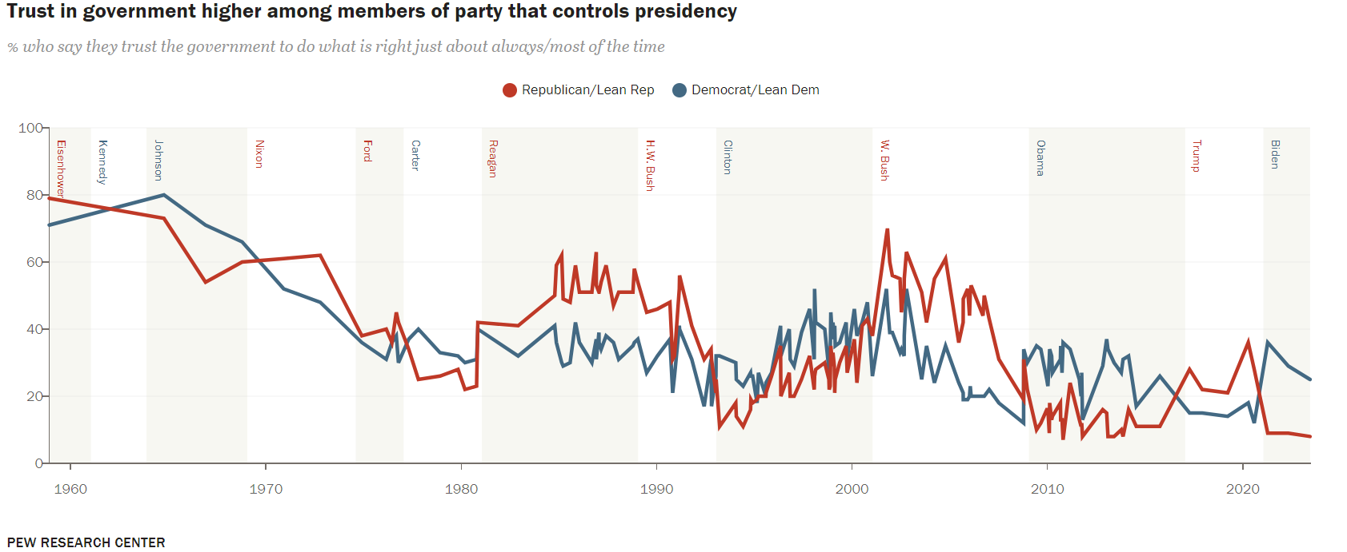
Government trust by party
Trust in government by party from Eisenhower to Biden
Center, P. R. (2023, September 19). Public Trust in Government: 1958-2023. Retrieved from Pew Research Center: https://www.pewresearch.org/politics/2023/09/19/public-trust-in-government-1958-2023/

Slide 9
Findings and Limitations
Findings
  Little connection
  Partisanship matters more
Limitations
  Limits of data
  Inseparable issues

Slide 10
Bibliography
Berlemann, M., & Enkelmann , S. (2013). THE ECONOMIC DETERMINANTS OF U.S. PRESIDENTIAL APPROVAL. University of Lüneburg Working Paper Series in Economics , 1-47. Retrieved from Econstor.
Blinder, A. S., & Krueger, A. B. (2004). What Does the Public Know about Economic Policy, and How Does It Know It? National Bureau of Economic Research, 1-61. Retrieved from https://www.nber.org/system/files/working_papers/w10787/w10787.pdf
CAMPBELL, J. E. (2005). The Fundamentals in US Presidential Elections: Public Opinion, the Economy and Incumbency in the 2004 Presidential Election. Journal of Elections, Public Opinion and Parties, 73–83.
Center, P. R. (2023, September 19). Public Trust in Government: 1958-2023. Retrieved from Pew Research Center: https://www.pewresearch.org/politics/2023/09/19/public-trust-in-government-1958-2023/
Center, P. R. (n.d.). U.S. Survey Methodology. Retrieved April 2, 2024, from Pew Research Center: https://www.pewresearch.org/our-methods/u-s-surveys/u-s-survey-methodology/
Dickerson, B. (2015). Economic Perceptions, Presidential Approval, and Causality: The Moderating Role of the Economic Context. American Politics Research, 1037 –1065.
ENNS, P. K., KELLSTEDT , P. M., & MCAVOY, G. E. (2012). THE CONSEQUENCES OF PARTISANSHIP IN ECONOMIC PERCEPTIONS . Oxford Journals, 287-310.
Gallup. (n.d.). Economy. Retrieved April 1, 2024, from Gallup: https://news.gallup.com/poll/1609/consumer-views-economy.aspx
Gallup. (n.d.). Most Important Problem. Retrieved April 3, 2024, from Gallup: https://news.gallup.com/poll/1675/most-important-problem.aspx
Gallup. (n.d.). An Overview of Gallup's Presidential Approval Ratings. Retrieved March 30, 2024, from Gallup: https://news.gallup.com/poll/245606/update-gallup-presidential-approval-ratings.aspx
Gallup. (n.d.). Presidential Job Approval Center. Retrieved March 6, 2024, from Gallup: https://news.gallup.com/interactives/507569/presidential-job-approval-center.aspx
Monroe, K. R., & Laughlin , D. M. (1983). Economic Influences on Presidential Popularity among Key Political and Socioeconomic Groups: A Review of the Evidence and Some New Findings. Political Behavior, 309-345.
Soroka, S. N., Stecula, D. A., & Wlezien, C. (2015). It's (Change in) the (Future) Economy, Stupid: Economic Indicators, the Media, and Public Opinion. American Journal of Political Science, 59(2), 457-474. Retrieved from https://www.jstor.org/stable/24363577?searchText=Public+Opinion+economy+United+States&searchUri=%2Faction%2FdoBasicSearch%3FQuery%3DPublic%2BOpinion%2Beconomy%2BUnited%2BStates%26efqs%3DeyJjdHkiOlsiYW05MWNtNWhiQT09IiwiWTJoaGNIUmxjZz09Il0sImRpc2MiOlsiY0c5c
Walstad, W. B. (1997). The Effect of Economic Knowledge on Public Opinion of Economic Issues. The Journal of Economic Education, 28(3), 195-205. Retrieved from https://www.jstor.org/stable/pdf/1183198.pdf
Wu, D. H., Stevenson, R. L., Chen, C. H., & Guner, N. Z. (2002). The conditioned impact of recession news: A time‐series analysis of economic communication in the United States. International Journal of Public Opinion, 14(1), 19-36. Retrieved from file:///C:/Users/andre/Downloads/index%20(1).pdf

