Slide 1
Androgen Receptor and Prostate Cancer

Slide 2
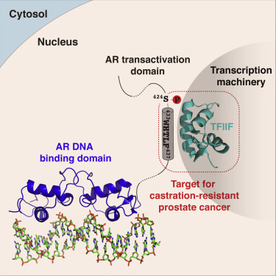
Prostate Cancer
Prostate cancer is the most common cancer in men, and the second most lethal
Like most cancers, it is driven by the activity of a transcription factor
Androgen receptor drives the progression of prostate cancer

Slide 3
Androgen Receptor
Like most transcription factors, Androgen receptor has three domains:
The DNA binding domain (DBD) binds DNA
The ligand binding domain (LBD) does… a lot of different things
The ligand binding domain (LBD) binds androgens (testosterone, DHT)
DBD
AD
LBD

Slide 4
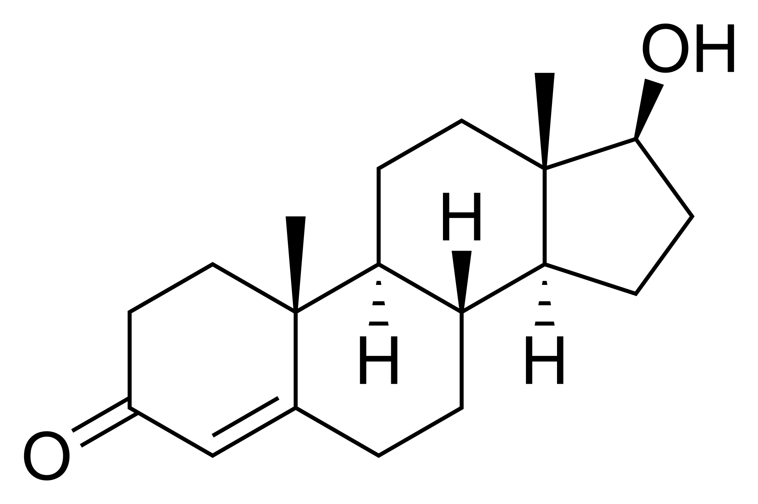
Androgen Receptor
Testosterone/DHT
LBD
LBD
LBD
LBD
DBD
LBD
DBD
DBD
DBD
DBD
Cytosol
Nucleus
HSP-70
Transcription machinery
AD
AD
AD
Cancer Progression
AD
AD

Slide 5
How to drug androgen receptor?
Testosterone
Since androgen receptor is activated by androgens, preventing androgen binding inactivates AR
Current Therapies
DBD
Androgen antagonists are the first line treatment for prostate cancer; they prevent androgens from binding to the LBD
LBD
No activity
HSP-70
AD
But… This approach doesn’t work

Slide 6
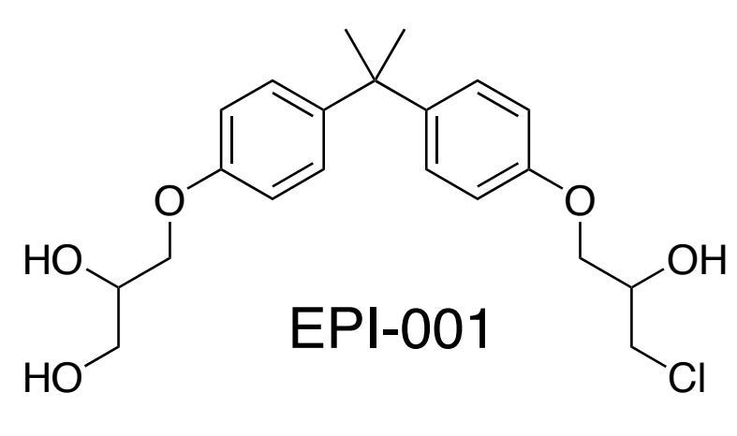
Drugging AR
Patients treated with LBD inhibitors end up expressing mutated AR
DBD
This has created interest in drugging the activation domain
LBD
AD drugs
HSP-70
However, this is tricky – the activation domain is an intrinsically disordered protein
AD

Slide 7
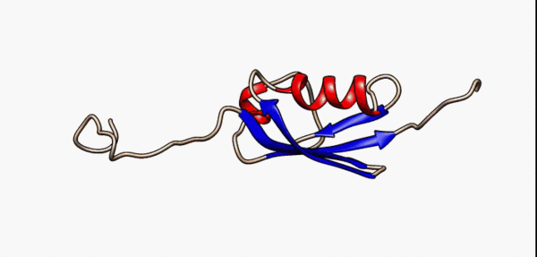
Intrinsically Disordered Proteins
Intrinsically disordered proteins don’t have rigid 3-dimensional structure
This makes structure-based drug discovery impossible
There is a drug candidate that targets the AD – it was discovered through phenotypic screening. It works due to a particular property of AR…

Slide 8
Biomolecular Condensates
AR forms biomolecular condensates
Biomolecular condensates are regions of de-mixed solution that contain higher concentrations of certain solutes than their surroundings
While they are necessary to the function of many biological systems, shifting the equilibrium of condensate formation can cause dysregulation

Slide 9
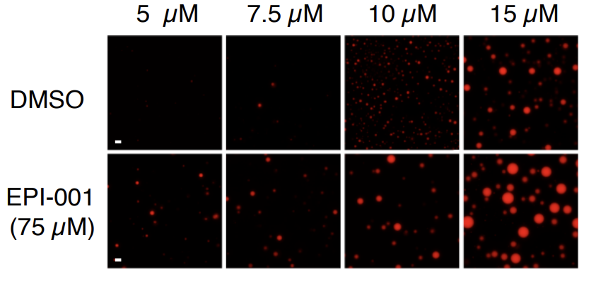
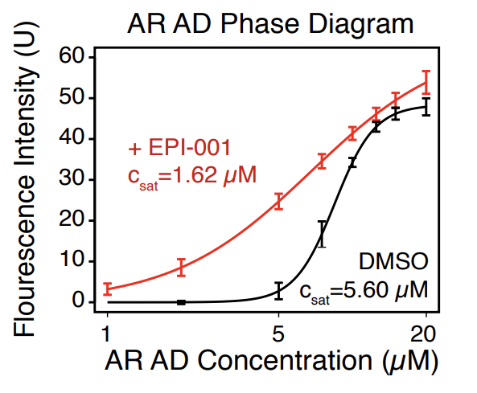
EPI-001
EPI-001 binds to activation domain and ‘shifts the phase separation equilibrium’ of androgen receptor (makes AR form more biomolecular condensates)
We’re currently trying to figure out the binding mechanisms

Slide 10
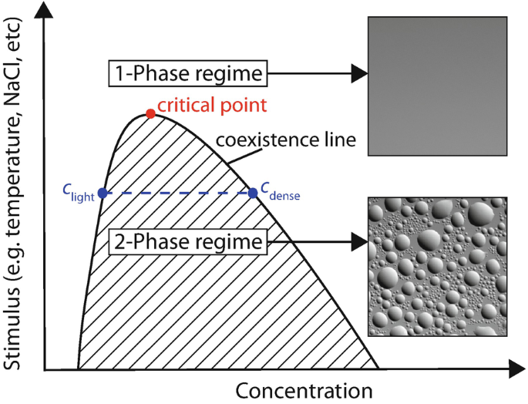
What factors effect AR phase separation?
The mechanisms that drive AR phase separation are not well-understood
My project was to develop an assay that could be used to measure AR phase separation under different conditions
I tried two different approaches: visualizing condensates directly with microscopy and measuring bulk condensation via absorbance

Slide 11
Microscopy
The activation domain fragment I used likes to form solid aggregates, which make microscopy… difficult

Slide 12
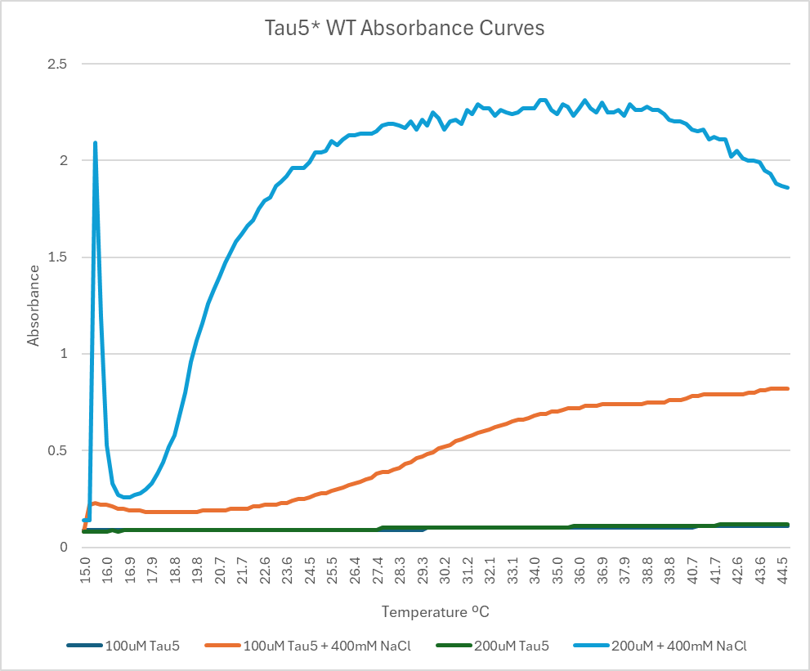
Absorbance Spec
However, absorbance spectrophotometry has yielded excellent results!
The assay developed here will be an excellent foundation for future research

