Slide 1
Governmental Transparency
By: Matthew Keyes-Johnson

Slide 2



What is Governmental Transparency?
Governmental transparency is how much a government tells the public about not just the state of the country but foreign affairs as well. In this regard, it is how open the government is with its citizens and how truthful they are when disclosing information.

Slide 3

How it is Measured
Transparency can be measured primarily by two different factors those being
Corruption in a nation: the more corruption a nation has the less likely they are to willingly share information with the citizens
Democratic stability: The level at which a nation can survive and flourish in a democratic system. Data shows that democratic nations tend to have more trust between them and their people because they give more information about state affairs to the people
These two are the determining factors to look at as they are the factors that determine the trustworthiness of a government. Looking at the data the common theme becomes that the more democratic a nation is the more trustworthy and transparent they are. This is the assumption as there is no clear data on transparency itself, only breakdowns of crime, corruption, and democratic stability.

Slide 4
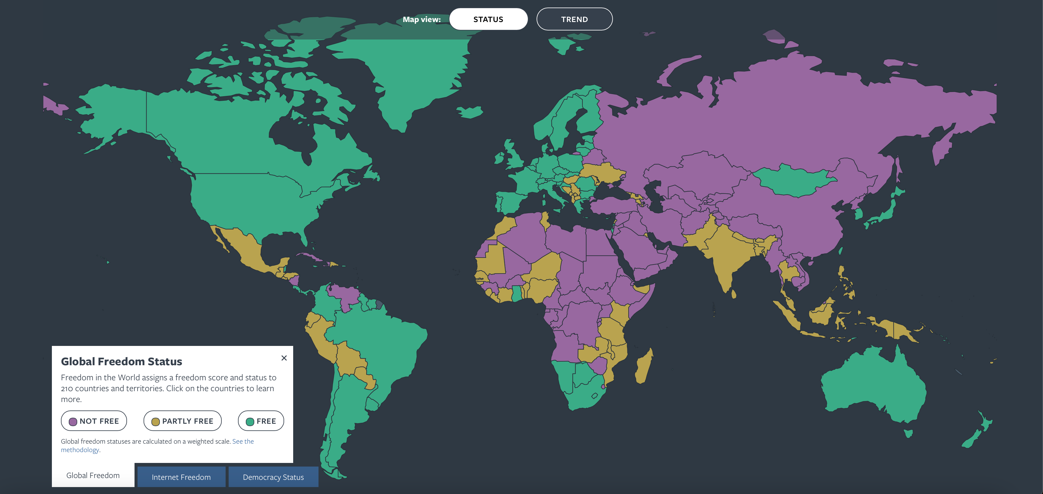
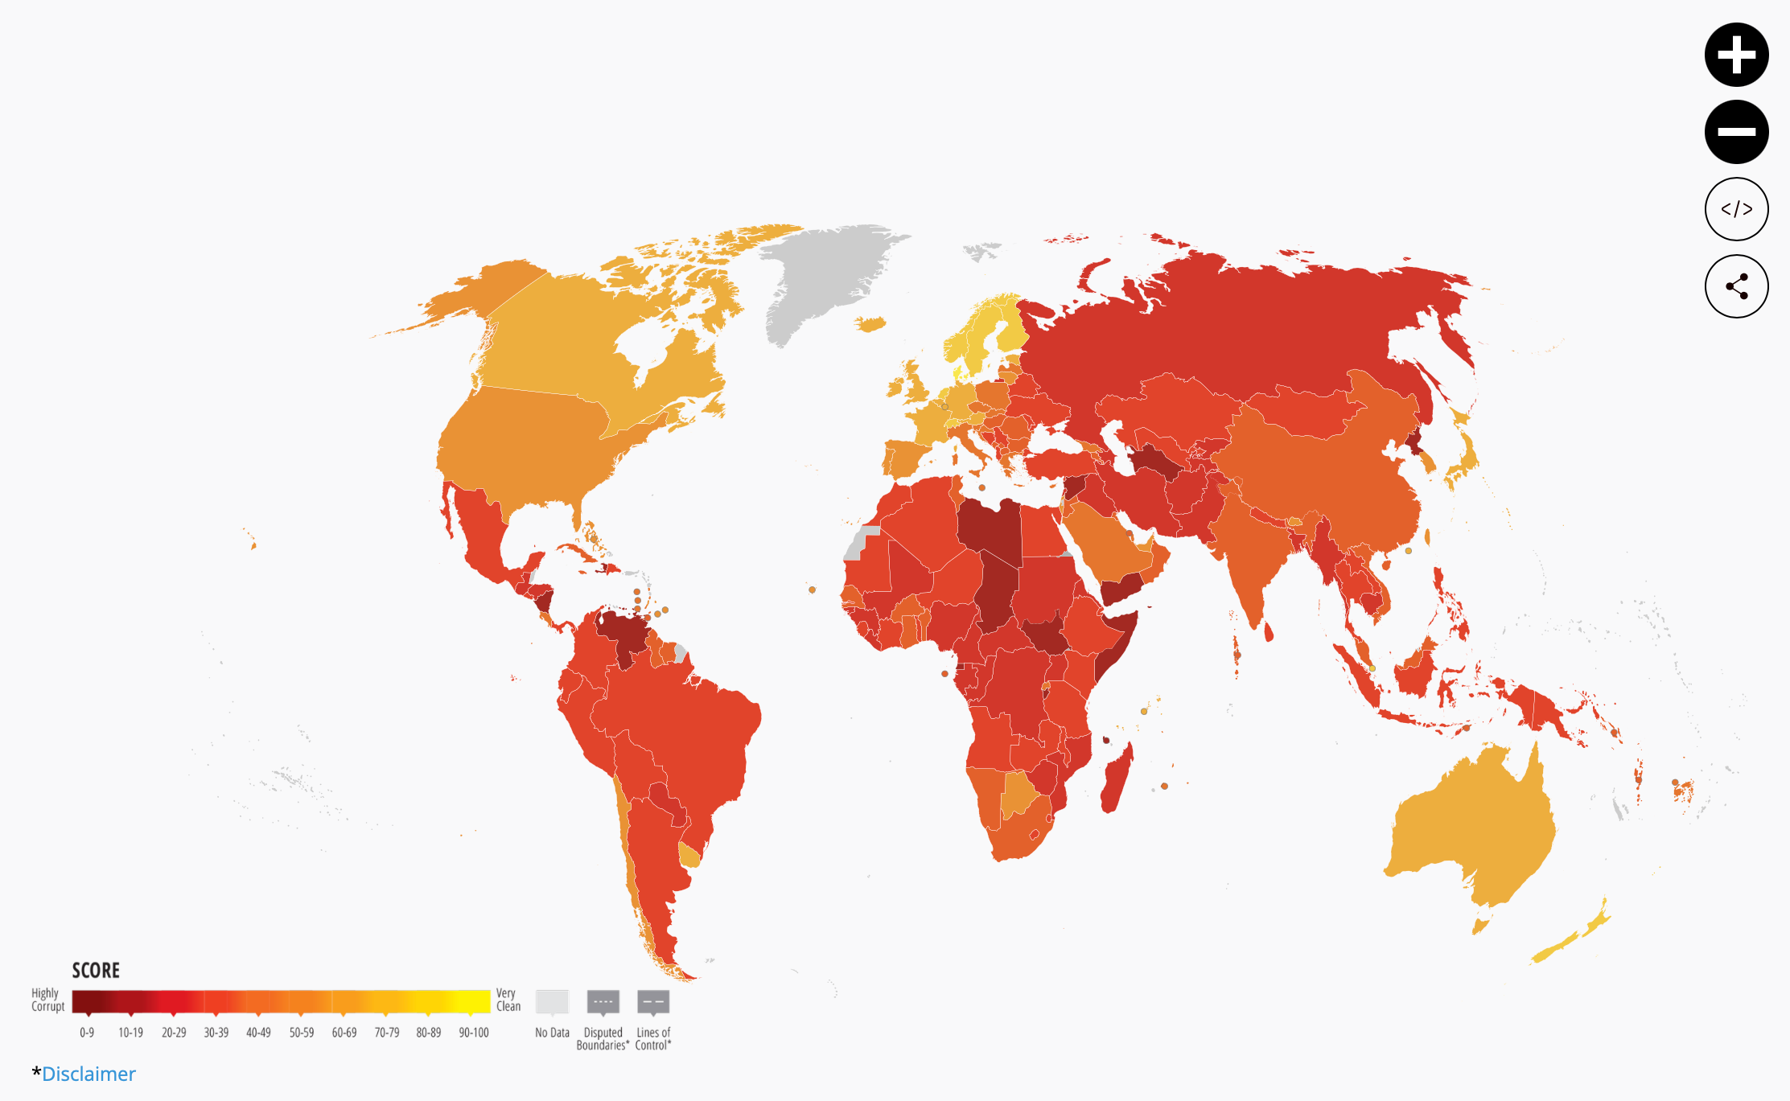
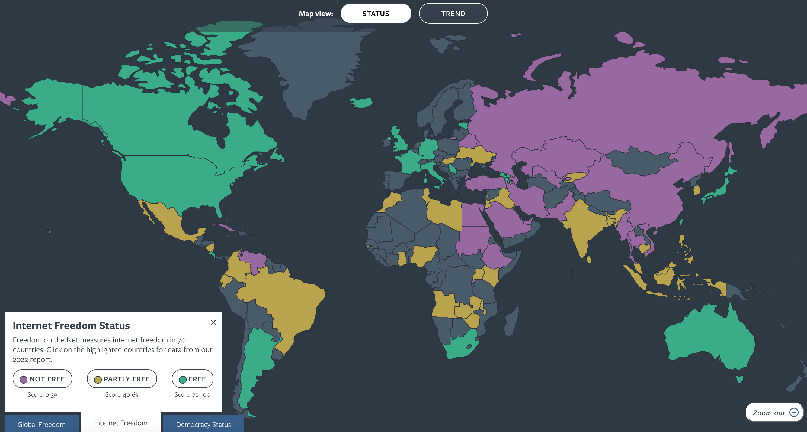
Data
Sources
https://freedomhouse.org/explore-the-map?type=fiw&year=2024
https://www.transparency.org/en/cpi/2022

Slide 5


How does it effect a country’s citizens
If a nation's citizens are kept from knowing the affairs of a nation either national or local then they are prevented from making proper decisions such as voting for certain policies, voting for elected officials
On a local level transparency as a direct correlation to corruption. According to Craemer, T. (2021, February 29). When Government Transparency Risks Reinforcing Racist Stereotypes and Residential Segregation. Retrieved from ProQuest: http://ezproxy.franklinpierce.edu/login?url=https://www.proquest.com/scholarly-journals/when-government-transparency-risks-reinforcing/docview/2502274534/se-2?accountid=37705:
  The censorship of crime data due to corruption and misinformation allows for the citizens of that town/city to be put at risk as the proportions of crime is not properly relayed.
  If this data is not given properly due to police corruption not reporting crime or being a part of it themselves then neighbors will never get better. This local risk can be brought to a national scale as all of this data is used to create reports that are supposed to entail how a nation functions and how stable its economy, communities, and government. Misrepresentation of this data is in itself not being transparent.

Slide 6

Examples
China has a yearly summit- A time event in which the state of affairs is discussed with the people, not allowing the press to ask questions any other time about state affairs and leaving the people to just trust the government is low transparency and allows for more corruption
In the same way, Russia does this by restricting media usage and availability to their people, they are prevented from looking into the state of affairs in their own country and most other countries as well.
  Restriction of media is the biggest way to be less transparent with citizens, it is the largest growing means of communicating information, and restricting it means that most will not know details that could alter decisions such as voting, traveling, and citizenship of a nation. Some restrictions can even affect the economy and how much people spend which raises inflation.
In a more democratic and free nation, the people are allowed to look into affairs of these matters, in The United Kingdom for example citizens are allowed to freely report news no matter the topic and give opinions on this topic, this allows for a better understanding of laws and foreign affairs. This helps understand not only what a community needs when voting for officials but also what the nation best needs. Allowing free usage of media helps promote topics that are not talked about as much as well as discussing better solutions on forums to solve a wide variety of issues from small to big.
Governments do this to accomplish their goals of doing what they feel is best for their people or to put their nation in a higher position of power. Transparency is an important factor in gaining control and power. Governments restrict or suppress data simply to gain the upper hand in situations and control the flow of information to be a few steps ahead of other nations.

Slide 7
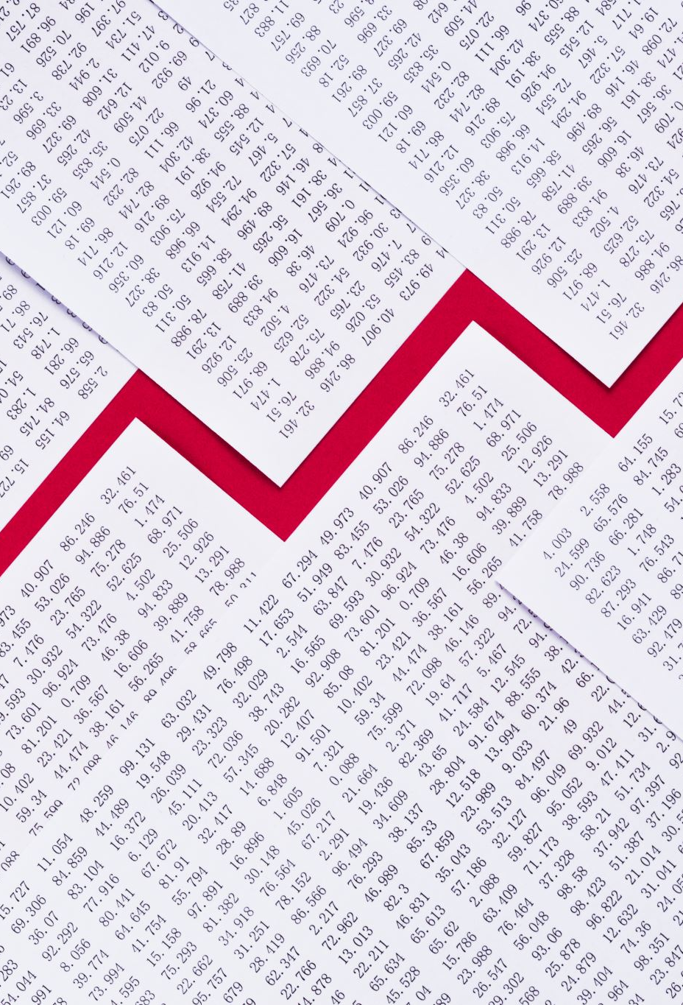
Analysis
The less democratic a nation is the more corrupt it tends to be on the average scale, the more corrupt the nation is the less transparency it has with its citizens. Democratic stability is the direct correlation of transparency. The more the government of a nation shares the less corrupt it can be as they gives out information about its actions making it easier to follow and track tendencies and misdeeds

Slide 8

Conclusion
The conclusion after conducting this research is that the level of transparency of a government has a greater effect on the citizens than most will realize.
The power of media is a tool that everyone uses to get a message across this goes for governments as well. When media is restricted it becomes a much easier task for governments to not be as transparent with the people government actions influence people’s opinions.
  This can determine how they act and feel about matters that influence the economy, education, crime rates, and voter turnout. All things that affect the government and how well they can perform overall are tied to media. It is the fastest way to get news to others and can be tempered with and twisted to benefit a certain party. Some governments take advantage of this and use it as a tool to suppress information or change the story to restrict certain parts of the information released.

Slide 9
Sources
Kothawala, A. (2004, May 27). Media expert urges more transparency. Retrieved from Pro Kothawala, A. (2004, May 27). Media expert urges more transparency. Retrieved from ProQuest : http://ezproxy.franklinpierce.edu/login?url=https://www.proquest.com/newspapers/media-expert-urges-more-transparency-government/docview/352768997/se-2?accountid=37705
Bertot, J. C., Jaeger, P. T., & Grimes, J. M. (2012, December 05). Promoting transparency. Retrieved from ProQuest: http://ezproxy.franklinpierce.edu/login?url=https://www.proquest.com/scholarly-journals/promoting-transparency-accountability-through/docview/928745679/se-2?accountid=37705
Chen, M. 1., Bogner, K. 1., Becheva, J. 1., & Grossklags, J. 1. (2023, October 10). On the transparency of the credit reporting system in China. Retrieved from ProQuest: http://ezproxy.franklinpierce.edu/login?url=https://www.proquest.com/scholarly-journals/on-transparency-credit-reporting-system-china/docview/2875235385/se-2?accountid=37705
Wang, Y., Sun, Y., & Miao, Y. (2023, November 07). Management of enterprise carbon emissions. Retrieved from ProQuest: http://ezproxy.franklinpierce.edu/login?url=https://www.proquest.com/scholarly-journals/management-enterprise-carbon-emissions-data/docview/2886738058/se-2?accountid=37705
Craemer, T. (2021, February 29). When Government Transparency Risks Reinforcing Racist Stereotypes and Residential Segregation. Retrieved from ProQuest: http://ezproxy.franklinpierce.edu/login?url=https://www.proquest.com/scholarly-journals/when-government-transparency-risks-reinforcing/docview/2502274534/se-2?accountid=37705
M.Sc., U. P.-P.-0.-P. (2017, July 04). Government Transparency: Reality or Mirage? Retrieved from ProQuest: http://ezproxy.franklinpierce.edu/login?url=https://www.proquest.com/scholarly-journals/government-transparency-reality-mirage/docview/2069494326/se-2?accountid=37705
MDPI AG. (2023, March 06). Transparency and E-Government in Electronic Public Procurement. Retrieved from ProQuest: http://ezproxy.franklinpierce.edu/login?url=https://www.proquest.com/scholarly-journals/transparency-e-government-electronic-public/docview/2785242542/se-2?accountid=37705

Slide 10
Sources
Bell, J. (2009, Febuary 24). GOVERNMENT TRANSPARENCY. Retrieved from ProQuest: http://ezproxy.franklinpierce.edu/login?url=https://www.proquest.com/scholarly-journals/government-transparency/docview/1695041158/se-2?accountid=37705
Ball, C. (2014, December 08). What Is Transparency? Retrieved from Taylor & Francis Online : https://www.tandfonline.com/doi/abs/10.2753/PIN1099-9922110400
FLORINI, A. (2004, May 04). Behind closed doors. Retrieved from Singapore Management University: https://ink.library.smu.edu.sg/soss_research/2323/
Stiglitz, J. (2016, March 02). Transparency in Government. Retrieved from Google Books: https://books.google.com/books?hl=en&lr=&id=56punueI7G0C&oi=fnd&pg=PA27&dq=g
Alcaraz-Quiles, F. J. (2014, November 01). Factors influencing the transparency of sustainability. Retrieved from Science Direct: https://www.sciencedirect.com/science/article/abs/pii/S095965261400674X
Chen, C. (2021, August 31). Do transparency mechanisms reduce government corruption? . Retrieved from Sage Journals : https://journals.sagepub.com/doi/abs/10.1177/00208523211033236
Fung, S. K. (2014, February 26). Does Trancparency Improve Governence . Retrieved from Annual Reviews : https://www.annualreviews.org/full/doi/10.1146/annurev-polisci-032210-144356
Yuan, L. (2024, March 06). A Window Into Chinese Government Has Now Slammed Shut. Retrieved from NewYorkTimes : https://www.nytimes.com/2024/03/06/business/china-national-peoples-congress.html?smid=url-share
Cambridge University . (2022, January 15). Government Transparency. Retrieved from Cambridge University Press : https://www.cambridge.org/core/elements/abs/government-transparency/501946EF70F2B666BAC76A4EAB03EB1B
National Post. (2001, Febuary 15). Government transparency. Retrieved from ProQuest: http://ezproxy.franklinpierce.edu/login?url=https://www.proquest.com/newspapers/government-transparency/docview/329857686/se-2?accountid=37705
Maidin, Z., & Rahim, W. A. (2002, June 15). Kelantan Government's transparency under scrutiny. Retrieved from ProQuest: http://ezproxy.franklinpierce.edu/login?url=https://www.proquest.com/newspapers/kelantan-government-s-transparency-under-scrutiny/docview/266758845/se-2?accountid=37705
Data
https://www.statista.com/statistics/235847/most-corrupt-countries/
https://www.transparency.org/en/cpi/2022
https://www.statista.com/statistics/235841/least-corrupt-countries/
https://freedomhouse.org/explore-the-map?type=fiw&year=2024
https://www.systemicpeace.org/inscr/SFImatrix2018c.pdf
https://www.systemicpeace.org/inscrdata.html

