Slide 1
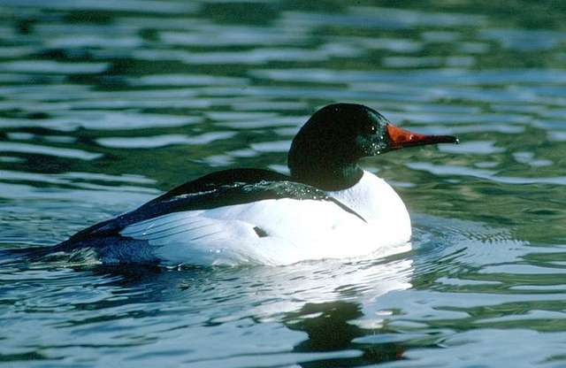
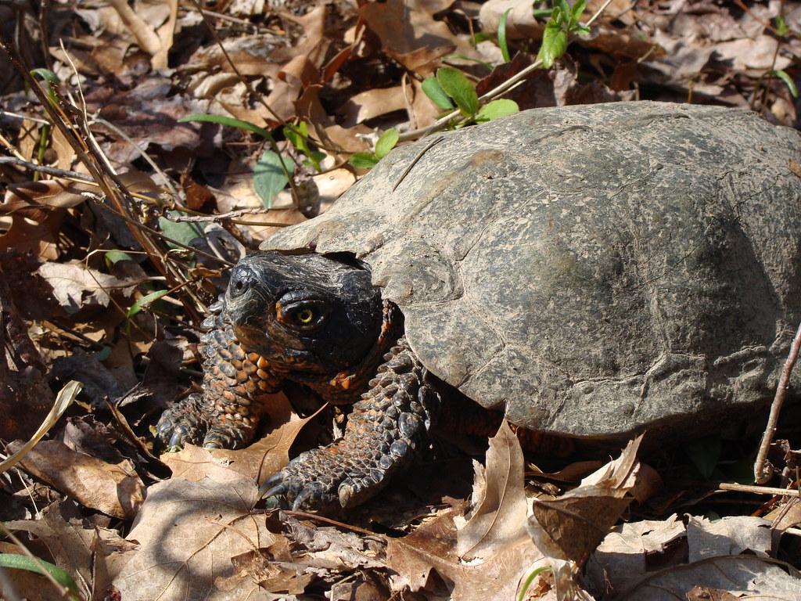
Natural and Cultural Resource Inventory Project for the FPU Rindge Campus
Catherine Owen Koning, Prof. of Env. Science and Policy
Connor Nordmann, ‘24

Slide 2
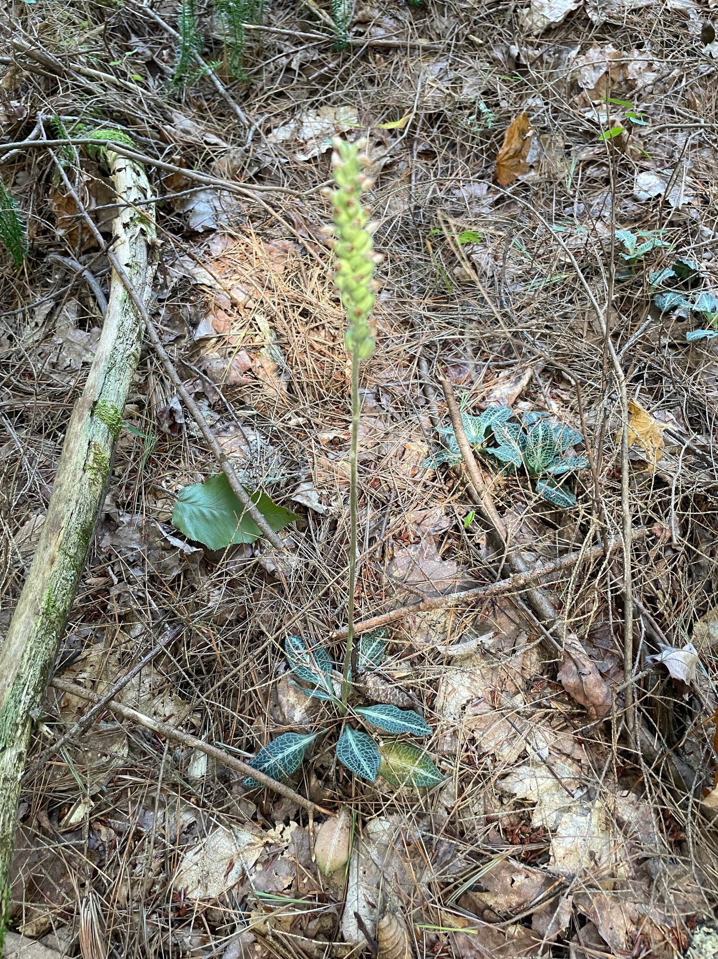
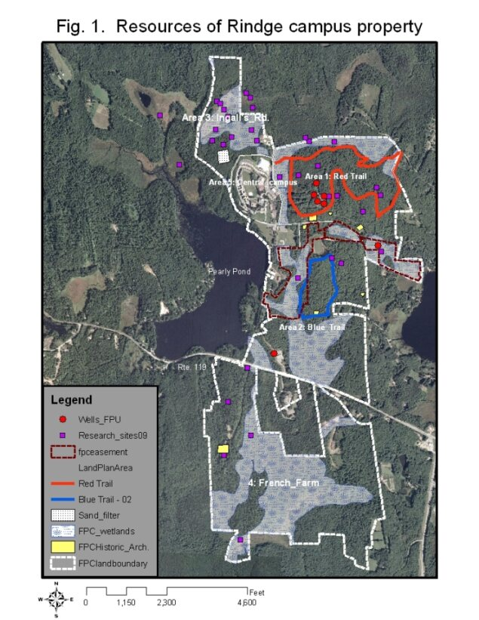
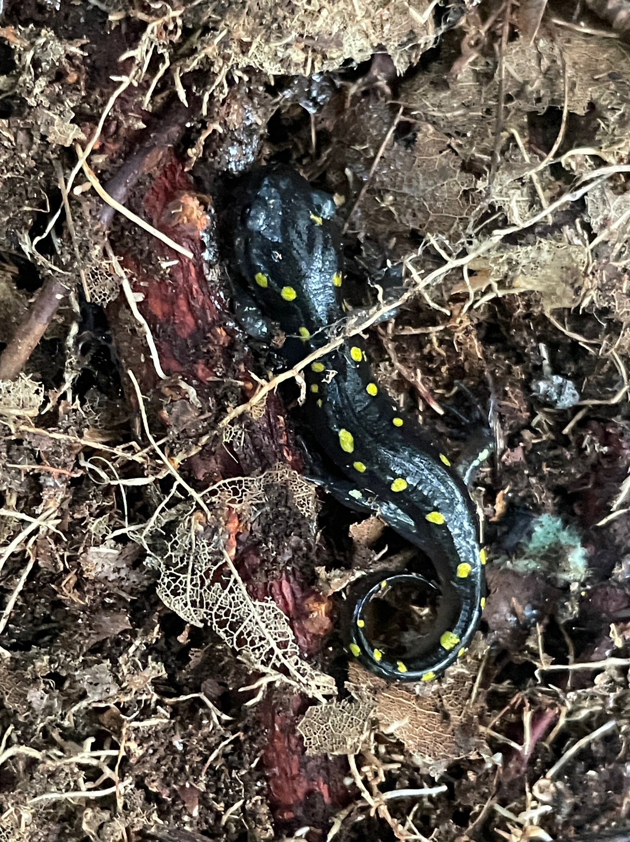
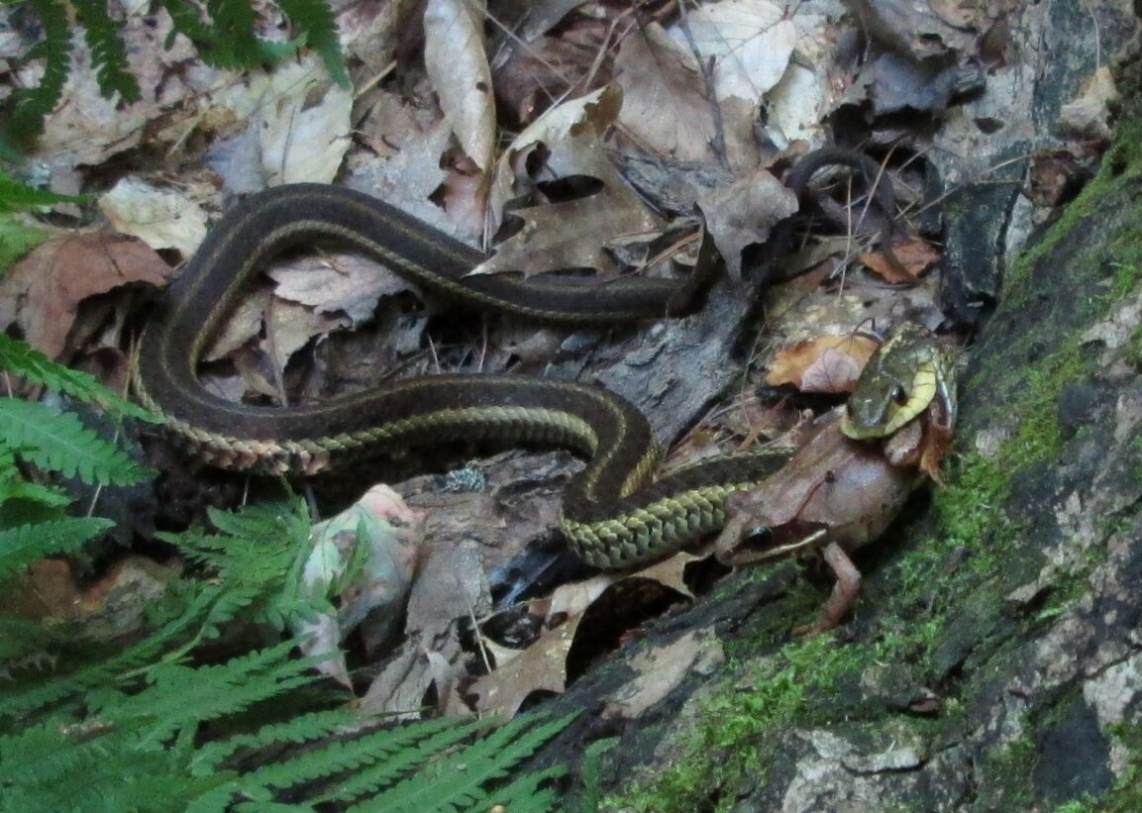
Background
60 years…
So many classes, labs, research projects, maps, studies, collections, observations!

Slide 4
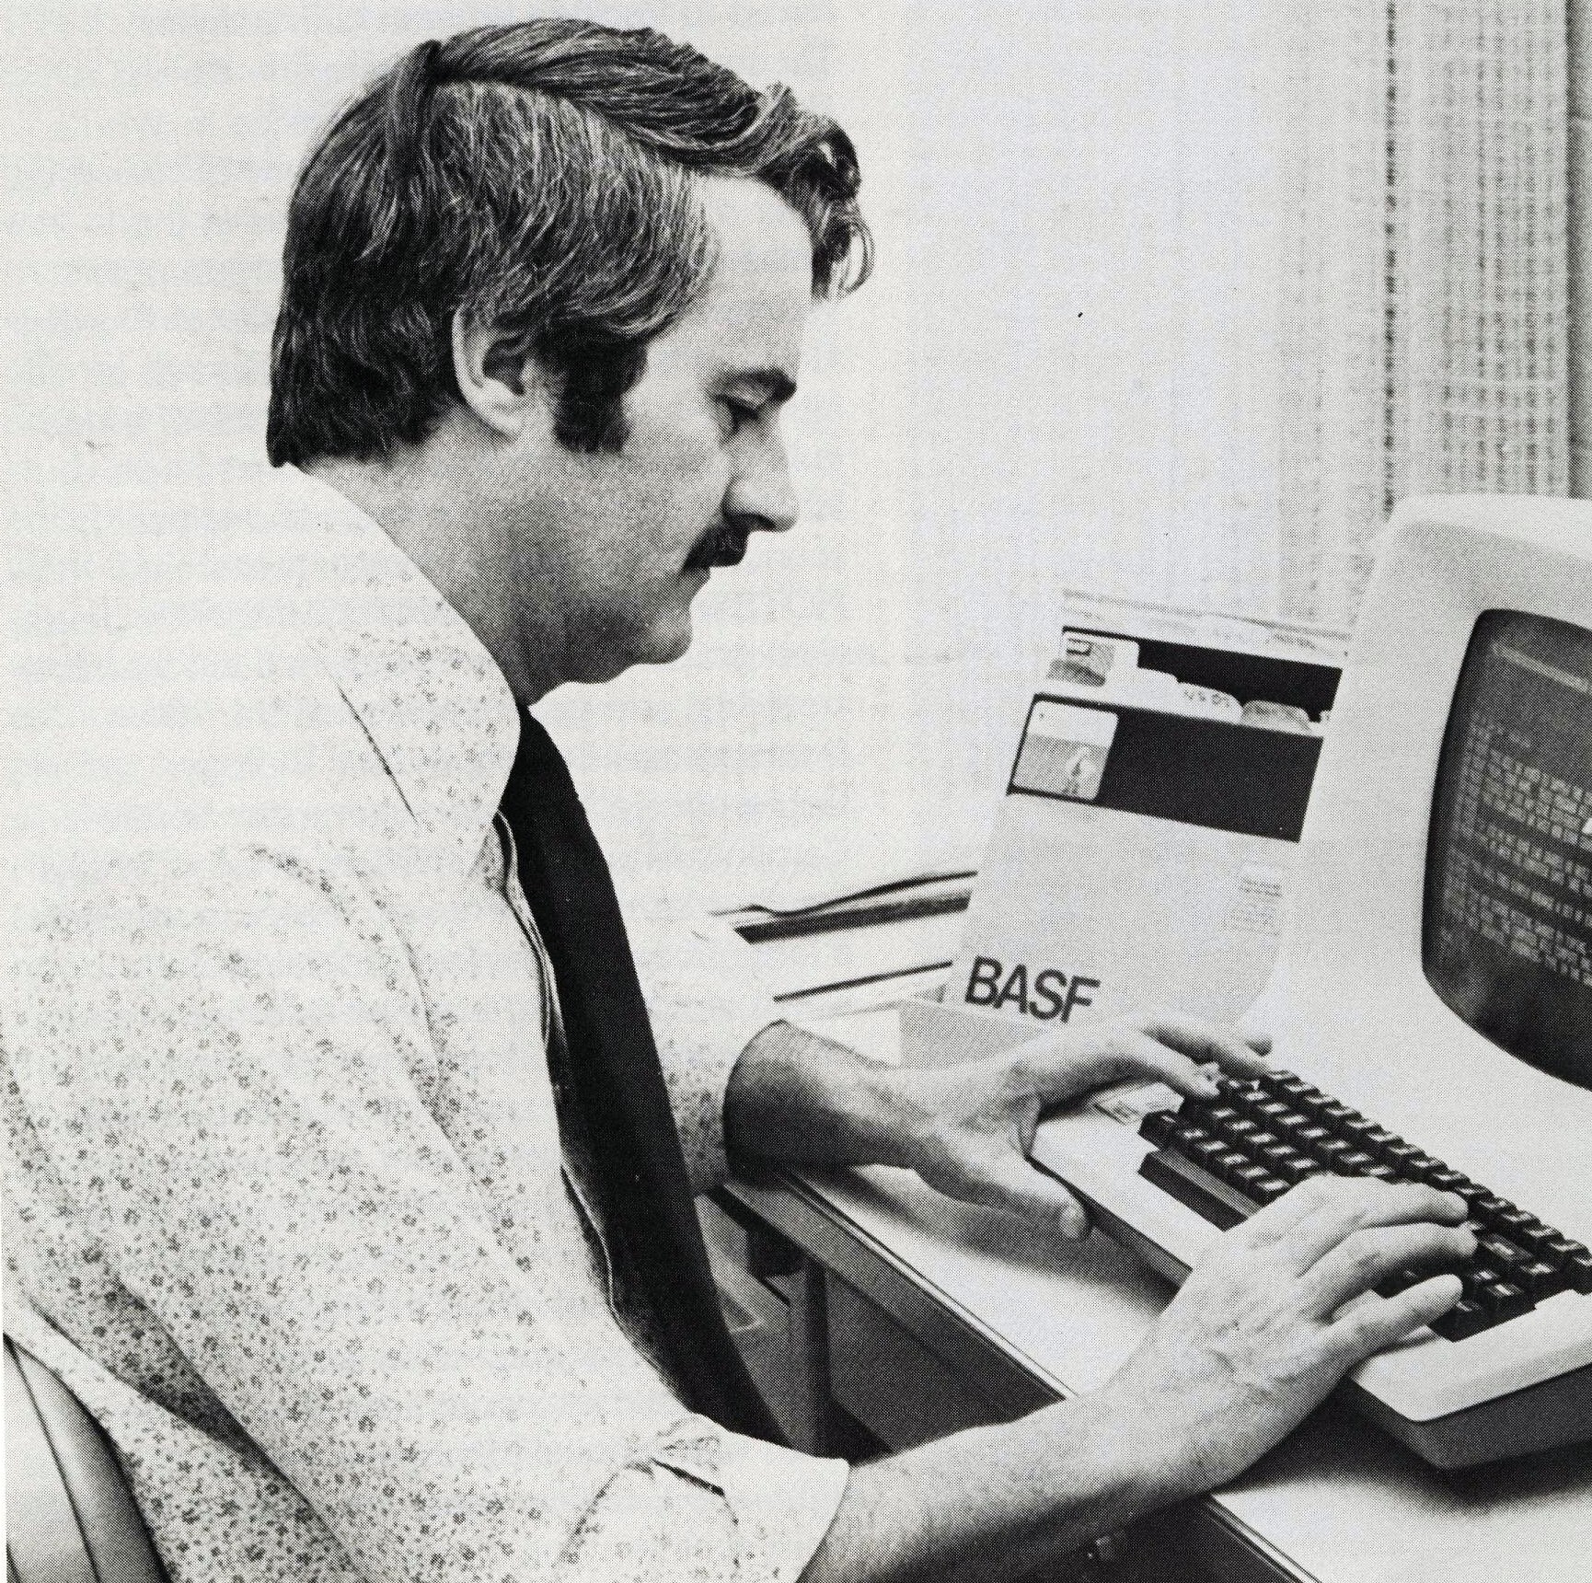
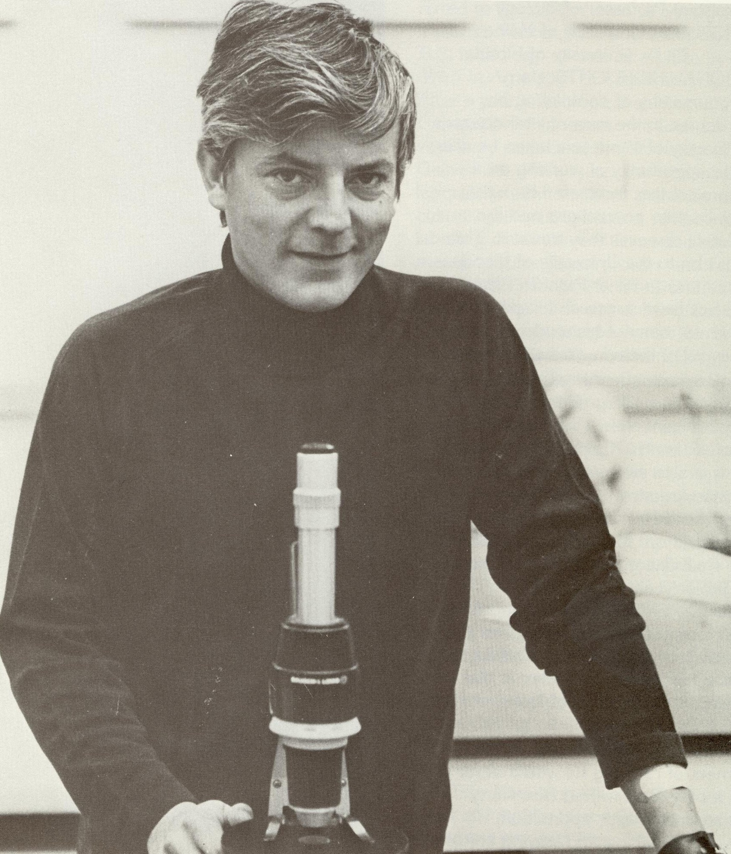
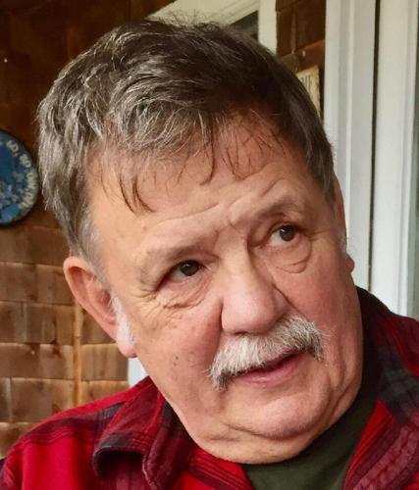
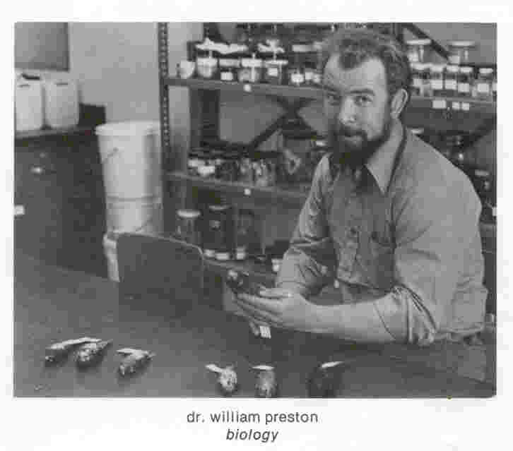
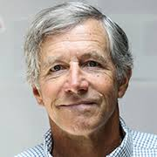
Many of the people who know the land have retired or passed away…
Norm Dion, Prof. of Mathematics
Dr. Richie Burns, Prof. of Biology
Dr. Harry Davis, Prof. of Biology
Dr. John Harris, Prof. of English and Env. Studies
Dr. Bill Preston, Prof. of Biology

Slide 5
Goal of the project: Organize, archive and make accessible information about:
Natural Resources
Mushrooms, fungi
Plants
Fish
Amphibians: Frogs, salamanders
Reptiles: Turtles, snakes
Birds
Mammals
Ecosystem processes and quality
Cultural Resources
Indigenous people’s use of the land
Cellar holes
Farm plots and farm history
Trails
Campus building history
Etc.

Slide 6
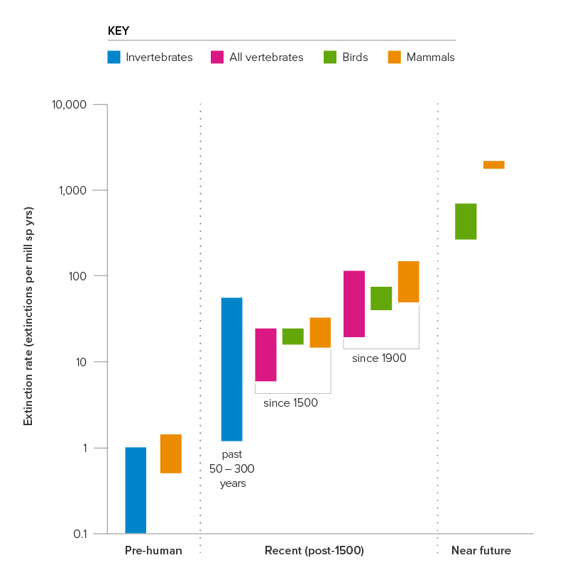
Species Extinction Crisis is upon us
Extinction rate is 100-1000 times faster than “natural”
25% of all species are threatened with extinction
Climate change is making it worse
To protect our species and ecosystems, we need information!
The Royal Society. 2024. https://royalsociety.org/news-resources/projects/biodiversity/decline-and-extinction/

Slide 7
eTour of Campus Lands was an earlier attempt to organize this information

Slide 8
All that these magnificent animals want is a home. That they are able to share the FPC property with us is a badge of honor for all of us who call this property our academic home, our alma mater.
The presence of such a diversity of species here shows that our land, and the lands nearby, are healthy and thriving... Starting here, starting today, Franklin Pierce College will not follow the rest of the country into the downward spiral of environmental destruction and species extinction that reigns there; through careful consideration of the consequences of our actions, we will lead our fellow colleges and citizens into a new era of responsibility and respect.
-Catherine Owen Koning, Pierce magazine, 2001

Slide 9
NRI Website! (A work in progress)
https://sites.google.com/view/franklinpiercemocknhi/home

