Slide 1
Food Choices and Nutritional Status of Franklin Pierce University Students
Briahna Bouchard and Patricia Egan
Faculty Advisor: Dr. Nancy Fey-Yensan

Slide 2
Purpose of the research
To determine the dietary habits of Franklin Pierce students and to explore some of the myriad factors that affect those food behaviors.

Slide 3
Why are we performing this study?
Honors project
Advanced Nutrition BI337
Mutual interest in nutrition
Curious to document the food behaviors and opinions of fellow students on the FPU campus
Influence institutional change, where possible

Slide 4
Review of the literature
Student overweight and obesity rates have significantly increased in the United States
Cornell University, 35 participants
Greatest unhealthy eating habit: irregular meals
Other factors:
Over-consumption of sweet foods
Unhealthy snacking
Skipping breakfast
(Sogari et al. 2018)
Notes:
https://www.ncbi.nlm.nih.gov/pmc/articles/PMC6315356/
Possibly provide more verbal background on the article for understanding purpose

Slide 5
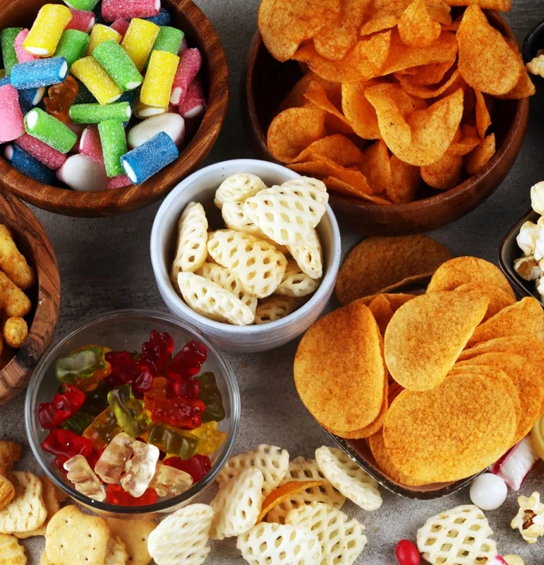
Review of the literature
Students encounter and must navigate myriad changes during the transition from high school to college
University of Parma, Italy
39 students (16 first-year, 23 upperclassmen)
Main barriers to healthful eating include:
Lack of time for cooking, limited financial resources, consumption of a limited diet and overconsumption of junk foods, and lack of knowledge about food and nutrition
(Wongprawmas et al. 2022)
Notes:
“We wanted to compare our data to previous research to observe any trends within our own university. We made sure to include within our survey certain questions that could support the evidence of other researchers…”

Slide 6
Why study student food behavior?
Studies show students are at great risk of developing unhealthy eating behaviors
“…university is a critical period for young adults regarding food choices and their relationship with weight gain”.
Nutrition impacts overall health
Adolescents and college students with access to nutritional food sources are more likely to have better overall health.
Affects brain development, memory and cognitive function, energy, attention and focus, etc.
Poor food choices and behaviors during young adult years can be associated with higher risk of experiencing chronic disease later in life
(Sogari et al. 2018)/( Second Harvest Of Silicon Valley, 2023)

Slide 7
Why study student food behavior?
Food insecurity is a prevalent issue in college students nationally
22.6% of undergraduate students report low or very low food security in last 30 days
11.9% of undergraduate students report marginal food insecurity
Approximately 3.9 million undergraduates experience food insecurity
(McKibben et al. 2023)

Slide 8
Research Study Overview
Currently enrolled undergraduate Franklin Pierce students (n = 73)
Both athletes and non-athletes, varying academic levels
Asked volunteers to complete a 15-minute paper survey
one time administration; anonymous
Survey focused on health, food intake, and diet-related habits
Recruitment by word-of-mouth and through classes of professors willing to allow us to administer survey
Data were imported into an Excel format for quantitative and qualitative analysis

Slide 9
Informed by previous research and anecdotal information from students, we anticipated the following:
Students would express that food access has declined due to changes to dining plans and hours the dining hall is open
The perception that meal choices lack variety
Athletes would indicate having a more difficult time accessing food on campus due to practice and lift times
Notes:
Hours are hard to work around, things have changed since being here, harder for athletes in particular with lift and practice times, therefore, access has declined

Slide 10
Selected Results

Slide 11
The study population – N=73
Identity:
Male – 20 (27%)
Female – 53 (73%)
Other – 0
Academic level:
Freshman – 6 (8%)
Sophomore – 21 (29%)
Junior – 22 (30%)
Senior – 24 (33%)
Graduate – 0
Working status:
Working, on campus – 26 (36%)
Working, off campus – 32 (44%)
Not working – 24 (33%)
Nicotine:
Never – 58 (80%)
<2x/week – 8 (9%)
1x/day – 2 (3%)
Throughout the day – 4 (5%)
Reports of family health issues:
None – 43 (59%)
Heart Disease – 14 (19%)
Diabetes – 13 (18%)
Cancer – 9 (12%)
Asthma/Stroke – 1
Reports of individual health issues:
None – 58 (80%)
Reports of current health issue – 15 (20%)
Notes:
11 had more than one job, one respondent left nicotine question blank

Slide 12
Activity and related health behaviors
Activity level:
Sedentary – 1
Some – 12 (16%)
Moderate – 23 (32%)
Vigorous – 36 (49%)
Athletics:
Athlete – 44 (60%)
Non-athlete – 29 (40%)

Slide 13
Diet and food behavior
Meal Plan:
None: 22
75 block: 15
15 meals/week: 7
125 block: 6
All access: 23
Appetite on campus vs. at home:
35 (47%) reported “sometimes” or “little to no” appetite while on campus
Quality of food on campus:
83% of respondents (n=61) said the quality of food on campus is “fair” or “poor”
Enough food on campus:
- When students were asked if they had access to enough food, 17 (23%) reported “sometimes” or “that they require more food to meet their needs”
Quality of diet on campus vs. at home:
Only 44% said their diet on campus was “good” or ”excellent”
90% said their diet at home was “good” or “excellent”

Slide 14
Diet and food behavior
Out of 73 respondents:
42 (58%) reported good or excellent ability to access food on campus
Only 25% of students surveyed indicated that they “never” skip meals
Most skipped meal = breakfast
Dinner was reported to be the least skipped meal
14 (19%) consume at least one caffeinated beverage a day

Slide 15
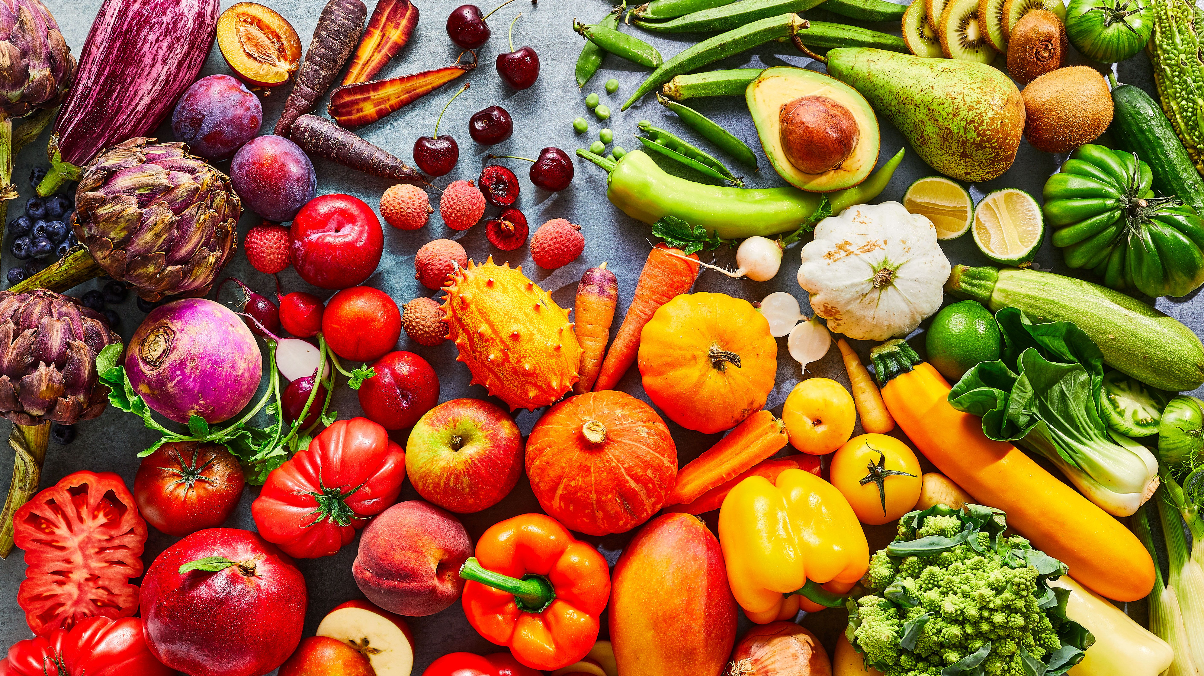
Student concerns and recommendations
Top Concerns:
Limited variety
Outside food purchases costs
Limited access due to hours
Not enough fresh fruits and vegetables or protein being offered
Top Recommendations:
Increase dining hall hours
Provide more variety
Provide healthier options and meal alternatives to improve the quality of food offerings

Slide 16
Discussion & conclusions
Many students report issue of limited dining hall hours, although accessibility did not emerge as an overriding concern
More variety and access to healthy options would provide significant dietary improvement
Replicating more "homecooked" meals may improve student appetite, food intake and nutritional status
Surprising Findings:
Indicate sufficient overall access to food, yet have dining hall hour concerns
Nicotine reports
Notes:
Majority of students felt this or that…this many students skip meals, etc…the important things
What we assumed vs what we found
So adjustments can be made to improve the food environment at FPU

Slide 17
Application and future directions
Immediate application of these data:
We plan to share an executive summary of these findings with the institution to open a discussion of potential changes to improve the food environment for students on campus.
Future research:
Study the differences in food behavior between students who have enrolled in BI235 (Human Health and Nutrition) and those who have not
Study food intake and behavior differences between athletic teams
Document interest in a non-academic course offering in food preparation and nutrition

Slide 18
Thank you for listening! Questions?

Slide 19
References
McKibben, B., Wu, J., & Abelson, S. (2023, August 3). New Federal Data Confirm that College Students Face Significant-and Unacceptable-Basic Needs Insecurity. The Hope Center. https://hope.temple.edu/npsas
Second Harvest Of Silicon Valley. (2023, December 21). Top 6 Reasons Healthy Food is Important for Students in School . https://www.shfb.org/impact/blog/top-6-reasons-healthy-food-is-important-for-students-in-school/#:~:text=Nutrition%20impacts%20overall%20health%2C%20including,overall%20health%20and%20development%20outcomes.
Sogari, G., Velez-Argumedo, C., Gómez, M. I., & Mora, C. (2018). College Students and Eating Habits: A Study Using An Ecological Model for Healthy Behavior. Nutrients, 10(12), 1823. https://doi.org/10.3390/nu10121823
Wongprawmas, R., Sogari, G., Menozzi, D., & Mora, C. (2022). Strategies to Promote Healthy Eating Among University Students: A Qualitative Study Using the Nominal Group Technique. Frontiers in nutrition, 9, 821016. https://doi.org/10.3389/fnut.2022.821016

