Slide 1
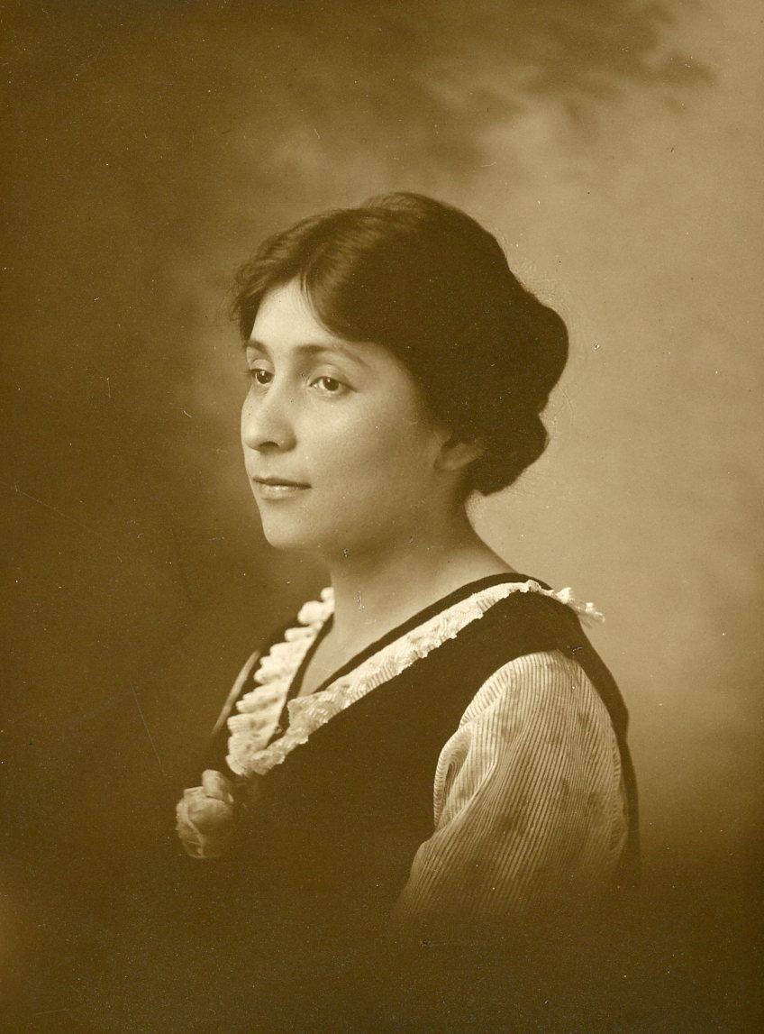


The Struggle to See Native People in the Monadnock Region
2024 Academic Showcase
Robert G. Goodby, Ph.D.

Slide 2
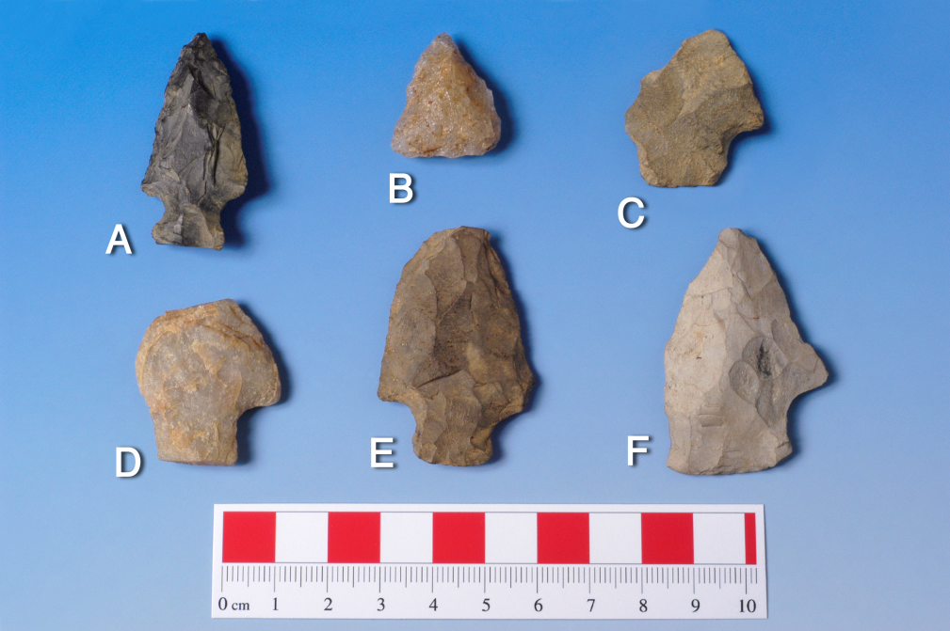
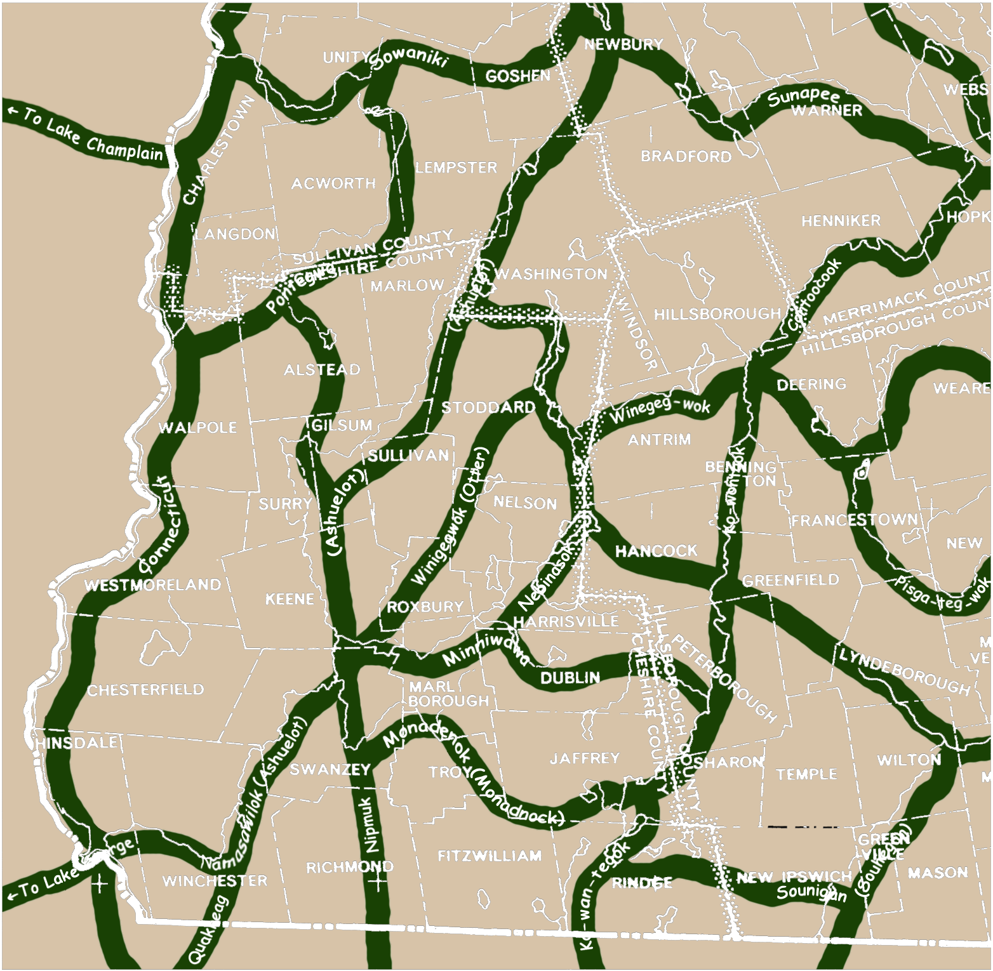
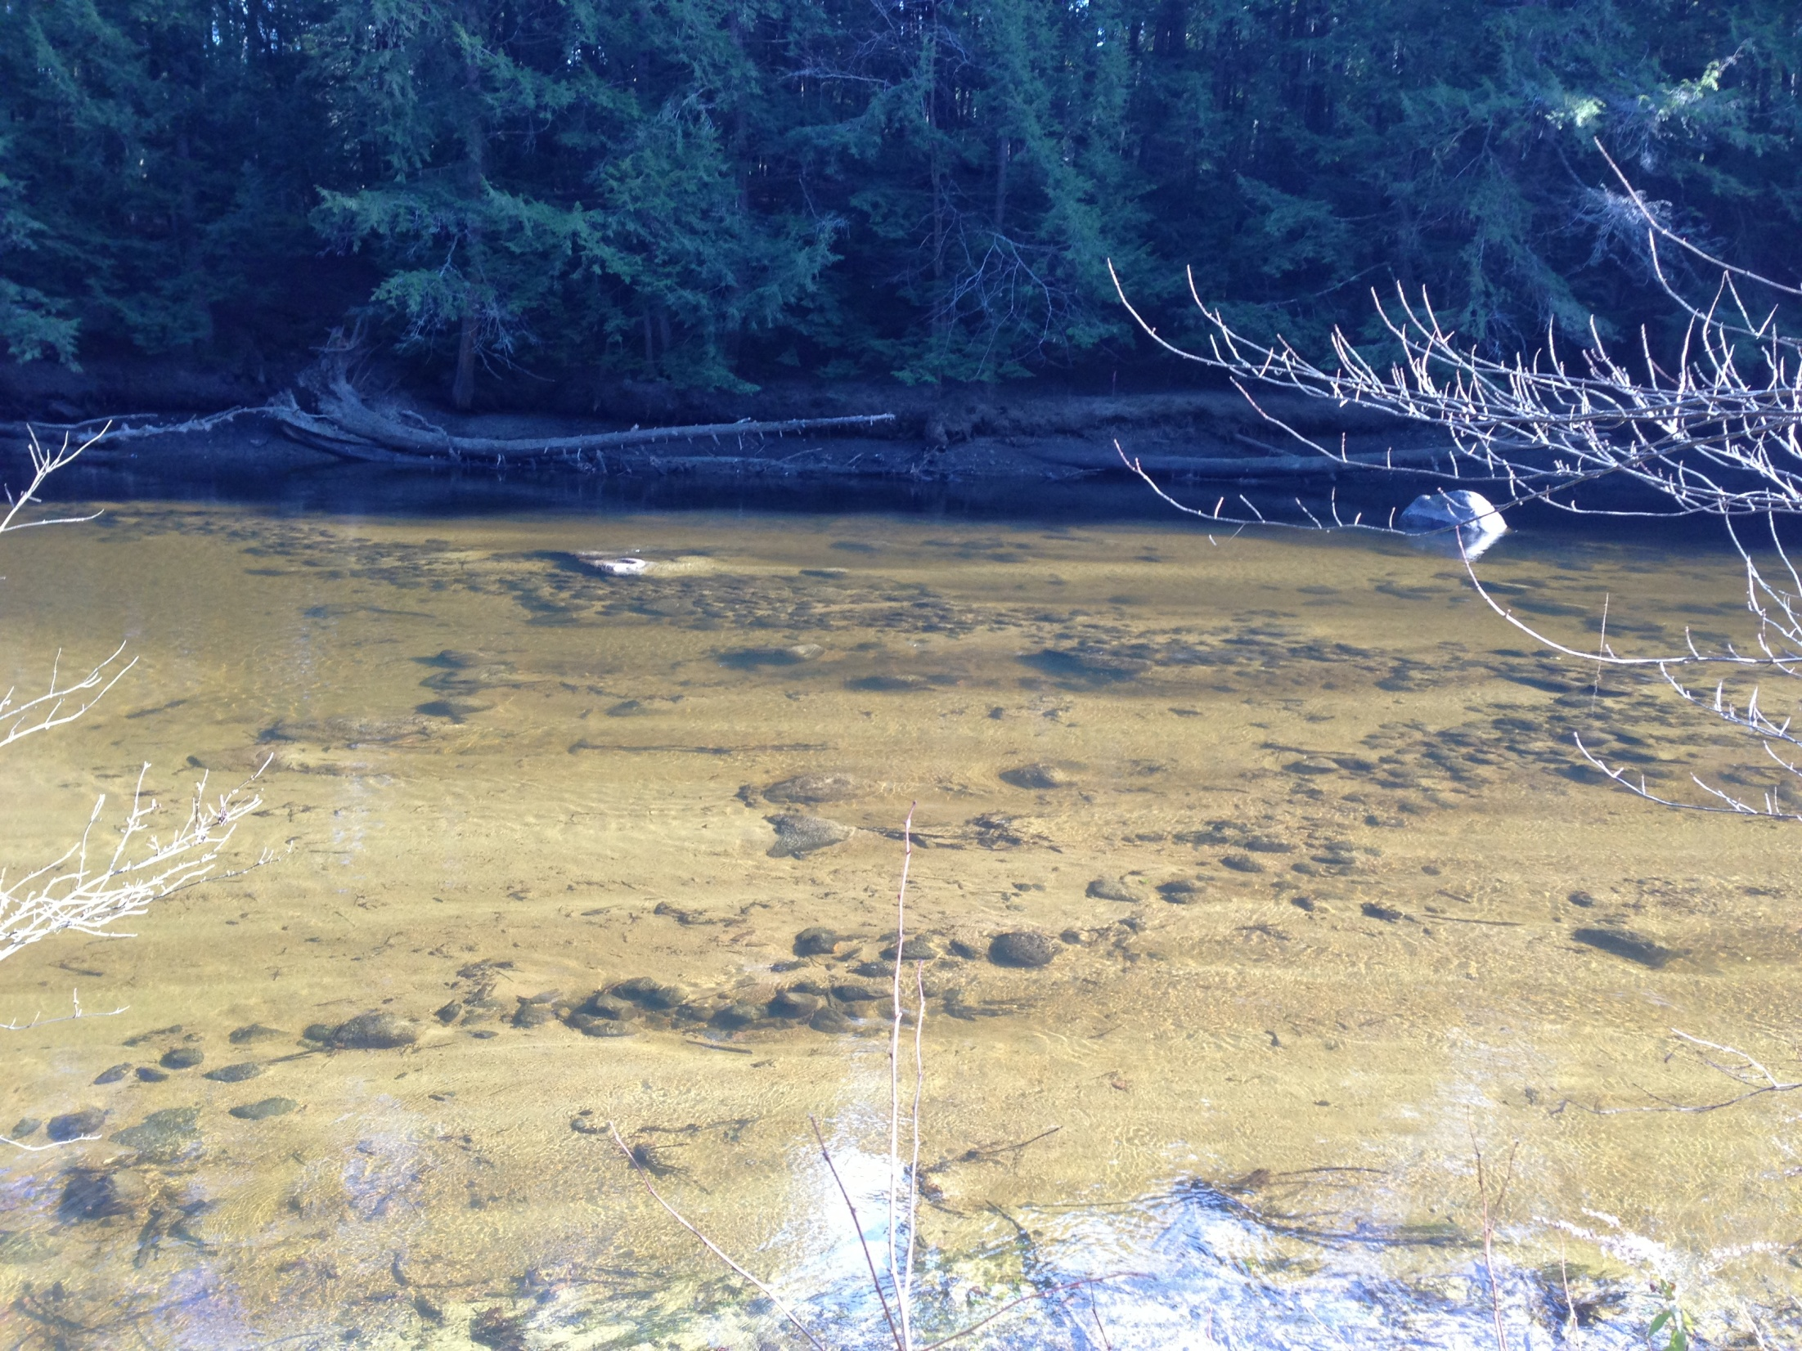
Native History and Archaeology in the Monadnock Region
Swanzey Fish Dam,

Slide 3
We marched north and west about nine miles and crossed several branches
of Miller’s River…and found where the Indians had lived last year and made a
Canoe, at the north end of the long pond [Lake Monomonac in Rindge]….
We camped at Peewundeun (Contoocook) Pond…and found
two wigwams made last year.
We marched west of Wenadnack (Monadnock) and crossed three
streams that run into the Contoocook…and found two wigwams
-Captain Samuel Willard, 1725. Cited in “Indians and Wolves”, Where the
Mountain Stands Alone. H. Mansfield, ed. 2006. University Press of New England.

Slide 4
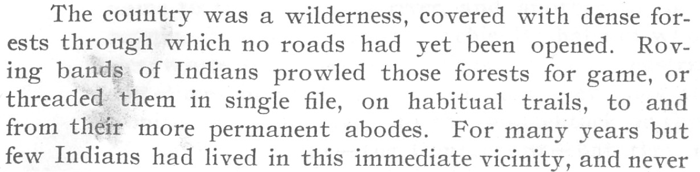
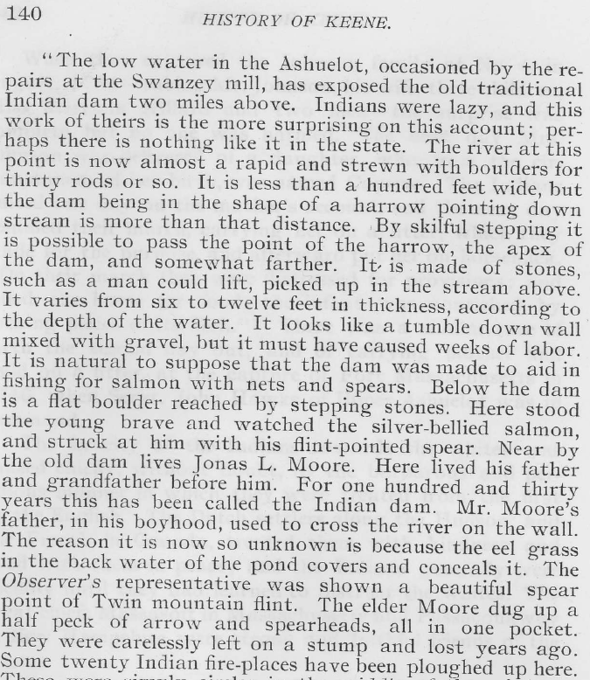
A History of the Town of Keene. Keene,
NH by Simon Griffin 1904, pgs. 29, 140

Slide 5
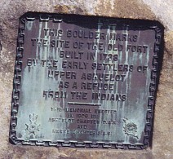
298 Main Street, Keene

Slide 6
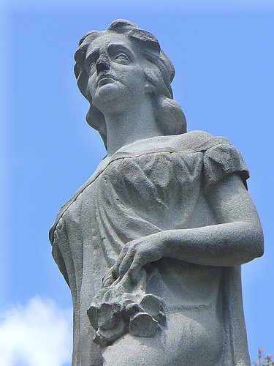
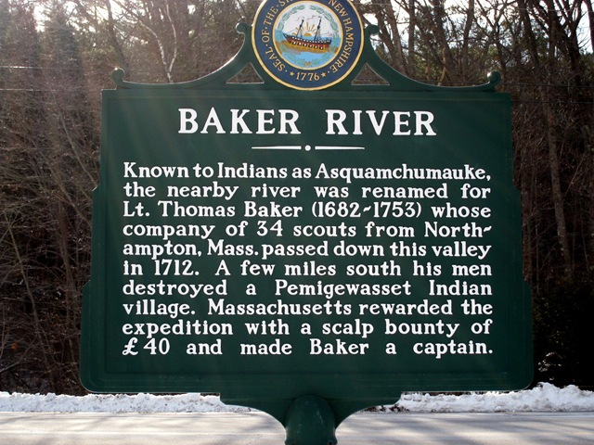
Hannah Dustin, 1697

Slide 7
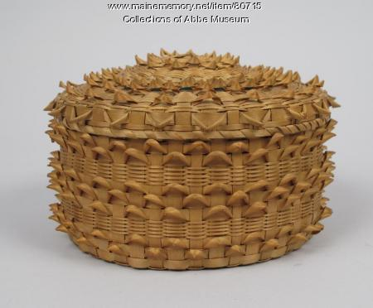
Basketmaking and Abenaki Survival
Abenaki Fancy Hamper, 19th Century. Courtesy of the Mt. Kearsarge Indian Museum

Slide 8
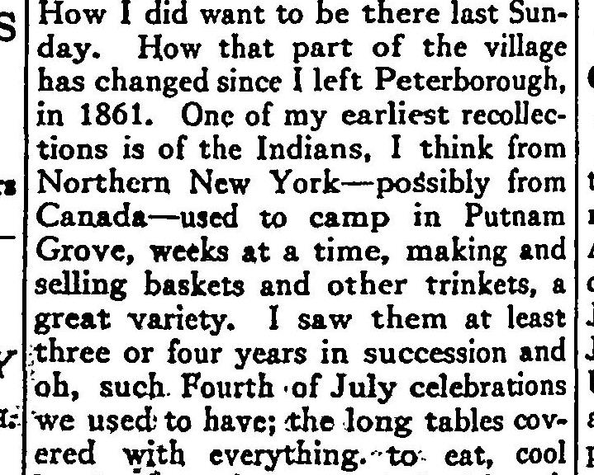
Peterborough Transcript November 22, 1923
From Indian Basketry of the Northeastern Woodlands by Sarah P. Turnbaugh and William Turnbaugh

Slide 9
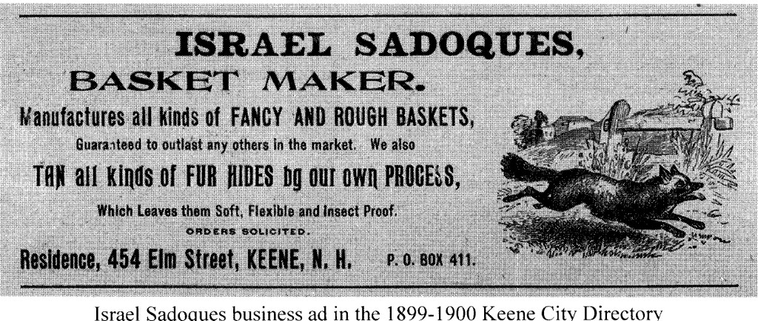
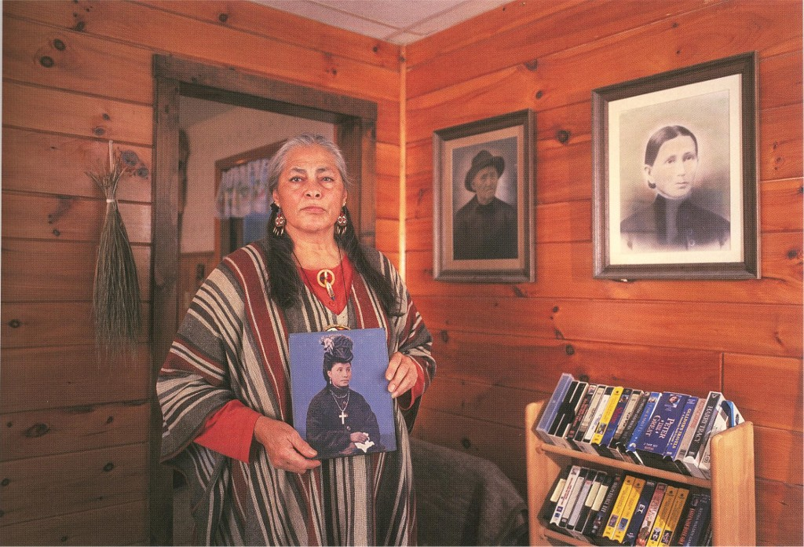
From “Abenakis at Ashuelot: The Sadoques
Family and Keene” by Marge Bruchac.
Newsletter of the Historical Society of
Cheshire County 22(2), 2006
Mali Keating with a picture of her grandmother, Mary Watso Sadoques
(from “Sokoki Homeland from Monadnock: K’namitobena Sokwaki” by Marge Bruchac. In Where the Mountain Stands Alone: Stories of Place in the Monadnock Region. Howard Mansfield, ed. University Press of New England 2006

Slide 10
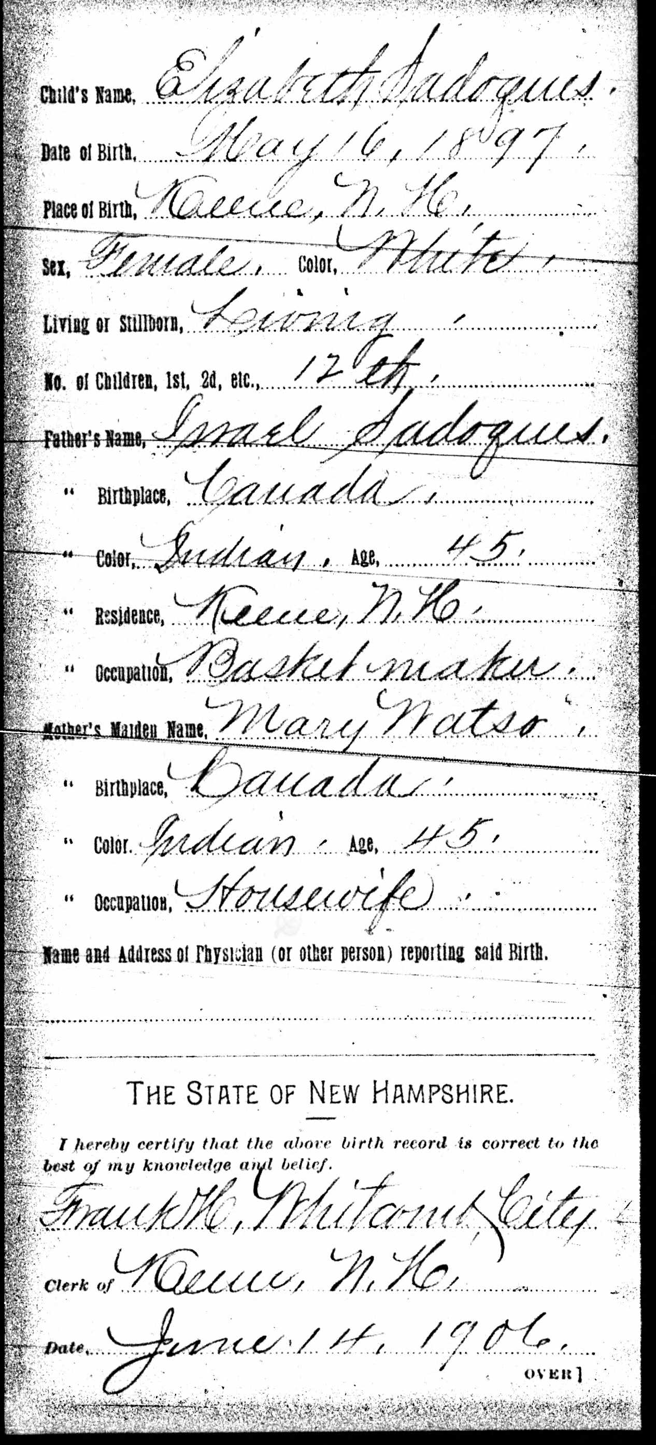
Making Native
People
Invisible
From the exhibit "Persistence of Identity" Lynn Murphy, Guest Curator, Mount Kearsarge Indian Museum,
Warner, NH August 2017.

Slide 11
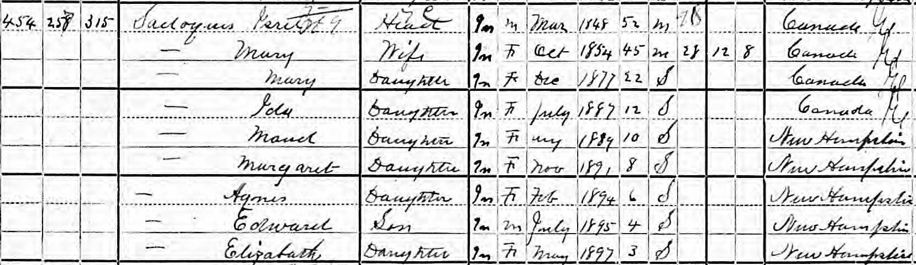
Sadoques Family, 1900 Federal Census

Slide 12
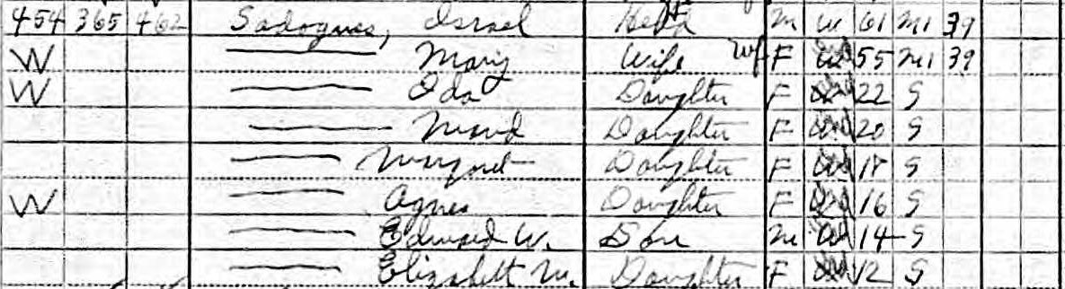
Sadoques Family, 1910 Federal Census

Slide 13
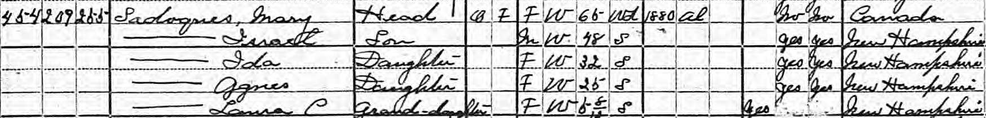
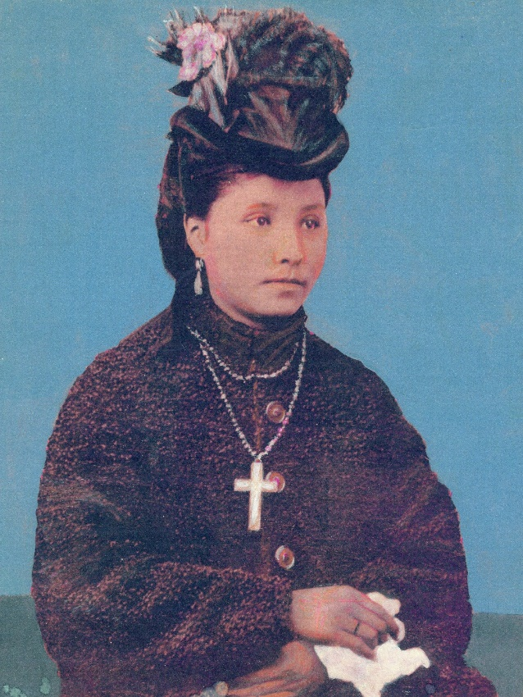
Sadoques Family, 1920 Federal Census
Mary Watso Sadoques, Wedding Portrait, 1872

Slide 14
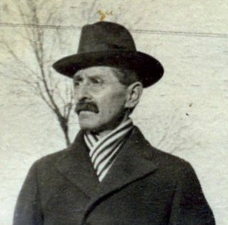
Israel Sadoques, Jr. Family, 1930 Federal Census

Slide 15
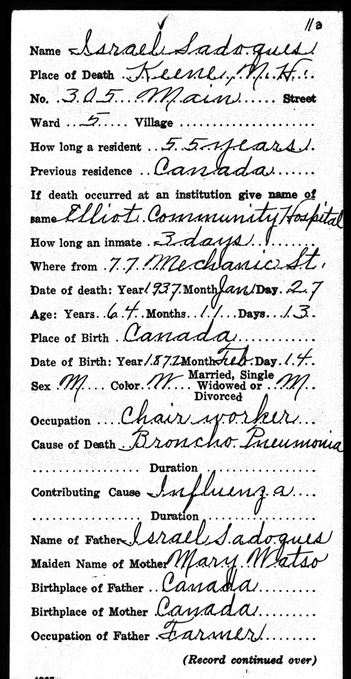
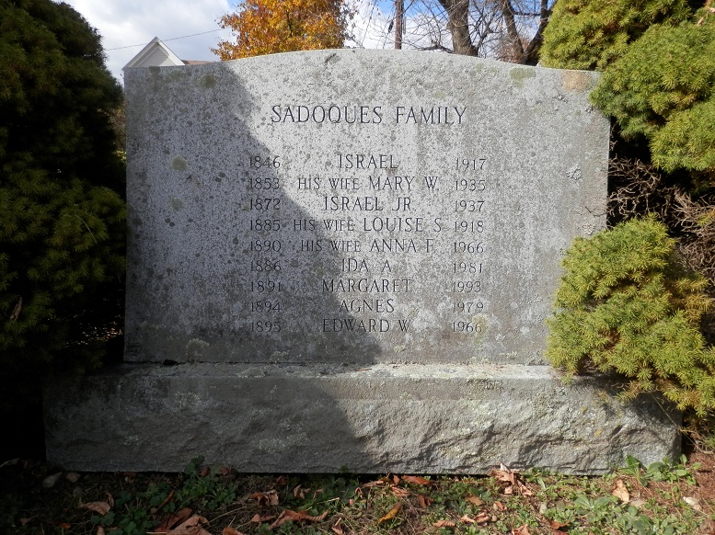
1937 Israel Sadoques, Jr.
Death Certificate

Slide 16

Educational Posters on Abenaki History

