Slide 1
Virtual Reality, how does it fit into the world of fitness and research?
Lindsay Vago

Slide 2
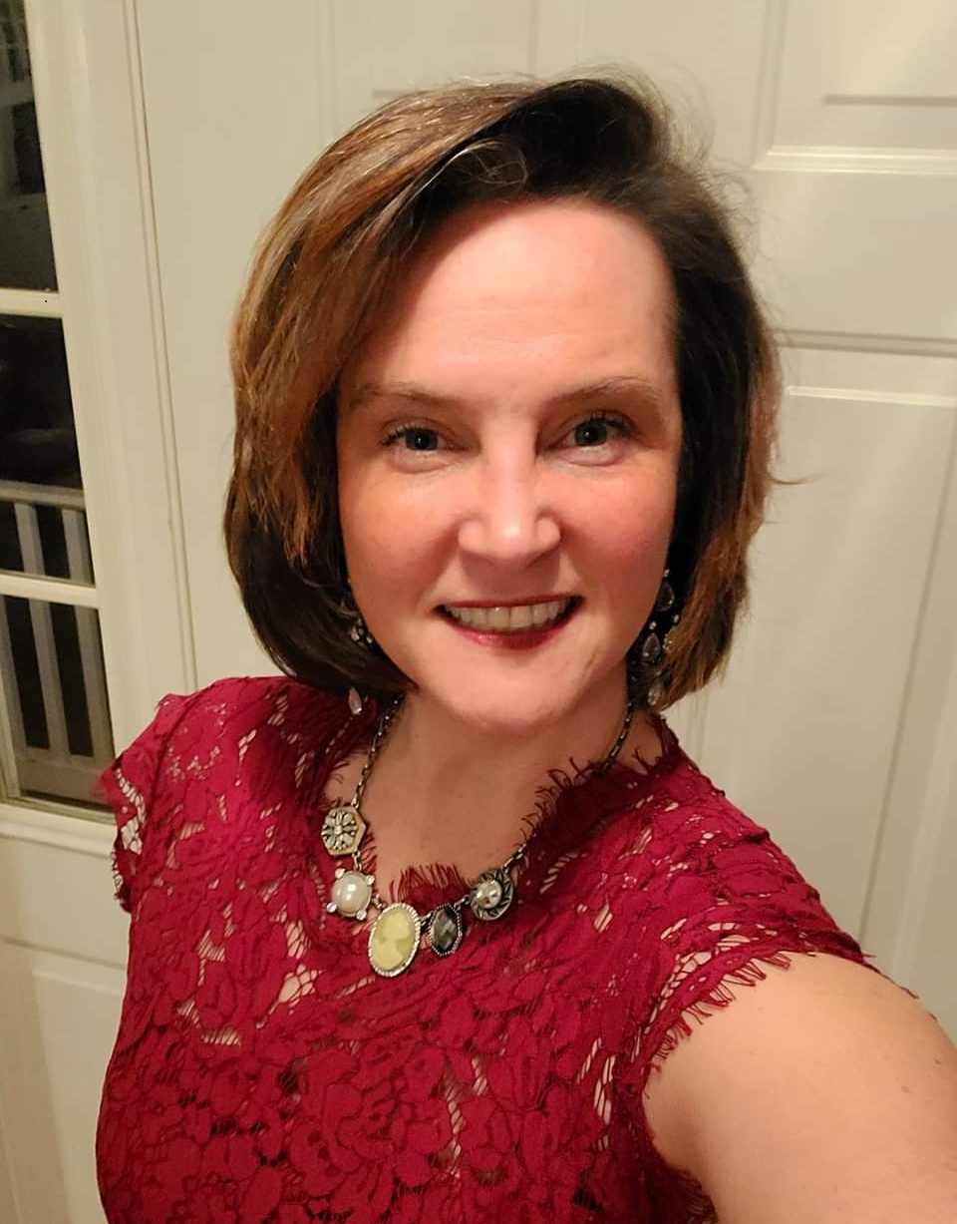
Lindsay Vago – Assistant Professor and Coordinator of the Health Sciences Program

Slide 3
Teaching
Scholarship
Faculty
Research
Service
Professional
Development
Advising

Slide 4
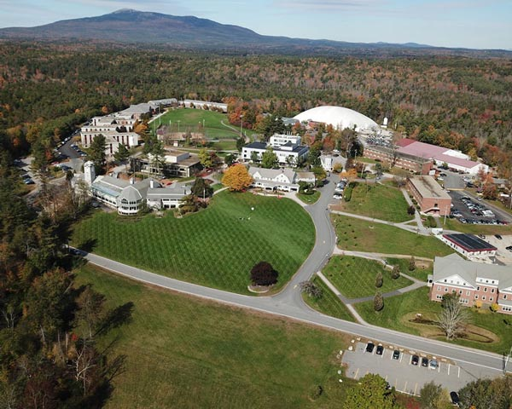
Virtual Reality, how does it fit into the world of and research?

Slide 5
Virtual Reality, how does it fit into the world of fitness and research?

Slide 6
https://cdn.akamai.steamstatic.com/steam/256923122/movie480_vp9.webm?t=

Slide 7
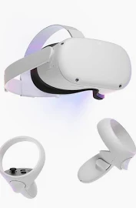
https://cdn.akamai.steamstatic.com/steam/apps/256923122/movie480_vp9.webm?t=1672595607gorilla tag

Slide 8
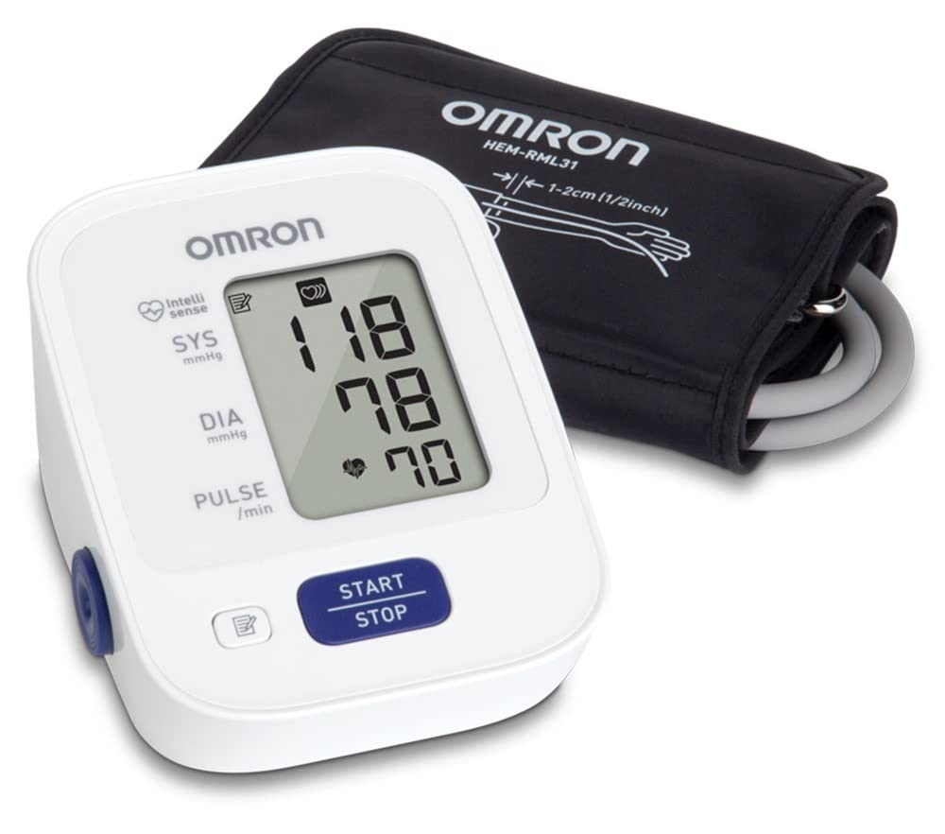
Assessing Vitalsvp9.webm?t=

Slide 9
Questions?

